Slide 1
2022
Playbook for Success
Notes:
We are excited to roll out our new playbook for success. And of course we would like to thank our esteemed Rep Advisory Board for their contribution, efforts and direction. This has truly been a team effort.

Slide 2
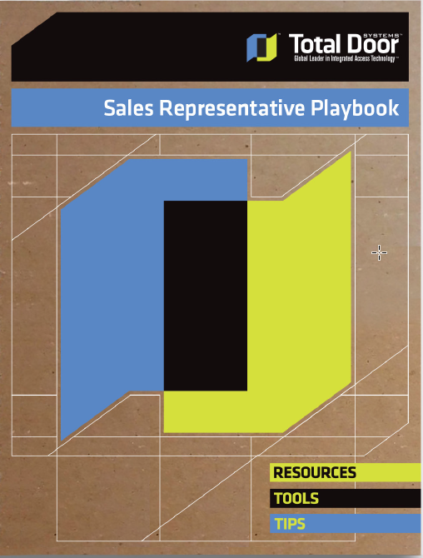
Why create Playbook?
Who We Are
Why Sales Representatives?
Tools & Resources
2020 Goals
Notes:
Why create a playbook? - No Team can be successful without knowing what the goal is and what the various team members roles and responsibilities are. The intent of this playbook is to clearly convey the 2020 goal for the Team and to provide a roadmap to success.
We will cover who we are and how we operate so you know what to expect from the Total Door team.
Most importantly, why is our Playbook based on the Sales Rep Model? We are a fiercely independent manufacturer and want to align ourselves with Independent Rep Agencies because we understand you are key to our success. We respect the knowledge and strength that you bring to the team. Independent Rep Agencies and Independent Manufacturers need each other. We cannot do this alone. We are 100% committed to our Sales Rep family.
We will also cover the Tools and Resources available. All tools and resources were developed at the request of our Rep Advisory Board. You will often hear us refer to our Rep Advisory Board because they are an integral part of the Total Door Team. They have provided exceptional insight and recommendations, all of which we have executed.
And of course we will cover the 2020 Goal, thus the need for all of the new tools and resources.
Along with this playbook, you also received a supplemental binder that includes a hard copy of all of the digital resources.

Slide 3
Why are we creating a Playbook?
1
3
1
2
Provide a road map to success
Clarify roles and expectations
We have your back
Notes:
The road map to success is all about developing your distribution network, and using the tools to ensure distributors are prepared for success when it comes to closing a deal and installing the Total Door project.
What are the roles of Total Door, the Sales Rep and the Distributor? How do we leverage each others’ abilities? When these are clearly defined it allows us to focus our support and efforts to maximize everyone's success.
And remember, we have your back. We will resolve issues efficiently and respectfully. We will always do our best to make you shine and look good to your customer. Your customer will never question whether you have the support of the factory, they will know it. We are one team.

Slide 4
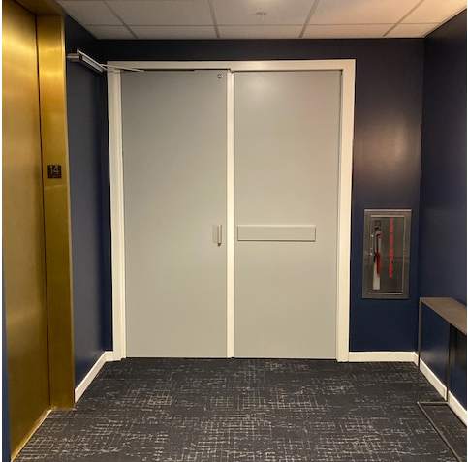
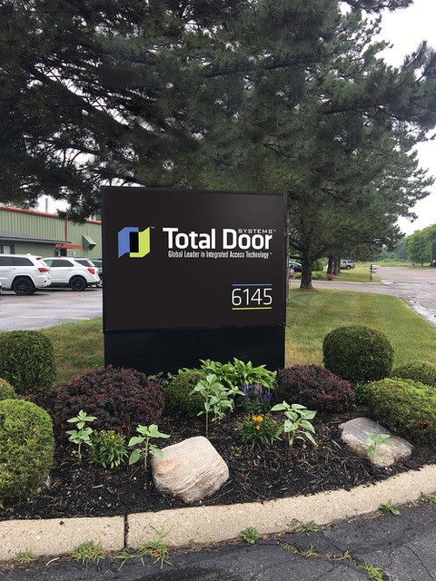
Road Map to Success
Notes:
It starts with a quality product with dependable delivery and gets to market through the Rep’s Distribution Network. Together we support the Distributor to ensure their continued success.

Slide 5
Clarify Roles and Expectations
Factory:
Quality Product, on time delivery. No exceptions!
Expertise (manufacturing, code compliance, fire ratings, etc.)
Tools (presentations, DoorBuilder, Construct Connect, Training Modules etc.)
Rapid Response Team (website, quoting, service., etc.)
Sales Rep:
Identify & open distribution
Develop & train distributor network
Promote Total Door through AIA & code presentations
Monitor close rates through DoorBuilder
Provide feedback to the Rep Advisory Council
Distributor:
Attend factory Sales & Installation training
Close projects
Project manage projects including proper installation
Service existing projects in the area
Notes:
Give a few sentences on each bullet point and what it would look like in terms of actions.

Slide 6
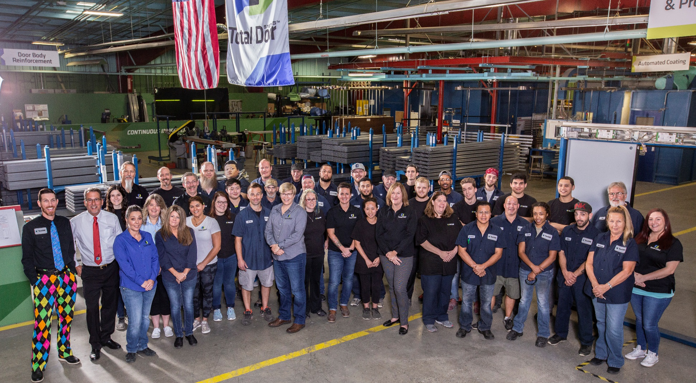
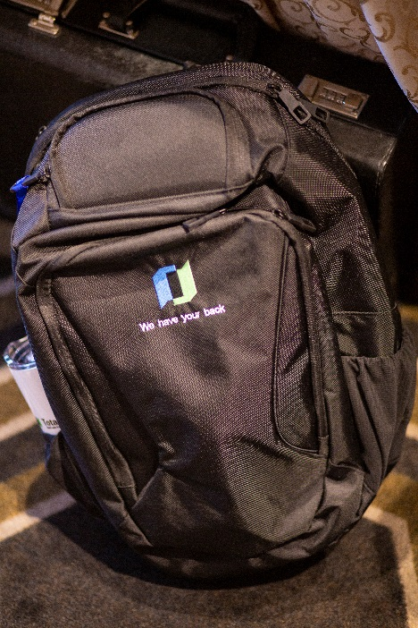
We Have Your Back
Notes:
Our entire team is committed to your success and understands what “we have your back” really means.

Slide 7
Who We Are
Notes:
Total Door has been leading the industry in innovation for over 45 years. Our award-winning manufacturing facility has been recognized by other industries for our processes and innovation. Every day we strive to be better and do better. We never compromise our integrity or yours.

Slide 9
What you can expect from Total Door Systems
1
We have your back. We stand behind you, our product, and our word.
4
Quotes returned within the same day
2
5
Full cache of tools and resources
Respond to all requests within 2 hours
3
6
M-F 8 a.m. – 5 p.m. EST phone support
Immediate response to in-field service calls

Slide 10
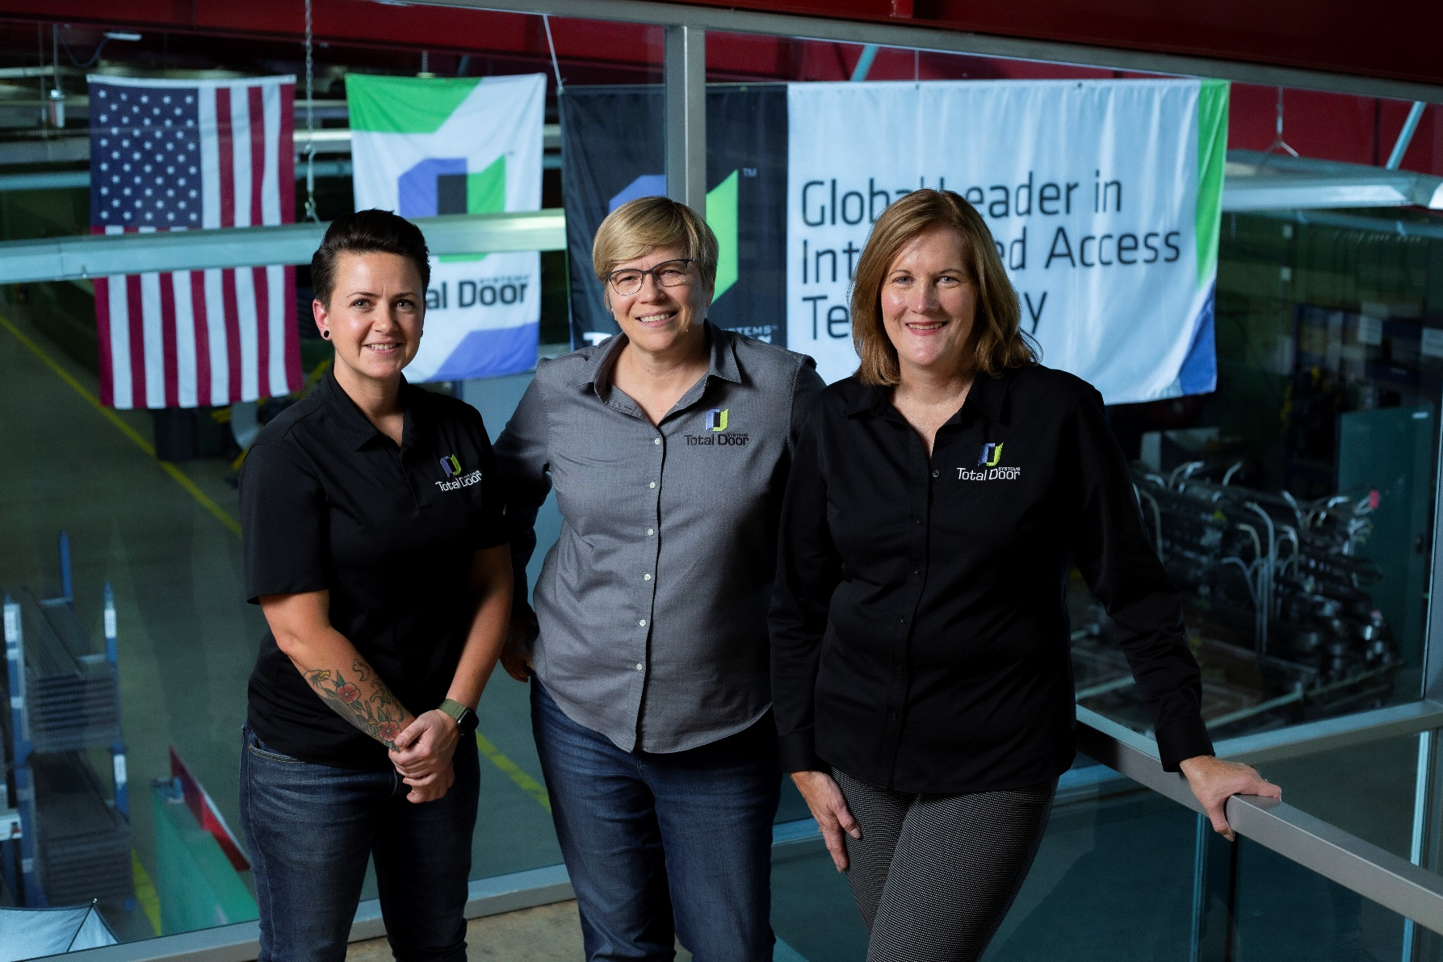
Who We Are
Privately-held
Made in the USA
Fiercely independent
Operate & communicate with integrity
Lean & sustainable processes
Continuous improvement

Slide 11
Certifications
ANSI/BHMA A156.32 – Standard for Integrated Door Opening Assemblies
UL EPD Certification
Intertek Certificate of Compliance
Notes:
Total Door is the only Manufacturer to achieve UL and BHMA certifications, and they are all readily available for download on our New website.

Slide 12
How We Work
Rules of Engagement
Always
Training
Promote from within
Company Culture
Notes:
Our Rules of Engagement set the tone for how we work with one another.
Training and is not just for Sales Reps and Distributors. Total Door believes in continuing education. Every year we invest in the education of our team, we always learn and we always improve.
The training we provide allows us to promote from within, building trust and loyalty.
The company culture is: Team First, meaning we put the Teams’ best interest before our own.

Slide 13
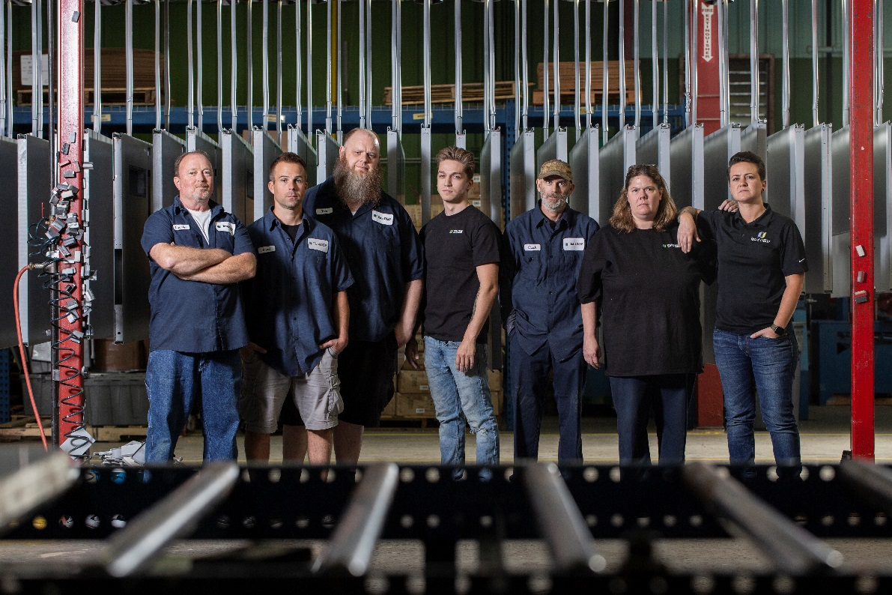
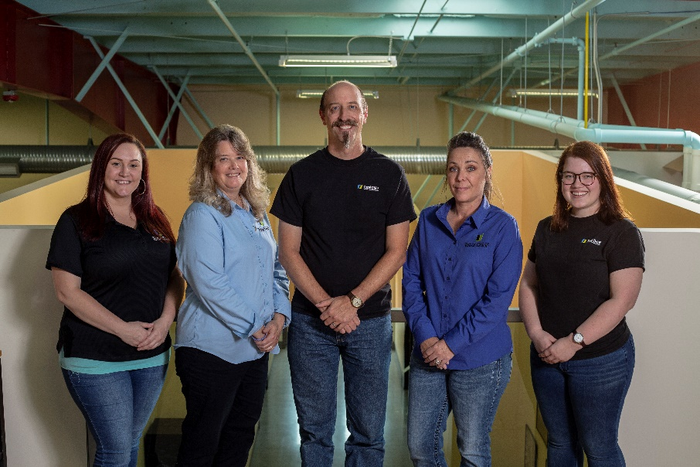
Notes:
Explain that every single member of the team has this card, and it is part of the contract of working at Total Door.

Slide 14
Why Sales Representatives?
Notes:
Independent Sales Reps bring a wealth of knowledge and experience to the equation that we as a manufacturer just don’t have:
An understanding of the market in your territory, knowledge of distribution and the best avenue to get Total Door to market, and most importantly, relationships and reputation.

Slide 15
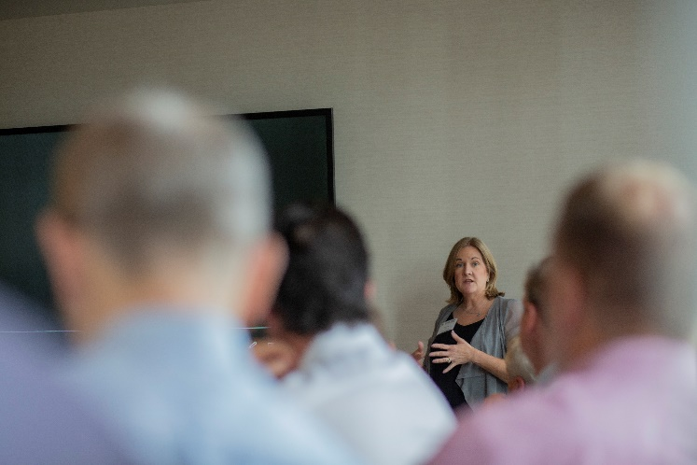
Sales Representative Role and Responsibility
Develop & Grow a Territory
Commit to Training
Commit to Promoting Total Door
Distributor criteria – vetting your network
What should your network look like?
- Current target market
- Recession proof plan
Distributor role & responsibilities
Trained in all Total Door sales tools
Train your Distributors with the sales tools
Give AIA presentations
Identify code events in your territory
Grow your market

Slide 16
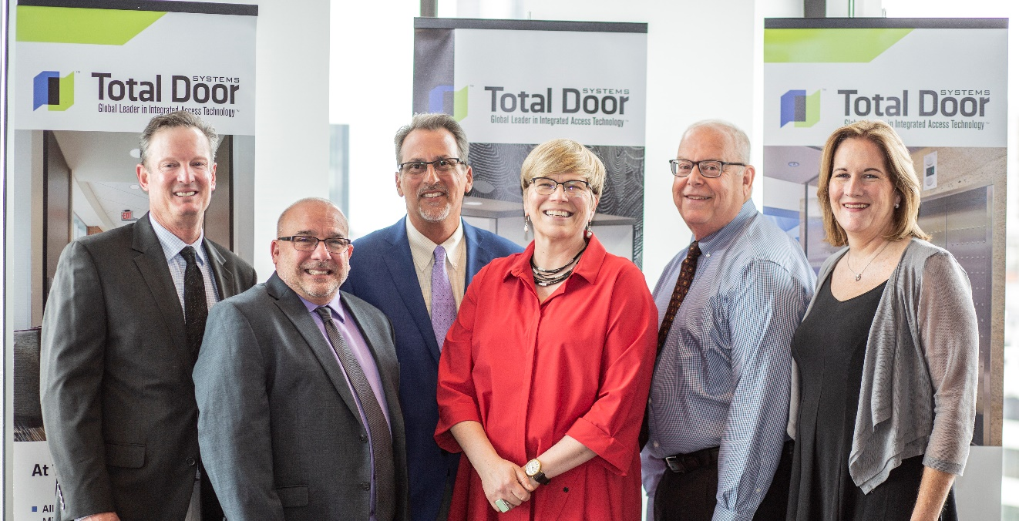
Sales Reps Expectations
1
Respect the relationship with independent manufacturers
2
Understand your market (territory)
3
Build the distribution base
4
Thoughtful feedback to help us refine approach to market
5
Promote Total Door
Understand your market (territory)

Slide 17
How We Start Selling
Where to Specify
Meeting a New Customer: The Basics
New Projects
Total Door Process
Estimating
Accessing resources
Identify projects and leads
Evaluating openings
1
2
3
4
5
6
5
6
About the Product
Our Leading Applications
Code focus
End users & Retrofits
The Total Door System difference
The benefits to an integrated door system
Notes:
Knowing the product well is key to selling effectively.
Know where to specify the product. Every sale is not necessarily a good sale.
Know our leading applications and where you will be most profitable and competitive.
Meeting a new prospect and the basics of turning them into a customer.
Leverage the code requirements to your advantage, we are in a unique position to do so.
We are successful in both new work and aftermarket.
We are here to support your efforts.

Slide 18
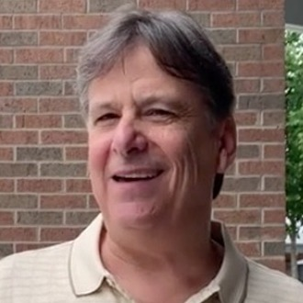
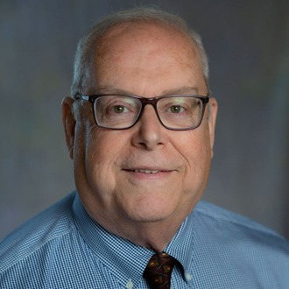
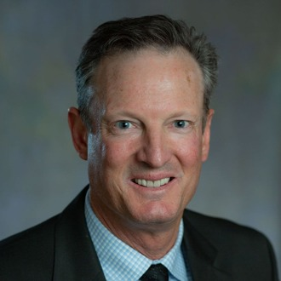
Total Door Systems Rep Advisory Council Advisory Council members are the best way to communicate your needs and insights to us!
Jeff Addis Mayo Associates Phone: 678.576.5753 | email: jaddis@teammayo.com Constituents:
Connection Network Agency
The Bekon Group
Smoot & Associates
Gary Deter Architectural Door Consultants Phone: 714.851.0303 | email: gary.deter@gmail.com
Constituents:
D.A. Loss Associates, Inc.
The Moyer Agency
Hardware Specialty Group
Stewart D. Walker, Inc.
Peter Elliott Elliott Associates Phone: office: 303.429.0133 ex 12 cell: 303.817.3388| email: peter@easales.com
Constituents:
The Eisen Group
Architectural Sales & Associates
Southwest Architectural Sales
Dan Arthur PJ Polke Company
Phone: 973.464.1540 | email: darthur@pjpolke.com
Constituents:
P.B. Walker & Associates
Architectural Marketing Associates
Oberting & Associates
Notes:
Total Door is very proud of our stellar Rep Advisory Board. They have been instrumental in our success over the last three years. Not only do they sit on the board, but they have also invested great effort in development of the vision they presented. Please identify your advocate and give them your feedback. Rest assured you will be heard and listened to.

Slide 19
Total Door Systems Rep Advisory Council
Recommend tools needed to market Total Door Systems
Identify and prioritize unmet customer needs
Gather feedback from constituents (minimally quarterly)
Identify product opportunities
Provide oversite during execution of assigned projects

Slide 20
Tools & Resources

Slide 21
Tools & Resources found on our website
1
https://www.totaldoor.com
Role driven website
4
PowerPoint presentations:
Architects
TD Intro & more
2
5
Animation videos of how a Total Door works and YouTube Videos of common installation & replacement processes
3
6
Marketing Materials on the Partner Portal of the website
TDS Documents & Factory Bulletins

Slide 22
Sales Tools
Presentations
AIA CES Presentations
Total Door Introduction
Total Door Product Training
Total Door Project Management Module
DoorBuilder

Slide 23
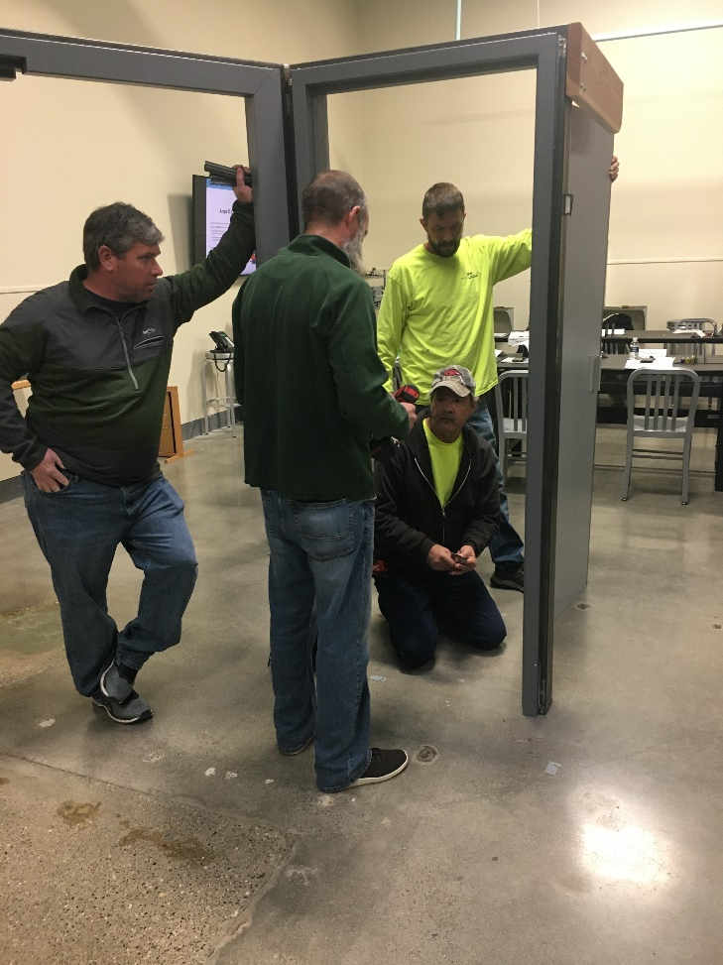
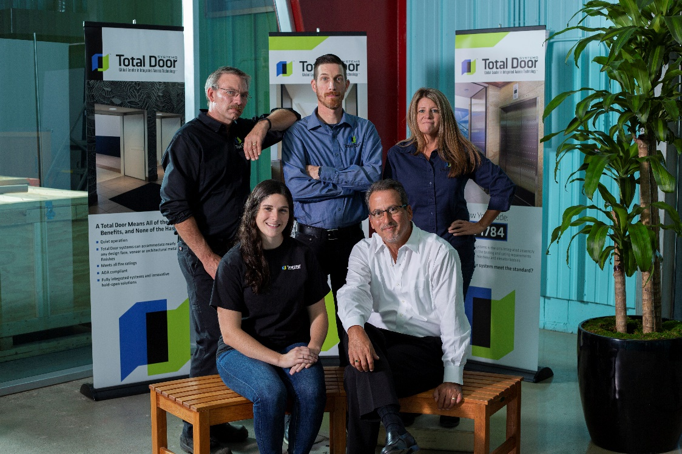
Sales Tools
Cont’d
Total Door Installation Class (Factory or On-site)
Total Door Sales Class (Factory or On-site)
Pop-ups

Slide 24
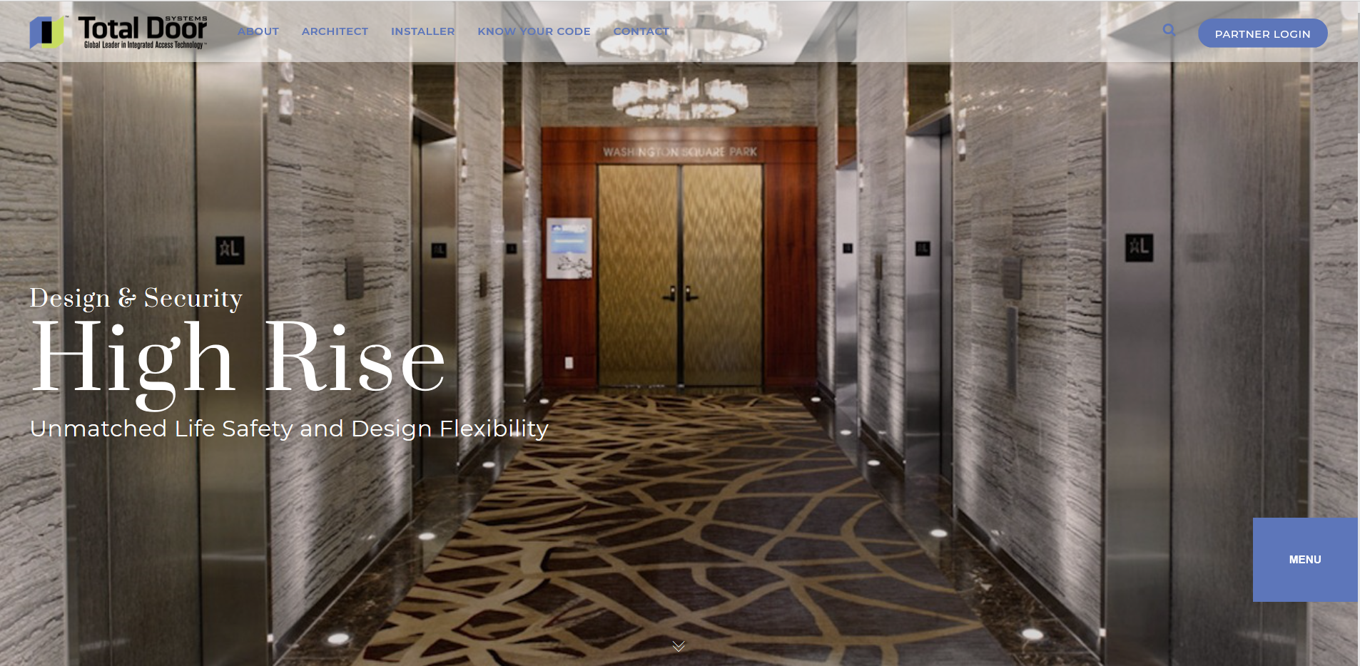
Sales Tools
Digital Tools
Total Door Website
- Specifications and Details
- Architect Page
- Know Your Code
AEC Daily (Online CE class)
Construct Connect
Master Spec / BSD SpecLink (RIB Software)

Slide 25
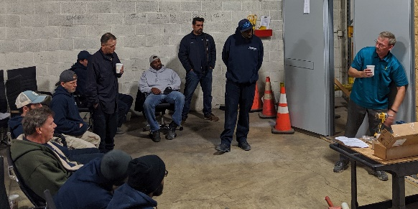
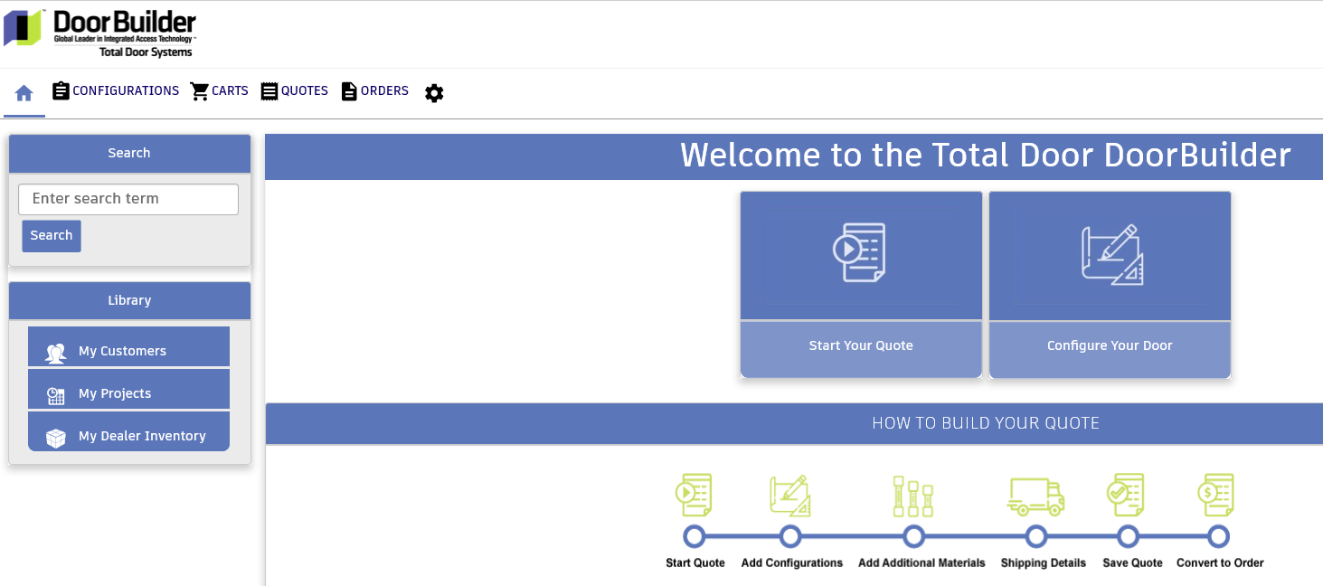
Resources
Service
Management
Communication
Codes/Standards
Total Door Installation Classes – delivered at the factory or in the field
YouTube installation and service tutorials
Sales Rep and Distributor Partner Pages
Total Door Systems DoorBuilder™
Newsletters (Sales rep and Distributor)
Social Media Channels
Factory Bulletins
Certified to BHMA 156.32
Tested as an assembly to UL1784 (w/o artificial bottom seal)

Slide 26
We have your back!

Slide 27
2022
GOALS

Slide 28
2022 Goals
Assess Distributor Network
3 Distributors to quote in each market
1 Service Company in each market
Create a SMART Plan
Specific
Measurable
Achievable
Relevant
Timely
Schedule Training Curriculum for Distribution
Update project status & win/loss status on DoorBuilder
Notes:
We have created and delivered the tools requested for success. This playbook kicks it off! Your feedback fuels our continuous improvement.

