Slide 1
New Code Requirements for Fire Rated Doors and Hardware
www.totaldoor.com
Notes:
Thank you for attending Total Door’s New Code Requirements for Fire Rated Doors and Hardware Presentation. We will take some time at the end of the presentation for a question-and-answer portion. Thank you for your time today.

Slide 2
New Code Requirements for Fire Rated Doors and Hardware
Total Door Systems®
6145 Delfield Dr.
Waterford, MI 48329
Course Number: TD-FRD-F2F
Learning Units: 1.0 LU/HSW Hour
Total Door® is a Registered Provider with The American Institute of Architects Continuing Education Systems (AIA/CES). Credit(s) earned on completion of this program will be reported to AIA/CES for AIA members. Certificates of Completion for both AIA members and non-AIA members are available upon request. This program is registered with AIA/CES for continuing professional education. As such, it does not include content that may be deemed or construed to be an approval or endorsement by the AIA of any material of construction or any method or manner of handling, using, distributing, or dealing in any material or product.
Questions related to specific materials, methods, and services will be addressed at the conclusion of this presentation.
This presentation is protected by US and International Copyright laws. Reproduction, distribution, display and use of the presentation without written permission of the speaker is prohibited.
Notes:
This now begins the AIA portion of the presentation. The New Code Requirements for Fire Rated Doors and Hardware Course is eligible for 1.0 Learning Unit/Health, Safety, Welfare Hour. We will address any questions at the end of the presentation.

Slide 3
Learning Objectives
At the end of this program, participants will be able to:
identify the sections of the IBC 2012 and 2015 that cover testing and labeling of fire rated doors
recall the different types of testing and rating, positive pressure, temperature rise, and smoke and draft doors
recall the different types of egress enclosure, i.e., fire barrier, smoke partition, smoke barrier, horizontal exit
Notes:
This course will reference the IBC 2012 and 2015, NFPA (National Fire Protection Association), and ADAAG (Americans with Disabilities Act Accessibility Guidelines).
To ensure that our intent matches our outcome, we have developed the following learning objectives:
Identify the sections of the IBC that cover testing and labeling of fire rated doors, as well as how rated doors can minimize the impact of fire and its effects on people, property, and the environment.
How smoke and draft doors enhance the safety and testing and rating for the doors.
How life safety issues are addressed in the code.
Describe the two rating types for fire door glazing and their role in fire protection.

Slide 4
Fire Rated Doors
Maintain integrity of fire rated enclosure
NFPA, ADA and IBC
Notes:
The role of a fire rated door is to maintain the integrity of a fire rated enclosure in the event of a fire, giving building occupants enough time to exit the burning building. Requirements for fire rated doors are found in National Fire Protection Association publications and within the requirements of the Americans with Disabilities Act, BUT to a large degree within the current International Building Code. Most states are in different years of the IBC or their own state’s code, but the codes we are going to discuss today are all generally in the same chapters and sections of each code book.
The most recent version of the International Building Code is IBC 2018.

Slide 5
IBC Terminology
Exit Enclosure
Exit, Horizontal
Exit Passageway
Fire Barrier
Fire Door
Fire Door Assembly
Fire Door Hardware
Fire Partition
Fire Protection Rating
Fire Resistance Rating
Fire Wall
Means of Egress
Self-Closing
Smoke Barrier
Smoke Compartment
Shaft
Shaft Enclosure
Notes:
Throughout this course, we will cover some terminology commonly used in the IBC. The words you see on the screen will be covered today throughout the presentation.

Slide 6
Use and Occupancy Classifications
Assembly: Groups A-1, A-2, A-3, A-4, A-5
Business: Group B
Educational: Group E
Factory and Industrial: Groups F-1 and F-2
High-Hazard: Groups H-1, H-2, H-3, H-4, H-5
Institutional: Groups I-1, I-2, I-3, I-4
Mercantile: Group M
Residential: Group R-1, R-2, R-3, R-4
Storage: Group S-1 and S-2
Utility and Misc.: Group U
Notes:
These are the 10 use and occupancy classifications. Buildings are classified into a category and these categories can determine where codes and fire rated doors are needed.
Assembly is for gathering of persons, generally a civic, social, or religious function. It could also be for food or drink consumption.
Business is for office, professional, or service type transactions.
Educational is for 6 or more people for educational purposes through the 12th grade. Some religious educational rooms will be classified under Assembly 3.
Factory and Industrial is for manufacturing, fabricating, finishing, packaging, and the like.
High-Hazard is classified as factory or industrial that constitute a physical or health hazard in quantities in excess of those allowed in control areas.
Institutional is places in which people are cared for or are supervised. They may be under restraint or security or could be medical or surgical areas that need 24-hour care.
Mercantile is for the display and sale of merchandise, like a department store.
Residential is for sleeping purposes.
Storage is for storage areas that are not considered hazardous.
Utility and Miscellaneous is for anything that cannot be classified in the other areas.

Slide 7
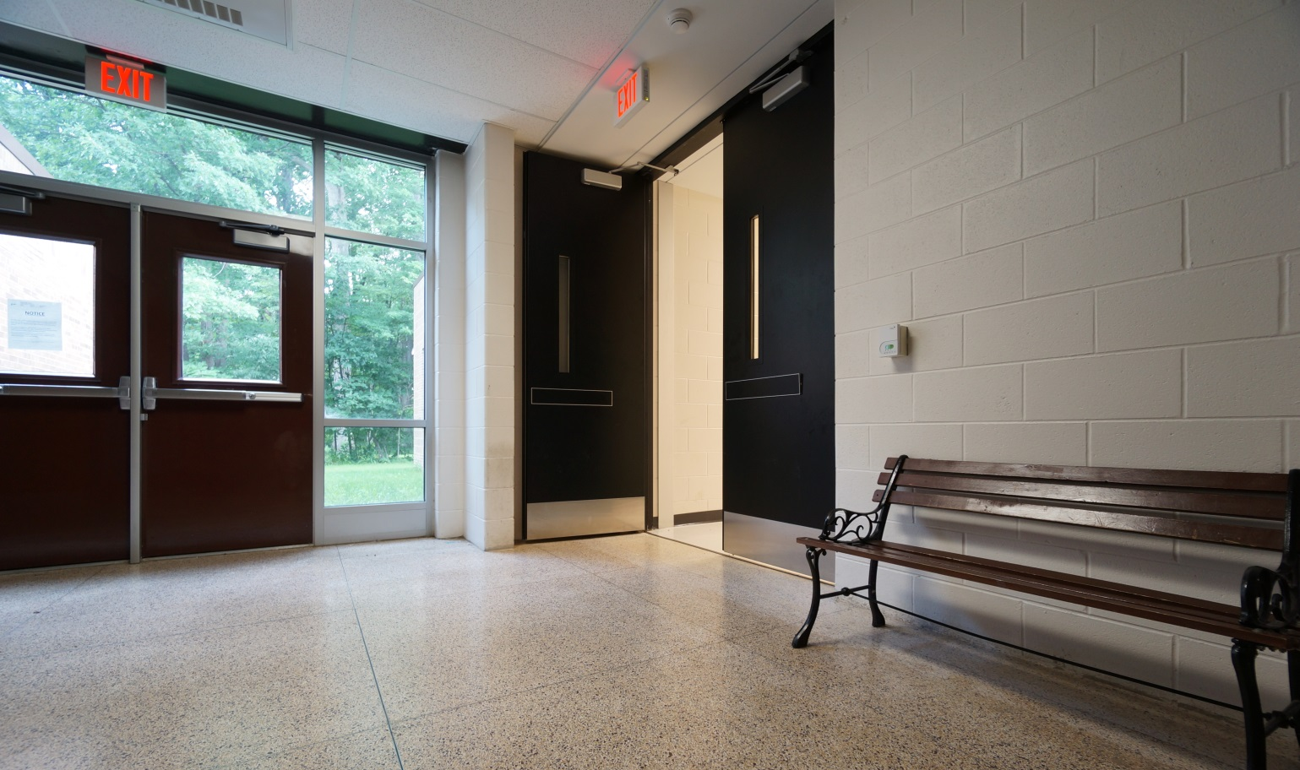
What Are Fire Rated Doors?
Notes:
What is a fire protection rating?
The fire protection rating is so important because it is the period of time that an opening protective assembly will maintain the ability to confine a fire as determined by tests prescribed in the IBC. Ratings are either stated in hours or minutes.

Slide 8
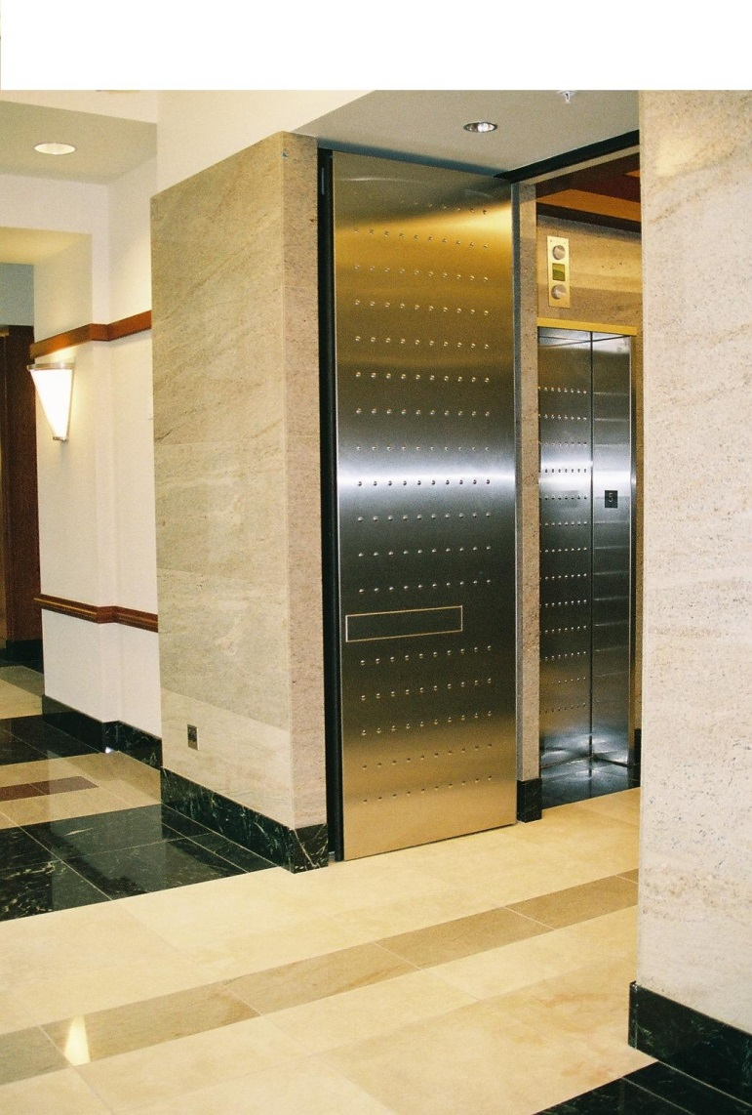
What Are Fire Rated Doors?
Resist heat and smoke
Third-party tested
UL 10A, UL 10B, or UL 10C
Fire doors are “rated” by time
Typically rated for ¾ of the rating of the surrounding wall
Notes:
What are fire rated doors?
Fire rated doors are doors built to resist heat and smoke and are tested by third-party agencies and labeled to show they meet certain performance requirements. The function of these doors is to contain smoke and heat from building occupants, long enough to have them escape a burning building. They are required for openings in fire rated walls. And what is a fire rated wall? A fire resistance rated wall having protected openings, which restricts the spread of fire and extends continuously from the foundation to or through the roof with sufficient structural stability under fire conditions to allow collapse of construction on either side WITHOUT collapse of the wall.
Rated doors are evaluated for their fire performance in accordance with the requirements of UL 10A, the Standard for Safety of Tin-Clad Fire Doors; UL 10B, the Standard for Safety of Fire Tests of Door Assemblies; or UL 10C, the Standard for Safety of Positive Pressure Fire Tests of Door Assemblies. These are all third party tested and you should ask for proof of these tests.
Fire doors are “rated” by the time that a door can withstand exposure to fire test conditions. The A label is for a 3-hour door, a B label is for a 90- or 60-minute door, a C label is a 45-minute door and the last option is a 20-minute door label. The label will show the hourly fire rating designations for the door.
A fire door is typically rated for ¾ of the rating of the surrounding wall. For instance, a 3-hour door is used in a 4-hour rated wall; a 1½-hour fire door is used in a 2-hour rated wall.

Slide 9
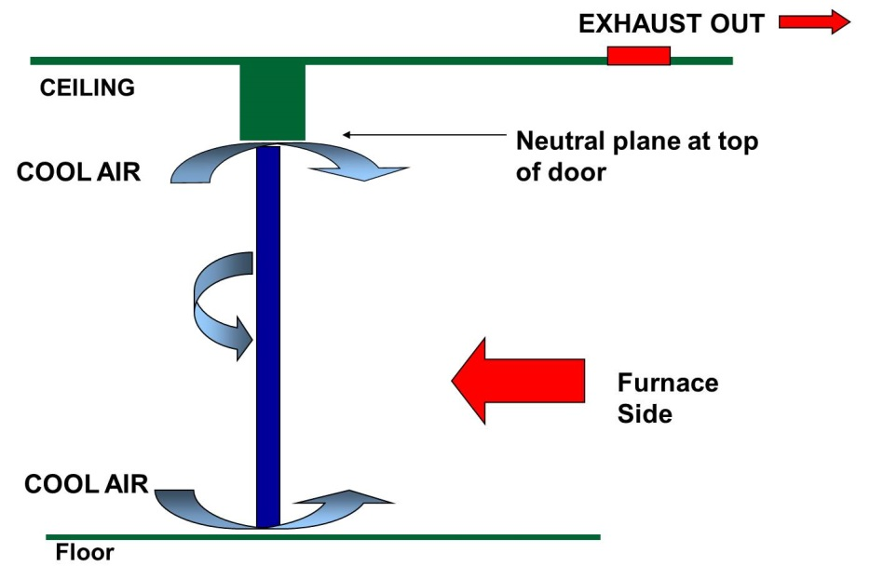
Positive Pressure Test
Previous tests furnace lower than atmospheric pressure.
Pulled the air into the furnace around the edge of the door, cooling the door and trapping the flames inside the furnace.
Historically, test done with neutral pressure on fire side of door. Neutral pressure plane then occurs at the top of the door.
Notes:
Since 1997, the IBC has required fire rated doors to be tested under positive pressure in accordance with UL 10C. This test evaluates the ability of a door assembly to remain in an opening during a predetermined test exposure. The positive pressure test differs from the previous neutral pressure test by introducing a slight positive pressure on the fire side of the test door. This more closely simulates the conditions of a real fire.
Historically, fire tests were conducted with the pressure in the furnace lower than atmospheric pressure. This pulled the air into the furnace around the edge of the door, cooling the door and trapping the flames inside the furnace. BUT real building fires exert positive pressures due to the expansion of gases, thereby forcing flames and non-combusted gas out of the room, speeding the spread of fire. The new positive pressure fire test standards reflect this reality.
As you can see in the depiction on the screen, the neutral air was remaining at the ceiling because the pressure in the furnace was lower than the atmospheric pressure.

Slide 10
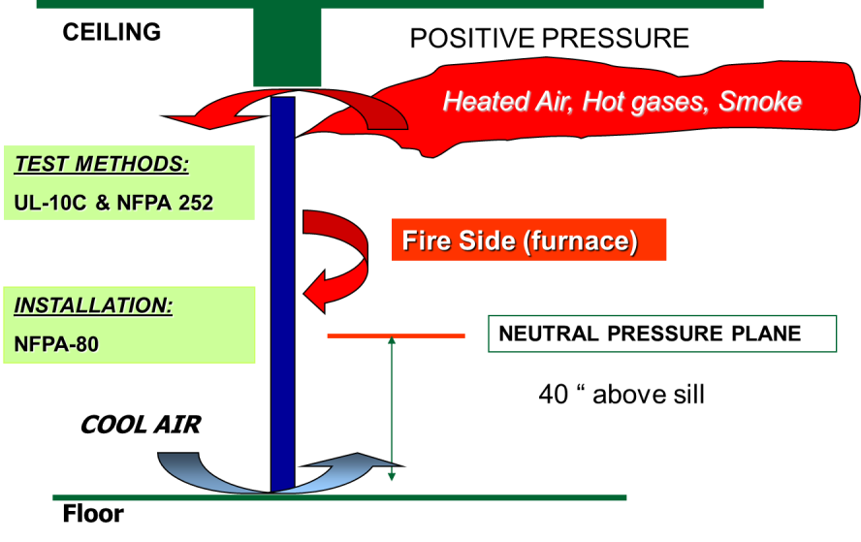
Positive Pressure Test
Real fire has high pressure zone at ceiling and low pressure zone at floor.
Test now simulates this.
Door gaskets.
Now, a positive pressure is induced on fire side of door to create a neutral pressure plane at 40 inches above sill.
Notes:
The positive pressure testing requirements more closely simulate the pressure changes in a real fire. In a real fire, there are internal pressure zones created by the differences in temperature within the fire-filled room. At the ceiling where the air is the hottest, a high-pressure zone occurs. This high pressure creates outward forces on the upper parts of the door.
At the floor where the air is the coolest, the pressure is low. Thus a vacuum occurs, causing air to be drawn into the burning room through the bottom of the door and out near the top of the door.
With positive pressure on the furnace side of the test door, hot air and gases are forced out at the top and sides of the door. This puts the door under much greater stress and hastens failure. In order to successfully pass a fire test under the positive pressure requirements, it is necessary for door manufacturers to provide doors with listed and approved seals or gasketing… which we will go over later.
As you can see in the picture on the screen, positive pressure is on the fire side, therefore creating a neutral pressure plane no more than 40” above sill.

Slide 11
Positive Pressure Test
Fire door assemblies are positive pressure tested according to UL 10C or NFPA 252. (IBC 2012 & 2015 716.5.1)
A “positive pressure” label applied to the door becomes an “assembly” label as opposed to simply a door body label.
Notes:
Fire door assemblies must be positive pressure tested according to UL 10C or NFPA 252 guidelines.
IBC Section 716 for Side-hinged or pivoted swinging doors states that doors shall be tested in accordance with NFPA 252 or UL 10C. After five minutes into the NFPA 252 test, the neutral pressure level in the furnace shall be established at 40 inches or less above the sill, as we just saw on the last slide.
A “positive pressure” label applied to the door becomes an “assembly” label as opposed to simply just a door body label.
And what is a fire door assembly? A fire door assembly is a combination of a fire door, frame, hardware, and other accessories that TOGETHER provide a specific degree of fire protection as the opening. This puts the responsibility on the company providing the products.

Slide 12
Smoke and Draft Control Doors
Tested with UL 1784, the Standard for Safety of Air Leakage Tests of Door Assemblies.
Required as per IBC 2015:
Smoke partitions (Section 710.5.2.2)
Corridors and smoke barriers (Section 716.5.3)
*Fire service access elevator lobbies (Section 3007.6.3)
*Occupant evacuation elevator lobbies (Section 3008.6.3)
* Without an artificial bottom seal.
Notes:
In addition to standard fire ratings, doors may also be tested for their ability to limit the smoke migration through door openings. These doors, called draft and smoke control door assemblies, are tested in accordance with UL 1784, the Standard for Safety of Air Leakage Tests of Door Assemblies.
Smoke and draft control door assemblies are required in the following applications according to the IBC:
Smoke partitions (Section 710.5.2.2)
Corridors and smoke barriers (Section 716.5.3)
Fire service access elevator lobbies (Section 3007.6.3)
Occupant evacuation elevator lobbies (Section 3008.6.3)
Fire service access elevator lobbies and occupant evacuation elevator lobbies are required to be protected with doors that are fire labeled according to UL 1784 without an artificial bottom seal.
Additionally, smoke barriers are required. Smoke barriers are a continuous membrane, either vertical or horizontal, such as a wall, floor, or ceiling assembly, that is designed and constructed to restrict the movement of smoke. And fire barriers are the same, but for fire restriction.

Slide 13
Smoke and Draft Control Door Testing and Labeling
Fire door assemblies meet the requirements for smoke and draft control doors tested in accordance with UL 1784. (IBC 2012 & 2015 716.5.3.1)
Smoke and draft control doors:
air leakage rate of the door assembly shall not exceed 3.0 cubic feet per minute per square foot
labeled showing the letter “S” on the fire rating label means in compliance when listed or labeled gasketing is also installed. (IBC 2012 & 2015 716.5.7.1)
Can be achieved two ways.
Notes:
What are the requirements for a smoke and draft control door?
IBC 716.5.3.1 says fire door assemblies shall also meet the requirements for a smoke and draft control door assembly tested in accordance with UL 1784. UL 1784 says the air leakage rate of the door assembly shall not exceed 3.0 cubic feet per minute per square foot of door opening at 0.10 inches of water for both the ambient temperature and elevated temperature tests. Installation of smoke doors shall be in accordance with NFPA 105.
These doors carry a smoke seal (S) label, which appears on the door label following the hourly rating. The requirements for an “S” labeled door mean the door must also have smoke and draft control gasketing. Listed or labeled gasketing is third-party tested and bears a Category H label.
The fire rated label shall indicate that the door and frame assembly are in compliance when listed or labeled gasketing is also installed.
It is important to note that a smoke and draft door assembly can be achieved in two ways.
First, an entire door assembly, consisting of specific doors, frames, gasketing, hardware and other accessories, tested as a smoke and draft control door assembly, can be used. In this situation, door assemblies must be installed in accordance with the installation instructions provided with each leakage-labeled component product. A fire door is just the door component of a fire door assembly.
Alternatively, separate components, including a listed swinging fire door (fire tested under positive pressure, and leakage tested as a smoke and draft control door), a listed fire door frame, and listed Category H gasketing material for fire doors, can be used. When separate components are provided instead of a complete tested assembly, the NFPA requirements put the onus on the company providing products to ensure proper components and installation. All components must be labeled separately as well.

Slide 14
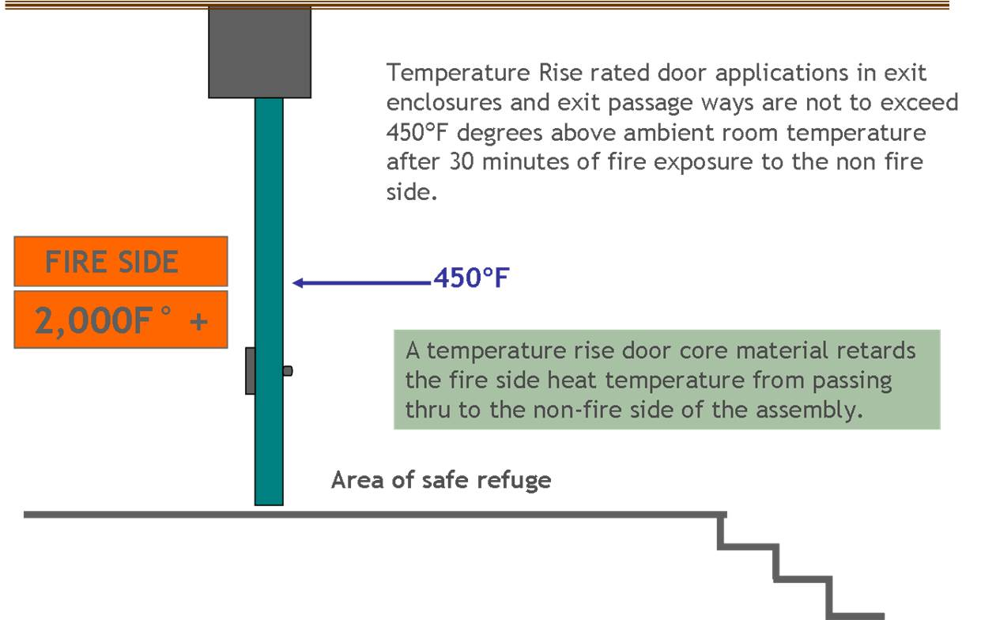
Temperature Rise Doors
Minimize heat transmission through door.
Label states the hourly rating and temperature rise rating of either 250°F, 450°F, or 650°F. (IBC 2012 & 2015 716.5.5)
Source: http://www.steeldoor.org/T-DOC/SDI-118.php
Notes:
In some locations, the IBC requires fire doors to be able to minimize the transmission of heat through the fire door. For instance, in high-rise stairwells, if the door can limit transmission of heat, building occupants can safely pass by the door and use the stairwell to escape the building.
The label on these doors will state the hourly rating and a temperature rise rating of either 250°F, 450°F, or 650°F.
The importance of this is because if you were just walking past int eh event of a fire, without a temperature rise core, you would completely burn on the non-fire side of the door. That is how hot is can get.
What are exit enclosures and exit passageways? An exit enclosure is an exit component that is separated from other interior spaces of a building by fire resistance rated construction for a protected path of egress. An exit passageway is the same thing, but it provides a path of egress in a horizontal direction only, whereas an exit enclosure is a vertical or horizontal direction. So, exiting horizontally just means that the path of egress is on the same level.
Doors in exit enclosures and exit passageways under the IBC states they shall have a maximum transmitted temperature end point of not more than 450° above ambient at the end of 30 minutes of standard fire test exposure.
The exception to that is that the maximum transmitted temperature rise is not required in buildings equipped throughout with an automatic sprinkler system installed in accordance with Section 903.
This is exactly what you are looking at in the diagram. A temperature rise core will slow the fire side heat temperature, which is much higher, from passing through to the non-fire side for a period of 30 minutes.

Slide 15
Door Labeling
Fire tested doors labeled with the appropriate test results. (IBC 2012 & 2015 716.5.7)
Labels shall:
show name of the manufacturer
name or trademark of the third-party inspection agency,
the fire protection rating and, where required the maximum transmitted temperature end point. (IBC 2012 & 2015 716.5.7.1)
Doors located in fire service elevator access lobbies MUST be tested in accordance with UL1784 without an artificial bottom seal
Notes:
As noted earlier when we were discussing smoke and draft control doors, fire tested doors must be labeled with the appropriate test results.
Section 716 also covers labeled protective assemblies. Fire door assemblies shall be labeled by an APPROVED agency. The labels shall comply with NFPA 80 and shall be permanently affixed to the door or frame. This will make it simple for code officials and fire marshals when inspecting.
Further, fire doors shall be labeled showing the name of the manufacturer or other identification readily traceable back to the manufacturer, the name or trademark of the third-party inspection agency, the fire protection rating and, where it is required for fire doors in exit enclosures and exit passageways. Smoke and draft control doors complying with UL 1784 shall be labeled as such and shall also comply with the IBC. Labels shall be approved and permanently affixed. Lastly, the label shall be applied at the factory or location where fabrication and assembly are performed.

Slide 16
Labeling
Oversized fire doors shall bear an oversized fire door label by an approved agency or shall be provided with a certificate of inspection furnished by an approved testing agency. (IBC 2012 & 2015 716.5.7.2)
Smoke and draft control doors shall show the letter “S” on the fire rating label of the door. (IBC 2012 & 2015 716.5.7.3)
Notes:
Oversized doors have specific requirements as well and shall bear an oversized fire door label by an approved agency or shall be provided with a certificate of inspection furnished by an approved testing agency. When a certificate of inspection is furnished by an approved testing agency, the certificate shall state that the door conforms to the requirements of design, materials, and construction, BUT HAS NOT been subjected to the fire test.
And again, smoke and draft control doors complying with UL 1784 shall be labeled in accordance with Section 716.5.7.1 and shall show the letter “S” on the fire rating label of the door. This marking shall indicate that the door and frame assembly are in compliance when listed or labeled gasketing is also installed.
The example label on the screen shows that it is a 3-hour temperature rise fire label and that it is smoke rated because of the “S”. It has been third party approved and clearly states the requirements that it meets, such as UL 10C and the positive pressure test. A fire and smoke label should be that easy to read.

Slide 17
Undercut Clearances
Field modifications of fire protection rated doors are severely restricted (NFPA 80, Fire Doors and Other Opening Protectives).
Wood and composite doors may be undercut up to ¾-inch. (NFPA 80, 4.1.3.2)
Combustible floor coverings (with specific radiant flux) may extend through 1½-hour, 1-hour, or ¾-hour rated fire protection fire door assemblies. Combustible floor coverings shall not extend through openings protected by 3-hour rated fire protection door assemblies. (NFPA 80 4.8.5.1, 4.8.5.2)
Notes:
NFPA 80, Fire Doors and Other Opening Protectives, includes details for the installation of fire protection rated doors and the maintenance of those doors. Because fire doors are tested and labeled assemblies, field modifications of the door are SEVERELY restricted. Some modifications are allowed with restrictions; one of those is undercutting the door. Under NFPA 80, wood and composite doors may be undercut up to ¾-inch in the field.
Doors are often undercut to allow for floor covering that continues under the door. It is important to note that under NFPA 80, there are requirements for the floor covering that extends under a fire rated door.
A proper undercut is important as it relates to UL1784 compliance. UL 1784 requires testing without an artificial bottom seal. This means that when tested, there must be a system with all fire door hardware on the fire rated assembly and there cannot be an artificial bottom seal.
So, NFPA 80 states that combustible floor coverings shall be permitted to extend through openings required to be protected by 1½-hour, 1-hour, or ¾-hour rated fire protection fire door assemblies without a sill where they have a minimum critical radiant flux of 0.22 watts/cm. This is in accordance with NFPA 253, Standard Method of Test for Critical Radiant Flux of Floor Covering Systems Using a Radiant Heat Energy Source.
Even further, combustible floor coverings shall NOT extend through openings protected by 3-hour rated fire protection door assemblies. For example, carpet may not extend under a 3 hour rated door. There must be a break in the carpet.

Slide 18
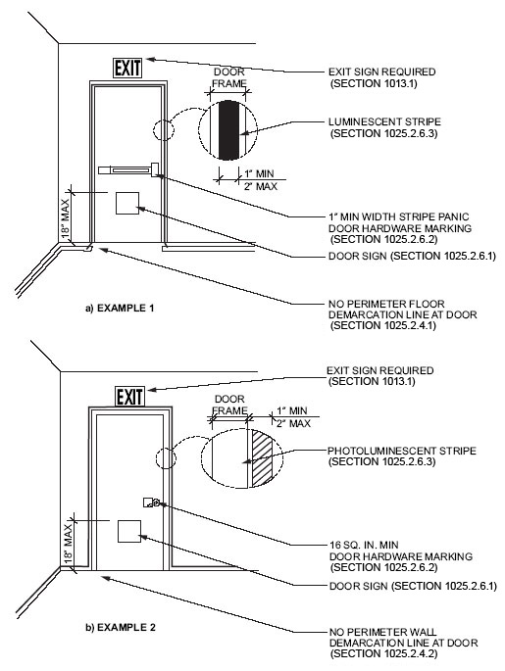
Luminous Egress Path Markings
Required in interior exit enclosures and exit passageways of all high-rise buildings, Groups A, B, E, I , M and R-1 (IBC 2012 1024.1, 1024.2, 1024.2.6 IBC 2015 1025.1, 1025.2, 1025.6).
Markings to have:
A 4” min high low-location luminous emergency exit symbol mounted no higher than 18 inches above the finished floor.
Hardware marked 16 sq. in. min. luminous material.
Door frame markings have solid and continuous 1” – 2”stripe.
Notes:
IBC section 1024 is for luminous egress path markings. Approved luminous egress path markings delineating the exit path shall be provided in high-rise buildings of Group A, B, E, I, M, and R-1 occupancies in accordance with Sections 1024.1 through 1024.5.
An exception to this is that luminous egress path markings shall not be required on the level of exit discharge in lobbies that serve as part of the exit path in accordance with Section 1027.1.
So what does that mean? High-rise buildings in Groups A, B, E, I, M, and R-1 (other groups are likely not going to be high-rise), must have luminescent or photoluminescent markings for the exit path.
1024.2 in the IBC specially references markings within exit components.
Egress path markings shall be provided in interior exit stairways, interior exit ramps, and exit passageways, in accordance with Sections 1024.2.1 through 1024.2.6.
So, what are the requirements of the markings?
Section 1024.2.6 covers the marking required for doors within an exit path. Doors through which occupants must pass in order to complete the exit path shall be provided with markings complying with the following:
A low-location luminous emergency exit symbol complying with NFPA 170. The exit symbol shall be a minimum of 4 inches in height and shall be mounted on the door, centered horizontally, with the top of the symbol no higher than 18 inches above the finished floor.
Hardware marked with no less than 16 square inches of luminous material.
Door frame markings marked with a solid and continuous 1-inch- to 2-inch-wide stripe.
In the image on the screen you can see the emergency exit symbol on the door (which is the square) near the bottom, the hardware markings for the panic and the lever, and the door frame luminescent stripes that are blown up for better imaging.

Slide 19
Minimum Required Egress Width: Stairway Doors
IBC 2015 1005.3.1, 1005.3.2, 1005.5, says means of egress width to be not less than total occupant load served by the means of egress multiplied by 0.3 inch (7.62 mm) per occupant for stairways and by 0.2 inch (5.1 mm) per occupant for other egress components.
The loss of any one means of egress cannot reduce the total width by more than 50%.
Minimum width or required capacity of the means of egress required from any story of a building shall not be reduced along the path of egress travel until arrival at the public way.
ADA Guidelines require a minimum clear opening of 32 inches.
Notes:
Means of egress is a continuous and unobstructed path of vertical and horizontal egress travel from any occupied portion of a building or structure to a public way. A means of egress consists of three separate and distinct parts: the exit access, the exit, and the exit discharge.
Building codes not only regulate number of exits for each building type and occupancy, but also the exit widths. Exit widths are a critical determinant of the capacity of any egress system.
IBC 1005 covers egress widths. The total width of means of egress in inches shall not be less than the total occupant load served by the means of egress multiplied by 0.3 inches per occupant for stairways and by 0.2 inches per occupant for other egress components. The width shall not be less than specified elsewhere in this code. Multiple means of egress shall be sized such that the loss of any one means of egress shall not reduce the available capacity to less than 50 percent of the required capacity. Minimum width or required capacity of the means of egress required from any story of a building shall not be reduced along the path of egress travel until arrival at the public way.
ADA guidelines also covers this. If the doors form part of a means of egress and an accessible route, then the ADA Guidelines require a minimum clear opening of 32 inches.
So, one leaf of a pair of doors or a single leaf for a single door must have a 32” clear opening.

Slide 20
Minimum Required Egress Width: Stairway Doors
The 2015 IBC has the exception to this rule for buildings with other than Group H and I-2 occupancies that have an automatic sprinkler system installed in accordance with Section 903.3.1.1 or 903.3.1.2 and an emergency voice/alarm communication system in accordance with Section 907.5.2.2.
In those buildings, the means of egress capacity factor is reduced to 0.2 inch (5.1mm) for stairways and 0.15 inch (3.8 mm) per occupant for other egress components.
Given: Fully sprinklered, two-story office building, 460 occupant load per floor and two stairways on the second floor
As per IBC 2015
Doors require 0.15 inches x occupant load
Stairways require .02 inches x occupant load
Door: 230 X 0.15 = 34.5" minimum width (each stairway)
Stairway: 230 X 0.2 = 46" minimum width (each stairway)
Notes:
In a building that is not Group H or I-2, that has an automatic sprinkler system and an emergency voice/alarm communication system, has a different multiplier for measuring minimum required egress.
Here is an example:
If the doors fall under “other egress components”, the egress width capacity multiplier changes from .3 to .15 inches x occupant load.
So, given that the example building is fully sprinklered, a two-story office building, 460 occupant load per floor and two stairways on the second floor, you would calculate the minimum egress width or other egress components by taking:
Egress: 230 X 0.15 (the new multiplier) = 34.5" minimum width
Stairway: 230 X 0.2 (the new multiplier) = 46" minimum width (each stairway)

Slide 21
Minimum Required Egress Width: Encroachment
Doors and hardware may encroach into this calculated width
Surface mounted latch release hardware exempt when
mounted to side of the door facing the corridor width and mounted between 34 inches and 48 inches
IBC 2015 SECTION 1005 EGRESS WIDTH
1005.7.1 Door encroachment.
Notes:
Doors and hardware are given a limited allowance for encroachment into this calculated width. IBC 2015 Section 1005.7 contains similar requirements in egress width and encroachment requirements:
Doors, when fully opened, and handrails shall not reduce the required means of egress width by more than 7 inches. Doors in any position shall not reduce the required width by more than one-half.
Exception: The restrictions on a door swing shall not apply to doors within individual dwelling units and sleeping units of Group R-2 and dwelling units of Group R-3.
This means that you would measure from the leading edge of the door and if the corridor width is reduced by more than 7” when open, the door is considered to be encroaching on the corridor. Additionally, if the door is open, from the leading edge, the door cannot reduce the required width by more than 50%.
Hardware should be mounted between 34 and 48 inches off the floor AND the hardware is mounted to the side of the door facing the corridor width.

Slide 22
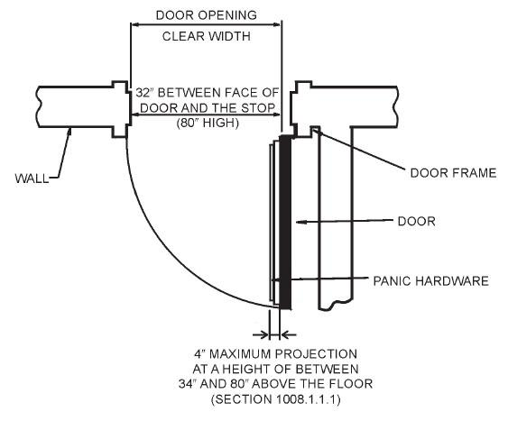
IBC Required Door Width
Clear width of 32 inches (813 mm)
Swinging doors measured between the face of the door and the stop.
With double doors - one door will provide the required opening width.
Height not less than 80 inches. (IBC 2012 1008.1 - IBC 2015 1010.1.1)
No projections into the required clear width lower than 34 inches (864 mm)
Projections between 34 inches (864 mm) and 80 inches (2032 mm) shall not exceed 4 inches (102 mm). (IBC 2012 1008.1.1.1 and IBC 2015 1010.1.1.1 with exception).
Insert pair drawing here
Notes:
In chapter 10 the IBC talks about the size of the doors.
There is a minimum clear width for a door opening. It is measured from the face of the door in the open position to the stop when open 90 degrees. At least one door leaf must have a 32 inch clear opening. The maximum width of a swinging door leaf is 48 inches unless otherwise tested. Door opening height cannot be less than 80 inches.
There are also stipulations on the projections into clear the width. There shall not be projections into the required clear width lower than 34 inches above the floor or ground. IF there is a projection in to the clear opening width between 34 and 80 inches, it cannot exceed 4 inches.

Slide 23
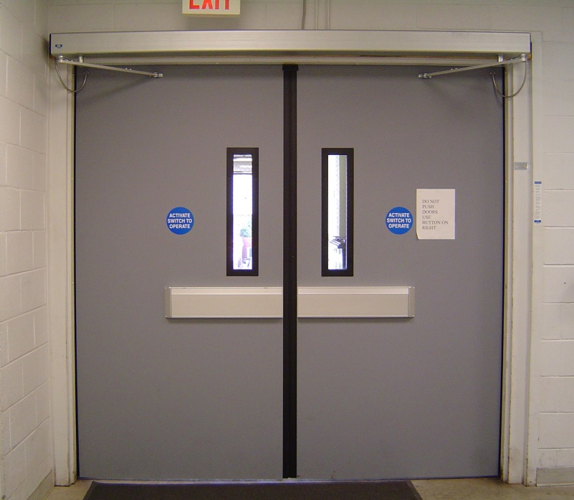
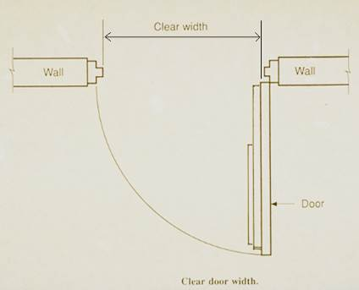
ADA and NFPA Required Door Width
ADA Guidelines require a minimum clear opening of 32”.
The NFPA 101, 2015, Sections 7.2.1.2.3.2 (7) and 7.2.1.9.1.5 states if paired openings are on operators, they do not have to comply with 32" min clear opening, but they cannot be narrower than 30".
Generally, width of doors is measured from the face of the door to the opposite door stop. Hardware is considered a projection into the clear width.
Notes:
Both the Americans with Disabilities Act (ADA) Guidelines and the NFPA guidelines impact clear door width.
As stated previously, ADA Guidelines require a minimum clear opening of 32 inches with the door open 90 degrees, measured between the face of the door and the opposite stop.
NFPA 101 Section 7 states if the paired openings are on operators, they do not have to comply with 32" min opening size, BUT they cannot be narrower than 30“ clear opening. Therefore, safely adhering to the ADA guidelines for 32” clear opening is a safe bet.

Slide 24
Egress Door Hardware Mounting Height
Door handles, pulls, latches, locks, and other operating devices shall be installed 34 inches (864 mm) minimum and 48 inches (1219 mm) maximum above the finished floor. (IBC 2012 1008.1.9.2 - IBC 2015 1010.1.9.2).
NFPA 2015 7.2.1.7 allows for a lower mounting height for existing installations.
Nor shall they require tight grasping, tight pinching or twisting of the wrist to operate. (IBC 2012 1008.1.9.1 - IBC 2015 1010.1.9.1)
Notes:
For mounting height of door hardware, the IBC and NFPA are very similar, but the NFPA allows for a lower mounting height for existing installations.
In chapter 10 section 8, the hardware height is discussed. Door handles, pulls, latches, locks, and other operating devices shall be installed 34 inches minimum and 48 inches maximum above the finished floor. Locks used only for security purposes and not used for normal operation are permitted at any height.
Even further, those operating devices on doors are required to be accessible by Chapter 11 and shall not require tight grasping, tight pinching, or twisting of the wrist to operate.

Slide 25
Where are Fire Doors Required?
Notes:
Fire rated doors are built to resist heat and smoke. The function is to save lives…..to contain smoke and sometimes heat from building occupants, so following the fire door requirements is extremely important.
So, where are fire doors required?

Slide 26
Fire Rated Door Locations
Fire partitions, smoke partitions, smoke barriers, fire walls, exit enclosures, exit passageways, horizontal exits, and means of egress doors.
Corridors
Cross Corridors
Stairway Doors
Area of Refuge
Elevator Lobby
Elevator Shaft
Security Applications
Mechanical Rooms
Between Adjacent Buildings
Classrooms
Offices
Psychiatric Applications
Trash/Laundry Chutes
Notes:
Fire and smoke rated doors are required for openings in fire partitions, smoke partitions, smoke barriers, fire walls, exit enclosures, exit passageways, horizontal exits, and means of egress doors.
A fire partition is a vertical assembly of materials designed to restrict the spread of fire in which openings are protected.
The slide shows locations where fire and smoke rated swinging doors may be required.
And while everything we are talking about is a summary of an extensive list, it does not replace a thorough code review.

Slide 27
Means of Egress
Continuous and unobstructed path of vertical and horizontal egress travel to a public way.
Three parts: the exit access, the exit, and the exit discharge.
Means of egress doors to be easily recognizable as doors. (IBC 2012 1008.1 - IBC 2015 1010.1)
Notes:
Means of egress doors must be clearly identifiable as such.
IBC chapter 10 and chapter 8 refers to the following. Means of egress doors must be readily distinguishable from the adjacent construction and finishes such that the doors are easily recognizable as doors. Mirrors or similar reflecting materials shall not be used on means of egress doors. Means of egress doors shall not be concealed by curtains, drapes, decorations or similar materials.
As previously mentioned, means of egress consists of three separate and distinct parts: the exit access, the exit, and the exit discharge. Exit passageways and exit enclosures form part of the means of egress. Openings and penetrations within the exit passageway and exit enclosure must meet the requirements of Section 716 of the IBC.
As we saw earlier, fire doors in exit passageways and exit enclosures must be temperature rated doors.

Slide 28
The Elevator Lobby
Fire Service Access Elevator &
Occupant Evacuation Elevator
Elevator hoistways penetrate floor-to-floor fire separations.
Enclosed elevator lobbies required at each floor where an elevator hoistway connects more than three stories. (IBC 2015 3006.2)
Fire Service Access Elevators & Occupant Evacuation Elevators lobbies shall be enclosed with a smoke barrier having a fire-resistance rating of not less than 1 hour. (IBC 2015 3007.6.2 & 3008.6.2)
Exceptions
Elevator serves only open parking garages.
Level(s) of discharge, provided level(s) is equipped with an automatic sprinkler system.
Elevator hoistway opens to the exterior
Notes:
The goal of fire and life safety aspects of the IBC is to compartmentalize buildings with fire rated walls, floors, and doors, restricting the movement of smoke and fire. Elevator shafts work against this principle, penetrating floor-to-floor separations. These areas are specifically addressed within the code.
Shaft enclosures are the walls or construction that form the boundaries of the shaft and the shaft is what connects vertical openings in successive floors.
Chapter 30, section 6 states that an enclosed elevator lobby shall be provided at each floor where an elevator hoistway connects more than three stories. The lobby shall separate the elevator hoistway shaft enclosure doors from each floor by fire partitions or smoke partitions with buildings equipped throughout with an automatic sprinkler system. There are some exceptions to this specific code that should be looked at.
Chapter 30, section 7 states the fire service access elevator lobby shall be enclosed with a smoke barrier having a fire-resistance rating of not less than 1 hour.
Chapter 30, section 8 says the same about occupant evacuation elevator lobbies that section 7 says about fire service access elevator lobbies.

Slide 29
Elevator Lobby Doors
Minimum fire protection rating of 3/4 hour required in elevator lobbies on fire service access elevators. (IBC 2015 3007.6.3 & 3008.6.3)
Shall be tested in accordance with UL 1784 without an artificial bottom seal. (IBC 2015 3007.6.3 & 3008.6.3)
For Occupant Evacuation Elevators, vision panel required. (IBC 2015 3008.6.3.1)
Notes:
Doors protecting elevator lobby enclosure fire partition walls must meet the following requirements (also from chapter 30):
Other than doors to the hoistway, elevator control room or elevator control space, each doorway to a fire service access elevator lobby shall be provided with a ¾-hour fire door assembly complying with Section 716. The fire door assembly shall comply with the smoke and draft control door assembly requirements with the UL 1784 test conducted without the artificial bottom seal.
The exact same thing is said about the fire door assemblies for occupant evacuation elevators.
The difference in regard to occupant evacuation elevators is that a vision panel shall be installed in each fire door assembly protecting the lobby doorway. The vision panel shall consist of fire-protection-rated glazing and shall be located to furnish clear vision of the occupant evacuation elevator lobby.

Slide 30
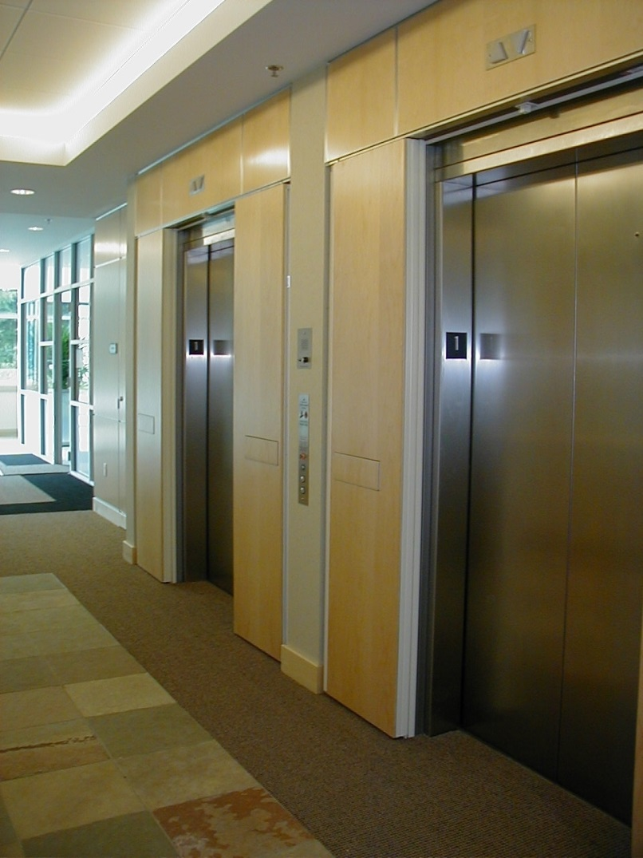
Elevator Lobby Alternative
Lobby not required where additional doors are provided at each elevator hoistway door opening. (IBC 2015 3006.3)
Doors must be openable from car side without a key, tool, special knowledge or effort. (IBC 2012 & 2015 3002.6)
Notes:
An alternative to an elevator lobby, is additional doors that are provided at the hoistway opening.
In chapter 30, one of the exceptions I mentioned, specifically exception number 3, is that an enclosed elevator lobby is not required where additional doors are provided at the hoistway opening. Again, such doors shall comply with the smoke and draft control door assembly requirements in Section 716 when tested in accordance with UL 1784 without an artificial bottom seal.
Doors at the elevator shaft must be readily openable from the elevator side without a key, tool, special knowledge, or effort.
The picture on the right is a good example because if the doors closed due to a fire and you were stuck in the elevator shaft, you would easily be able to push the door open and get out because it is a swing door with a panic bar.

Slide 31
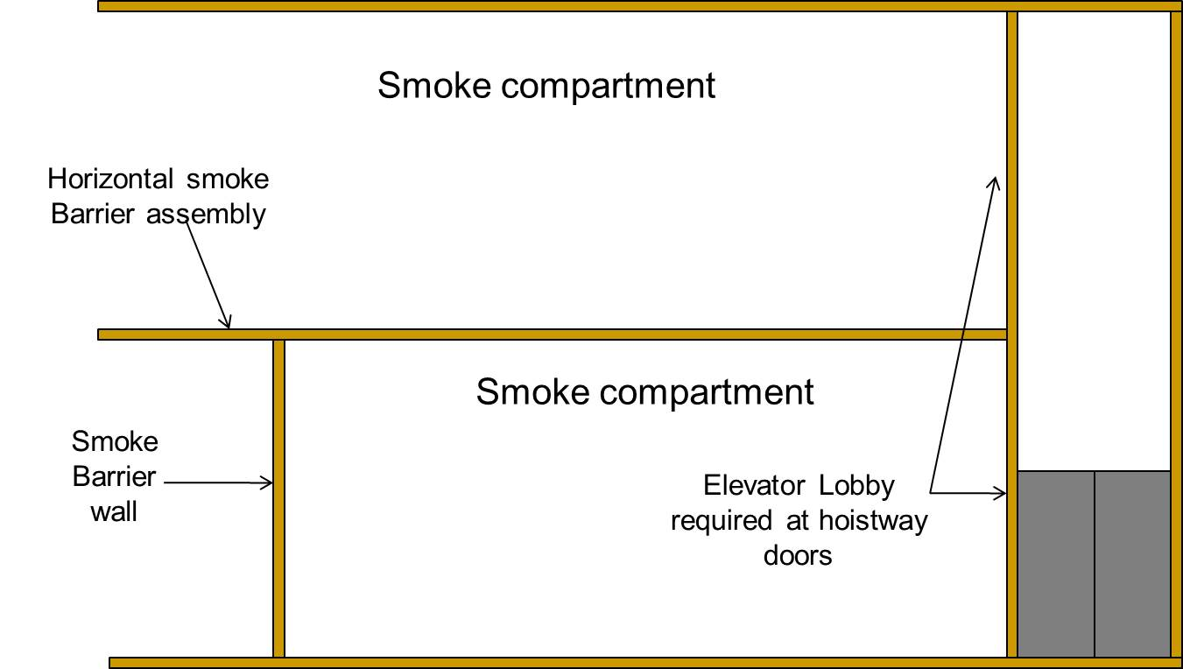
Smoke Barriers and Elevator Lobbies
Elevator lobby or additional protection in front of elevator hoistway required in all multi-story buildings regardless of the number of stories. (IBC 2012 711.9)
Notes:
Chapter 7, section 11 is regarding SMOKE BARRIERS. Regardless of the number of stories connected by elevator shaft enclosures, doors located in elevator shaft enclosures that penetrate the horizontal assembly shall be protected by enclosed elevator lobbies complying with Section 713.14.1. Openings through horizontal assemblies shall be protected by shaft enclosures complying with Section 713. Horizontal assemblies shall not be allowed to have unprotected vertical openings.
Let's break that down. Regardless of the number of stories in a building, if it is a smoke barrier or smoke compartment, if the elevator shaft penetrates from floor to floor, the horizontal assembly shall be protected by an enclosed elevator lobby. This smoke compartment on the slide is enclosed by smoke barriers on all sides including the top and bottom.

Slide 32
Smoke Partitions
Smoke partitions not required to have a fire resistance rating.
Doors in smoke partitions must be smoke and draft control rated and self-closing. (IBC 2012 & 2015 710.5.2.2 & 710.5.2.3)
The maximum length of time from alarm notification to actual release of the smoke door must be 10 seconds. (IBC 2012 & 2015 716.5.9.3)
Notes:
Smoke partitions are designed to prevent the passage of smoke and are not required to have a FIRE resistance rating. Unless it is stated somewhere else in the code book, smoke ratings are what the IBC generally calls for in these applications. Doors in smoke partitions must be smoke and draft control rated and also be self-closing. This means that the fire door must have an approved device to ensure closing after having been opened, for example, a closer.
The maximum length of time from alarm notification to actual release of the smoke door can be no more than 10 seconds.

Slide 33
Fire Door Operation
Notes:
Fire resistance rating is based on the period of time a building assembly maintains the ability to confine a fire based on the tests in the IBC.
Operating of these fire and smoke resistance doors is an important component for life safety.

Slide 34
Fire Rated Door Closers
All fire rated assemblies must be self-closing and/or self-latching. (NFPA 80, IBC 2012 & 2015 Section 716.5.9)
Self-closing door has a door closer, no hold-open.
Automatic closing door (smoke activated door) is held open electronically and must release upon actuation of the building’s fire/smoke alarm system. Then it becomes self-closing. (IBC 2012 & 2015 716.5.9.3)
Notes:
As per NFPA 80 and IBC Section 716, all fire rated assemblies must be self-closing and/or self-latching. Whenever the codes call for RATED assemblies, then latching is required. A self-closing door is a door equipped with a door closer, without any type of hold-open mechanism. An automatic-closing door is held open electronically by means of an electro-magnetic holder or closer/holder unit. Automatic-closing fire door assemblies shall be self-closing in accordance with NFPA 80. The electronic hold-open device must release upon actuation of the building’s fire/smoke alarm system or upon loss of power to the smoke detector or hold-open device. Upon release of the hold-open device, the door becomes self-closing.
So, in the event of a fire, the fire alarm will trigger the automatic release of a hold open device by loss of power to the hold open device and the closer will shut the door and the door will self-latch, all according to code.
Doors that are automatic-closing by smoke detection shall also not have more than a 10-second delay before the door starts to close after the smoke detector is actuated.
A self closing door is a door equipped with a door closer, without any type of hold-open mechanism. An automatic closing door is held open electronically by means of an electro-magnetic closer/holder unit.

Slide 35
Smoke Activated Doors
Locations:
doors installed across a corridor
doors that protect openings in exits or corridors required to be of fire resistance rated construction or in walls that are capable of resisting the passage of smoke
doors in smoke barriers, fire partitions, fire walls, shaft enclosures
doors in refuse and laundry chutes and access and termination rooms
certain doors in underground buildings including walls for compartmentation and elevator lobby walls, and
doors in smoke partitions.
Notes:
Automatic-closing fire doors and smoke doors should be in the following locations:
doors installed in cross corridor settings
doors that protect openings in exits or corridors required to be of fire resistance rated construction or in walls that are capable of resisting the passage of smoke
doors in smoke barriers, fire partitions, fire walls, shaft enclosures
doors in garbage and laundry chutes and access and termination rooms
certain doors in underground buildings including walls for compartmentalization and elevator lobby walls
and
doors in smoke partitions.

Slide 36
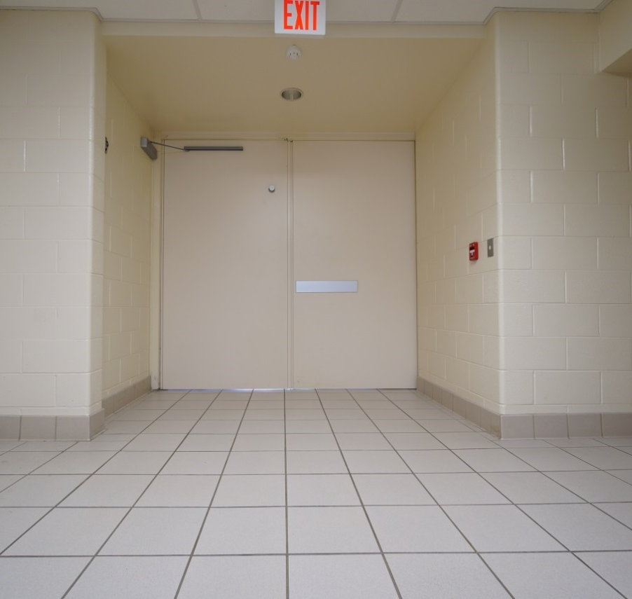
Smoke Partition Doors
Must be self-closing and self-latching (IBC 2012 & 2015 710.5.2.3)
Notes:
Chapter 7, section 10 for smoke partitions states that where required elsewhere in the code, doors in smoke partitions shall be self- or automatic-closing by smoke detection in accordance with Section 716.

Slide 37
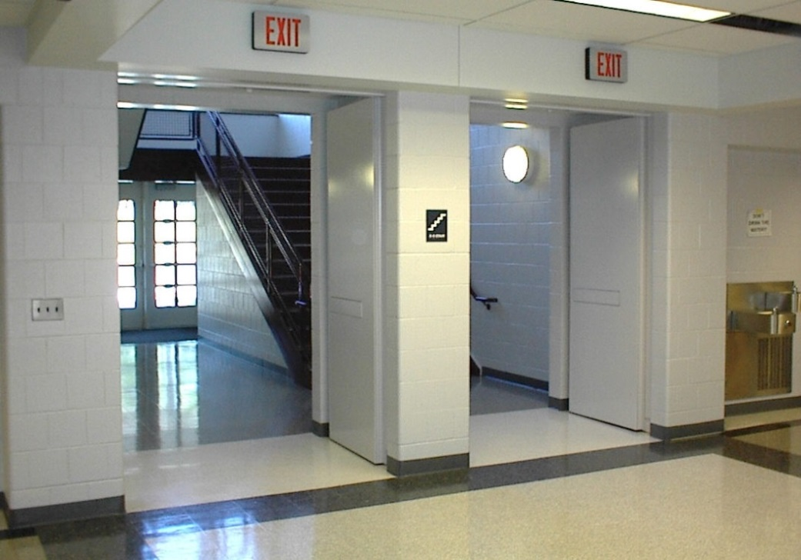
Horizontal Exits
Require self-closing or automatic-closing doors. (IBC 2012 1025.3 - IBC 2015 1026.3)
Notes:
Horizontal exits also require self-closing or automatic-closing doors.
Chapter 10, section 25 for opening protectives at horizontal exits, states fire doors in horizontal exits shall be self-closing or automatic-closing when activated by a smoke detector in accordance with Section 716. Doors, where located in a cross-corridor condition, shall be automatic-closing by activation of a smoke detector installed.

Slide 38
Egress Door Operation
Egress doors must be readily openable from the egress side without the use of a key or special knowledge or effort.
Maximum unlatching force of panic hardware shall not exceed 15 pounds (67 N). (IBC 2012 1008.1.3 - IBC 2015 1010.1.3)
Notes:
Egress doors must be readily openable from the egress side without the use of a key or special knowledge or effort.
Chapter 10 of the IBC also involves installation of hardware devices. Where panic or fire exit hardware is installed, it shall comply with the following:
1. Panic hardware shall be listed in accordance with UL 305;
2. Fire exit hardware shall be listed in accordance with UL 10C and UL 305;
3. The actuating portion of the releasing device shall extend at least one-half of the door leaf width; and
4. The maximum unlatching force shall not exceed 15 pounds.

Slide 39
Egress Door Opening Force
Pushing or pulling force for interior swinging egress doors other than fire doors, not to exceed five pounds (22N). (IBC 2012 1008.1.3 - IBC 2015 1010.1.3)
For other swinging doors, as well as sliding and folding doors, the door latch shall release when subjected to a 15-pound (67 N) force, The door shall be set in motion when subject to a 30-pound (133 N) force The door shall swing to a full-open position when subject to a 15-pound (67 N) force. (IBC 2012 1008.1.3 - IBC 2015 1010.1.3)
Fire Doors shall have a minimum opening force allowable by appropriate administrative authority. (ADA 2010 Guidelines 404.2.9)
Notes:
The IBC requires that the force for pushing or pulling open interior swinging egress doors, other than fire doors, not exceed five pounds. ADA Guidelines require that interior hinged doors within an accessible route also have a maximum force of five pounds to operate the door. ADA Guidelines note that fire doors shall have the minimum opening force allowable by the appropriate administrative authority. These forces do not apply to the force required to retract latch bolts or disengage other devices that may hold the door in a closed position.
IBC Chapter 10, section 8 is the area regarding door opening force. These forces do not apply to the force required to retract latch bolts or disengage other devices that hold the door in a closed position. For other swinging doors, as well as sliding and folding doors, the door latch shall release when subjected to a 15-pound force. The door shall be set in motion when subject to a 30-pound force.
ADA 2010 guidelines are more vague in the fact that it just says fire doors shall have a minimum opening force allowable by appropriate administrative authority.

Slide 40
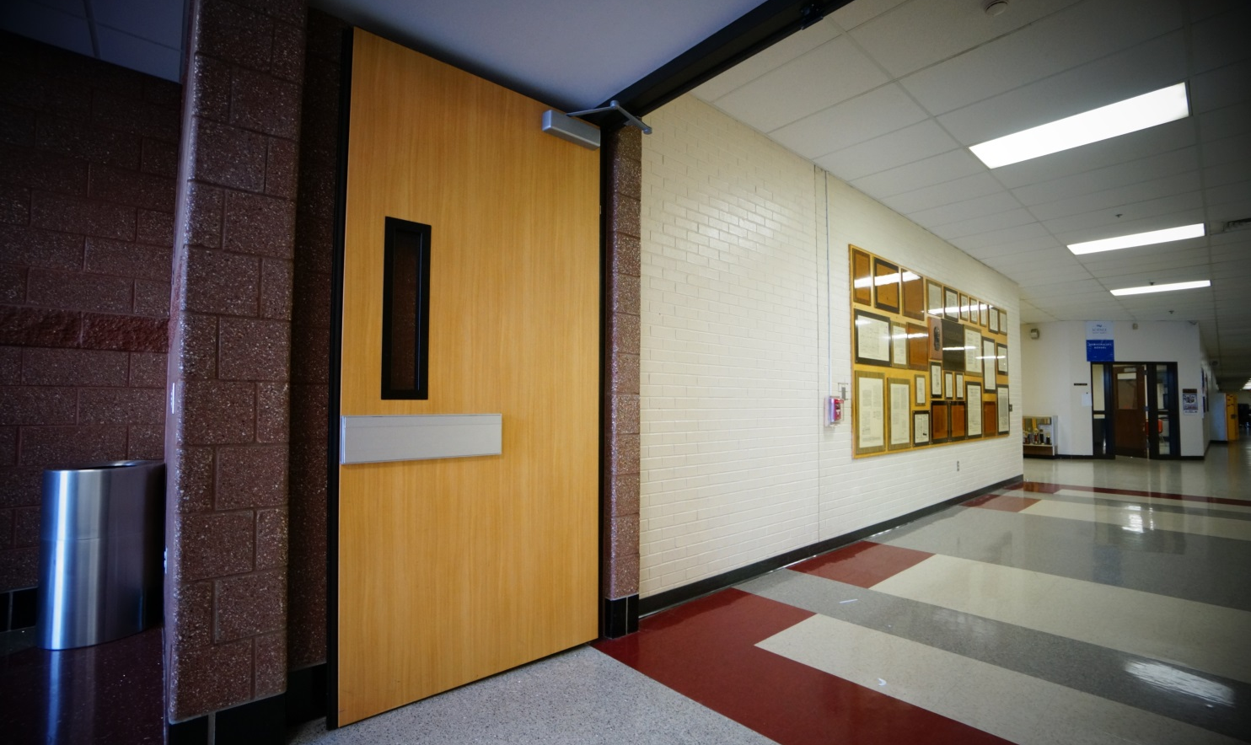
Fire Door Glazing
Notes:
Glass is allowed in fire rated doors as long as it meets all code requirements. The size, fire rating, and type of glass are all affected by IBC requirements.

Slide 41
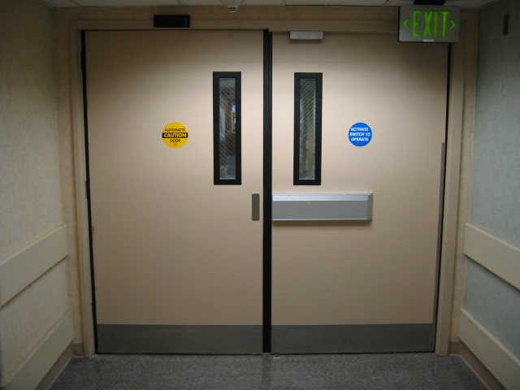
Wired Glass
Used to be the most common glass used in fire rated door lites.
Must be impact rated. (IBC 2012 & 2015 2406.4.1)
Glazing in all fixed and operable panels of swinging, sliding and bifold doors shall be considered a hazardous location.
Markings/Identification –
D - Meets fire door assembly criteria.
H - Meets fire door assembly hose stream test.
T - Meets 450°F temperature rise criteria for 30 minutes.
Notes:
For many years, the most common glass used in fire rated door lites was wired glass. At the time, it was the only material that could meet the requirements of a rated glazing. But despite being able to maintain its position in a fire, wired glass isn’t very impact resistant and when broken, it becomes dangerous because of the exposed wires. For this reason non-impact resistant wire glass is no longer used in door lites.
Glazing in all fixed and operable panels of swinging, sliding and bifold doors shall be considered a hazardous location.
For fire-rated glazing, the label shall bear the identification required in the IBC.
“D” indicates that the glazing is permitted to be used in fire door assemblies.
“H” indicates that the glazing meets the hose stream requirements.
“T” indicates that the glazing meets the temperature requirements.

Slide 42
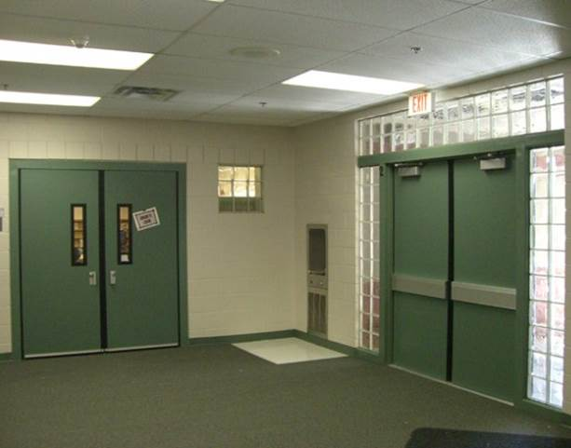
Glazing Impact Test
Door lite glazing in swinging, sliding and bifold doors must pass an impact test.
TABLE 2406.2(1) MINIMUM CATEGORY CLASSIFICATION OF GLAZING USING CPSC 16 CFR PART 1201
Exposed surface area of one side of one lite | Glazing in storm or combination doors | Glazing in doors | Glazed panels regulated by section 2406.4.3 | Glazed panels regulated by section 2406.4.2 | Doors and enclosures regulated by section 2406.4.5 | Sliding glass doors patio type
9 square feet or less | I | I | No requirement | I | II | II
More than 9 square feet | II | II | II | II | II | II
Notes:
Door lite glazing in swinging and bifold doors must pass an impact test.
When required by other sections of this code, glazing shall be tested in accordance with CPSC 16 CFR Part 1201. Glazing shall comply with the test criteria for Category II, unless otherwise indicated in Table 2406.2.
Based on the table, the exposed surface area of glazing will determine whether you need to test for category I or category II.

Slide 43
Fire Door Lite Size
Glazing panels in doors shall have the bottom of at least one glazed panel located 43 inches (1090 mm) maximum above the finish floor. (2010 ADA Accessibility Guidelines, 404.2.11)
Table 716.5 - Opening Fire Protection Assemblies, Ratings & Markings. Chart lays out vision panel size limits and adds a column that specifies the sidelite and transom rating requirements. (IBC 2012 & 2015 Table 716.5).
Notes:
The 2010 ADA Accessibility Guidelines note one reference to door vision lites in section 404:
Doors, gates, and side lights adjacent to doors or gates, containing one or more glazing panels that permit viewing through the panels, shall have the bottom of at least one glazed panel located 43 inches maximum above the finish floor. Exception- Vision lights with the lowest part more than 66 inches from the finished floor or ground shall not be required to comply with section 404.2.11.
Table 716.5 in the IBC, lays out vision panel size limits and adds a column that specifies the sidelite and transom rating requirements. The table also denotes sizes for fire “protection” rated products, and fire “resistance” rated products.

Slide 44
Thank you for your time
Questions? This concludes The American Institute of Architects Continuing Education Systems Course
www.totaldoor.com
Notes:
This concludes the AIA portion of the presentation. Thank you so much for your time and attention today. If you have any questions, please feel free to ask them now and if I do not know the answer, I will happily find it for you. Please also note Total Door is happy to assist with any review of plans for any code questions.
Please enjoy this brief introductory video about Total Door.

Slide 46
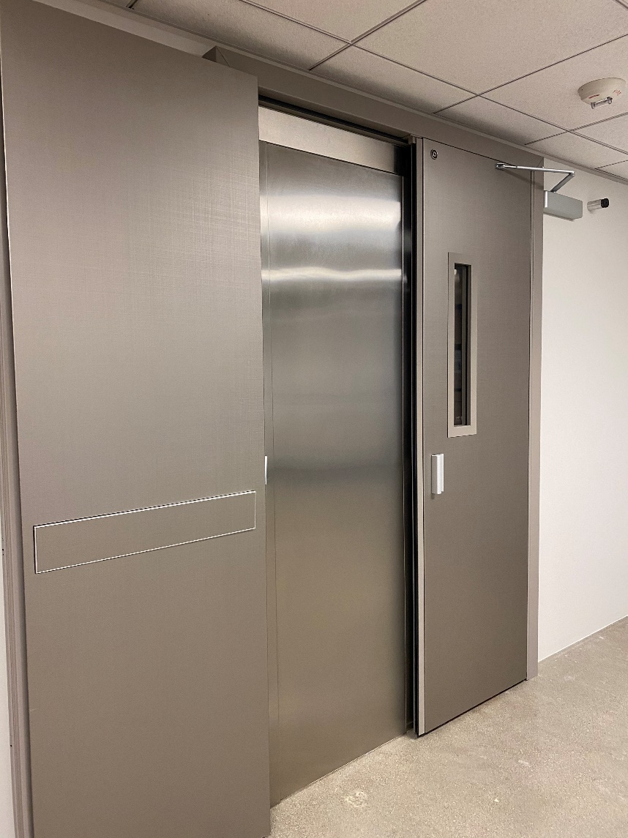
System Pricing
Hardware
Factory Finish
Installation
Notes:
Total Door is sold as a complete system with very competitive pricing. That means when you get pricing back, you are looking at the full price, factory finished, all hardware (including closers, hold opens, panics, levers, grips, seals, and surface mounted seals), and installation included from our distribution team as well. We are always here to help budget for any project and provide the best customer service possible.
Again, we would like to thank you for your time today. Any questions?

