Slide 1
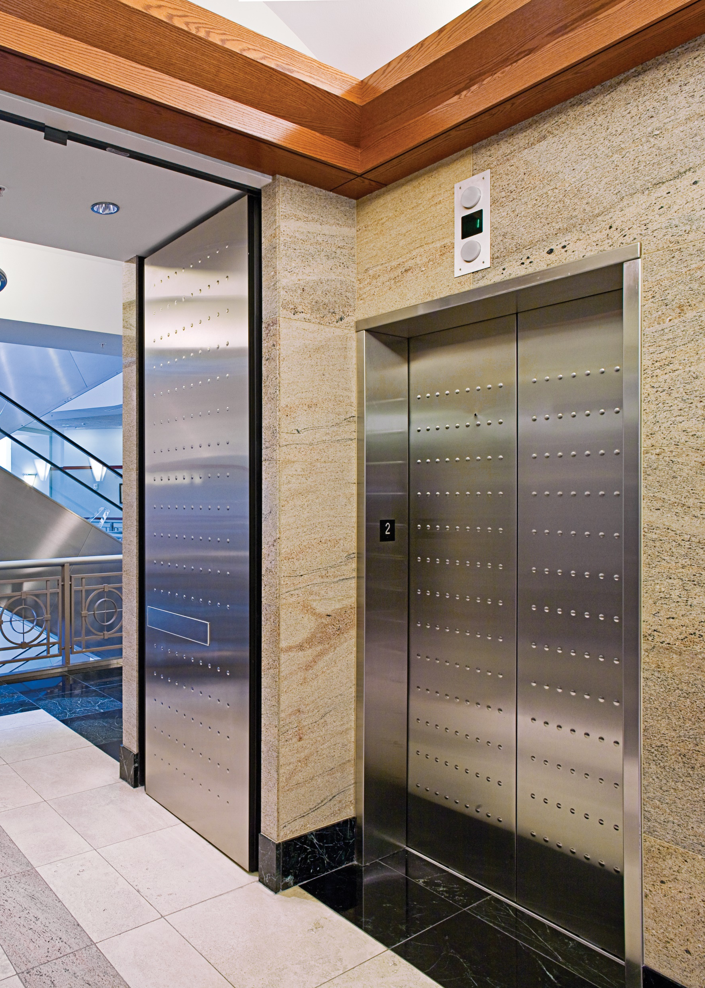
Integrated Fire and Smoke Door Systems: Specifying Your Own Safety Net
www.totaldoor.com
248-623-6899
Notes:
Thank you for attending our presentation on Integrated Fire and Smoke Door Systems: Specifying Your Own Safety Net. My name is Candace Kitchen, and I am Total Door’s customer service specialist. I can be reached at designsupport@totaldoor.com or by calling the factory. We will take some time at the end of the presentation for a question-and-answer portion, so please put your questions into the question-and-answer box. Thank you for your time today.

Slide 2
Integrated Fire and Smoke Door Systems: Specifying Your Own Safety Net
Total Door® is a Registered Provider with The American Institute of Architects Continuing Education Systems (AIA/CES). Credit(s) earned on completion of this program will be reported to AIA/CES for AIA members. Certificates of Completion for both AIA members and non-AIA members are available upon request. This program is registered with AIA/CES for continuing professional education. As such, it does not include content that may be deemed or construed to be an approval or endorsement by the AIA of any material of construction or any method or manner of handling, using, distributing, or dealing in any material or product.
Questions related to specific materials, methods, and services will be addressed at the conclusion of this presentation.
This presentation is protected by US and International Copyright laws. Reproduction, distribution, display and use of the presentation without written permission of the speaker is prohibited.
Total Door Systems®
6145 Delfield Dr.
Waterford, MI 48329
Course Number: IFDS - 01
Learning Units: 1.0 LU/HSW Hour
Notes:
This now begins the AIA portion of the presentation. Integrated Fire and Smoke Door Systems: Specifying Your Own Safety Net is eligible for 1.0 Learning Unit/Health, Safety, Welfare Hour. Certificates will also be given.

Slide 3
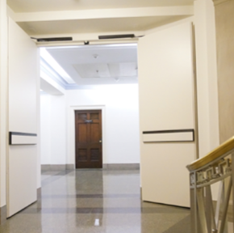
Learning Objectives
At the end of this program, participants will be able to:
Understand the importance of fire and smoke protection systems
Know the code surrounding fire and smoke door systems
Learn about integrated door system applications
Understand the benefits of integrated door systems
Notes:
To ensure that our message matches our outcome, we have developed the following learning objectives:
Understanding the importance of fire and smoke protection systems
Knowing the code that surrounds smoke and fire door systems
Learn about integrated door systems and their applications
Understand the benefits of integrated door systems

Slide 4
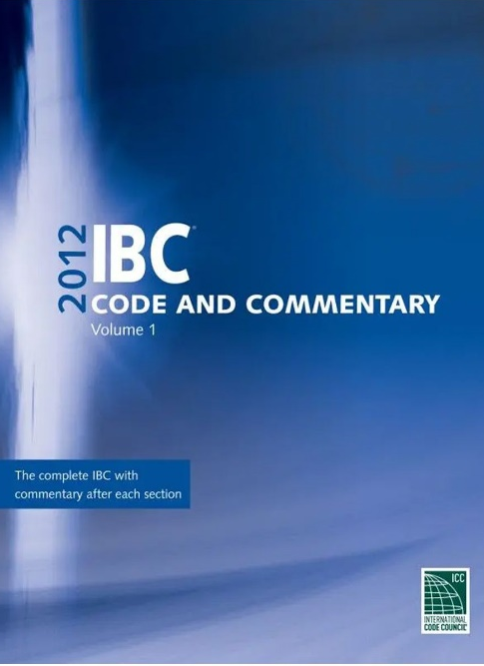
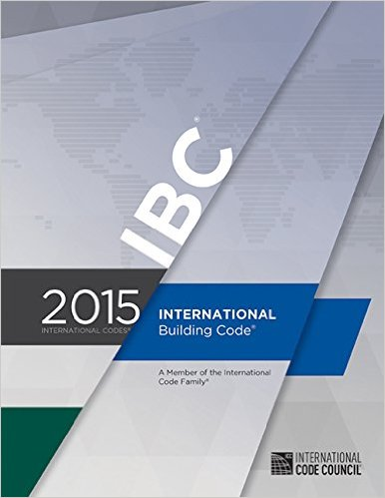
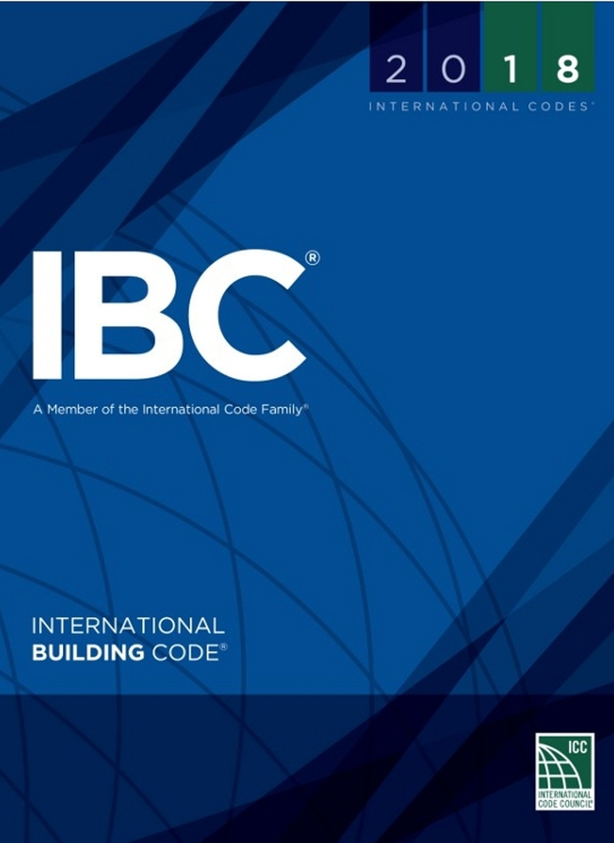
IBC
Notes:
The goal of the International Building Code is the protection of people, buildings, and continuous product development. Page 9 of the IBC specifically states that these codes are looked at on a 3-year cycle “to allow for new construction methods and technologies to be incorporated into the codes”. It also states on page 3 that the “code is intended to establish provisions that adequately protect public heath, safety, and welfare; that do not unnecessarily increase construction costs; that do not restrict the use of new materials, products, or methods of construction ; and that do not give preferential treatment to particular types or classes of materials, products, or methods of construction”.
So, when we cover integrated doors systems today, the goal is to provide solutions to safety without unnecessary increased costs.
The IBC 2018 is the most current International Building Code. Each state has either adopted their own building code or renditions of different years of the building codes combined. Canada’s building code is similar in their adaptation because it is based on per providence. These codes are standards, and it is up to each state to put these standards into their own building codes.
It is important to note that while the code books do continue to change, the general chapters across the books remain similar. If there are any questions, we are happy to help identify any requirements specific to your region.

Slide 5
History
“Those who don’t know history are doomed to repeat it”
346 Pages
Notes:
A little bit on the history of the International Building Code.
The famous saying is “those who don’t know history are doomed to repeat it”. They designate a specific book to what changes are made and why. Significant Changes to the International Building Code 2018 is 346 pages long. All of these changes and modifications are constructed for risk management based on past events. These past events are why we have fire rated doors, fire rated walls, protection at elevator shafts, stairwells, and cross corridor protection.
So, the 346 pages are full of additions, deletions, modifications, and clarifications.
An example is on page 182, and it says, “Because so many fire deaths occur as the result of occupants of residential buildings being asleep at the time of a fire, the IBC selectively requires that all basements and all sleeping rooms below the fourth story have windows or doors that may be used for emergency escape or rescue”.
The point is, as information and knowledge about fires evolves, the code evolves with it. The building codes are adapting to necessary change. Today in this course we will learn about history and trends, but we will also learn how to fix and prevent these issues.

Slide 6
Trends in Fires, Deaths, Injuries, and Dollars
In the United States:
1,291,500 fires in 2019
3,704 deaths in 2019
16,600 injuries in 2019
14.8 billion dollars lost in 2019
Every 24 seconds a fire department in the United States responds to a fire somewhere in the nation.
Occupants have less than 3 minutes to escape a fire
Structure fires account for 20% of fires, 49% of civilian deaths, 80% of civilian injuries, and 67% of property damage
Notes:
The following information on the screen is from the US Fire Administration www.usfa.fema.gov/data/statistics and National Fire Protection Association NFPA report - Fire in Industrial or Manufacturing Properties.
In the United States there were 1,291,500 fires in 2019, 3,704 deaths, 16,600 injuries.
The cost of that? 14.8 billion dollars.
The NFPA says that occupants have less than 3 minutes to escape a fire. NFPA also says, on average, it takes the fire department 4 to 4 and a half minutes to arrive on scene. The math does not add up well for building occupants.
So how can you do your part in protection of people and property?

Slide 7
Case Study – Twin Parks Northeast
17 people died
Self-closing doors malfunctioned
18,305 open violations in 10,610 buildings as of January 11, 2022
Notes:
Here is a case study of an apartment fire in Bronx, New York. 17 people died in early 2022 at the Twin Parks Northeast apartment complex. According to the New York post, the “Fire Commissioner singled out malfunctioning self-closing doors […] as a key reason smoke from the flames quicky engulfed much of the 19-story tower.” “Inspectors from the city’s Department of Housing Preservation and Development cited the tower six times between 2013 and 2019 for failing to keep all of the building’s self-closing doors in working order”.
They also went on to say that “The stairwell was very dangerous as the door was left open and some of the floors – certainly on 15 – the door was open from the stairs to the hall and the 15th floor became quite untenable”.
City repeatedly flagged busted fire doors before Bronx tower inferno (nypost.com)
Damaged Doors Posing Fire Risks Plague Thousands of Buildings Like Twin Parks - THE CITY Four years prior to this devastation, the Prospect Avenue fires took the lives of 13 people, including an infant. An open door fanned the flames in a blaze that consumed the apartment building.
If you are in New York this data may hit closer to home. 58 buildings in Queens had 100 open violations related to self-closing doors. A building in Brooklyn has 21 open violations. A Bronx building, 20 violations.
Overall, as of January 11, 2022, in New York, there were 18,305 open violations in 10,610 buildings. That’s scary.

Slide 8
What are Fire Rated Doors?
Resists fire and smoke migration
Tested by third party Independent Testing Laboratories
Fire doors are “rated” by time
Typically rated for ¾ of the rating of the surrounding wall
Notes:
So, what are fire doors and why do we talk about them? Well, the previous couple of slides are why we do these presentations. Fire and smoke doors must perform reliably and correctly.
Fire doors have one job and that is to save lives… they must be maintained in a constant state of preparedness.
Fire and smoke rated doors are for compartmentalization!
Fire rated doors are doors built to resist heat, fire, and smoke and are tested by third-party agencies and labeled to show they meet certain performance requirements. The function of these doors is to contain smoke and heat from building occupants, long enough to have them escape a burning building.
Rated doors are evaluated for their fire performance in accordance with the requirements of UL 10A, UL 10B, or UL 10C. These are all third party tested and you should ask for proof of these tests.
Fire doors are “rated” by the time that a door can withstand exposure to fire test conditions. This is either an A, B, C, or 20-minute label and the door is typically rated for ¾ of the surrounding wall.

Slide 9
What is an Integrated Door Assembly?
Combines door, frame, and hardware as a tested assembly under a single testing label
In 1975 the first integrated door assembly went on the market
Ideal for exits, cross corridor, stairwells, elevator shafts, elevator lobbies, and fire doors
Notes:
So, what is an integrated door assembly?
An integrated door assembly combines the door, hardware, and sometimes frame as a completely tested assembly. The hardware does not need to be labeled separately as the components of the system are all tested together under a single testing label. So, that means that in a conventional door or doors that are not considered integrated, you will need to have labels on each piece of hardware because it has not all been tested together.
The first integrated door assembly went on the market in 1975.
Integrated door assemblies are ideal for exits, cross corridor, stairwells, elevator lobbies, elevator shafts, and fire doors.

Slide 10
Quick Installation
CONVENTIONAL DOOR AND HARDWARE
INTEGRATED DOOR SYSTEM
Up to
10 manufacturers and
4
trades
Single Source responsibility 1
Manufacturer
1
Distributor
INSTALLS 4X FASTER THAN CONVENTIONAL DOORS AND HARDWARE
QUALITY EFFICIENCY PROFITABILITY AESTHETICS
Notes:
Integrated Door systems install 4 times faster than a conventional door.
So, you could get a door like the one on the left where you would put it together on the site and risk losing pieces or parts. You may even find that an installation warehouse is necessary for installation. There are unknown conditions in the field. You could be missing the proper tools or there could be inconsistent lighting.
Or you could get a door like the one on the right, complete and ready to go into the opening.
That means fewer trades are involved and fewer manufacturers. It will limit onsite conflicts with other trades. This will improve quality, efficiency, profitability, and performance. Labeled components does NOT mean rated assembly.
Single source responsibility gives reliability. That means without an Integrated Door System, you will lose time and money.
Which by the way, the door on the left, all those pieces and parts are only for one leaf.

Slide 11
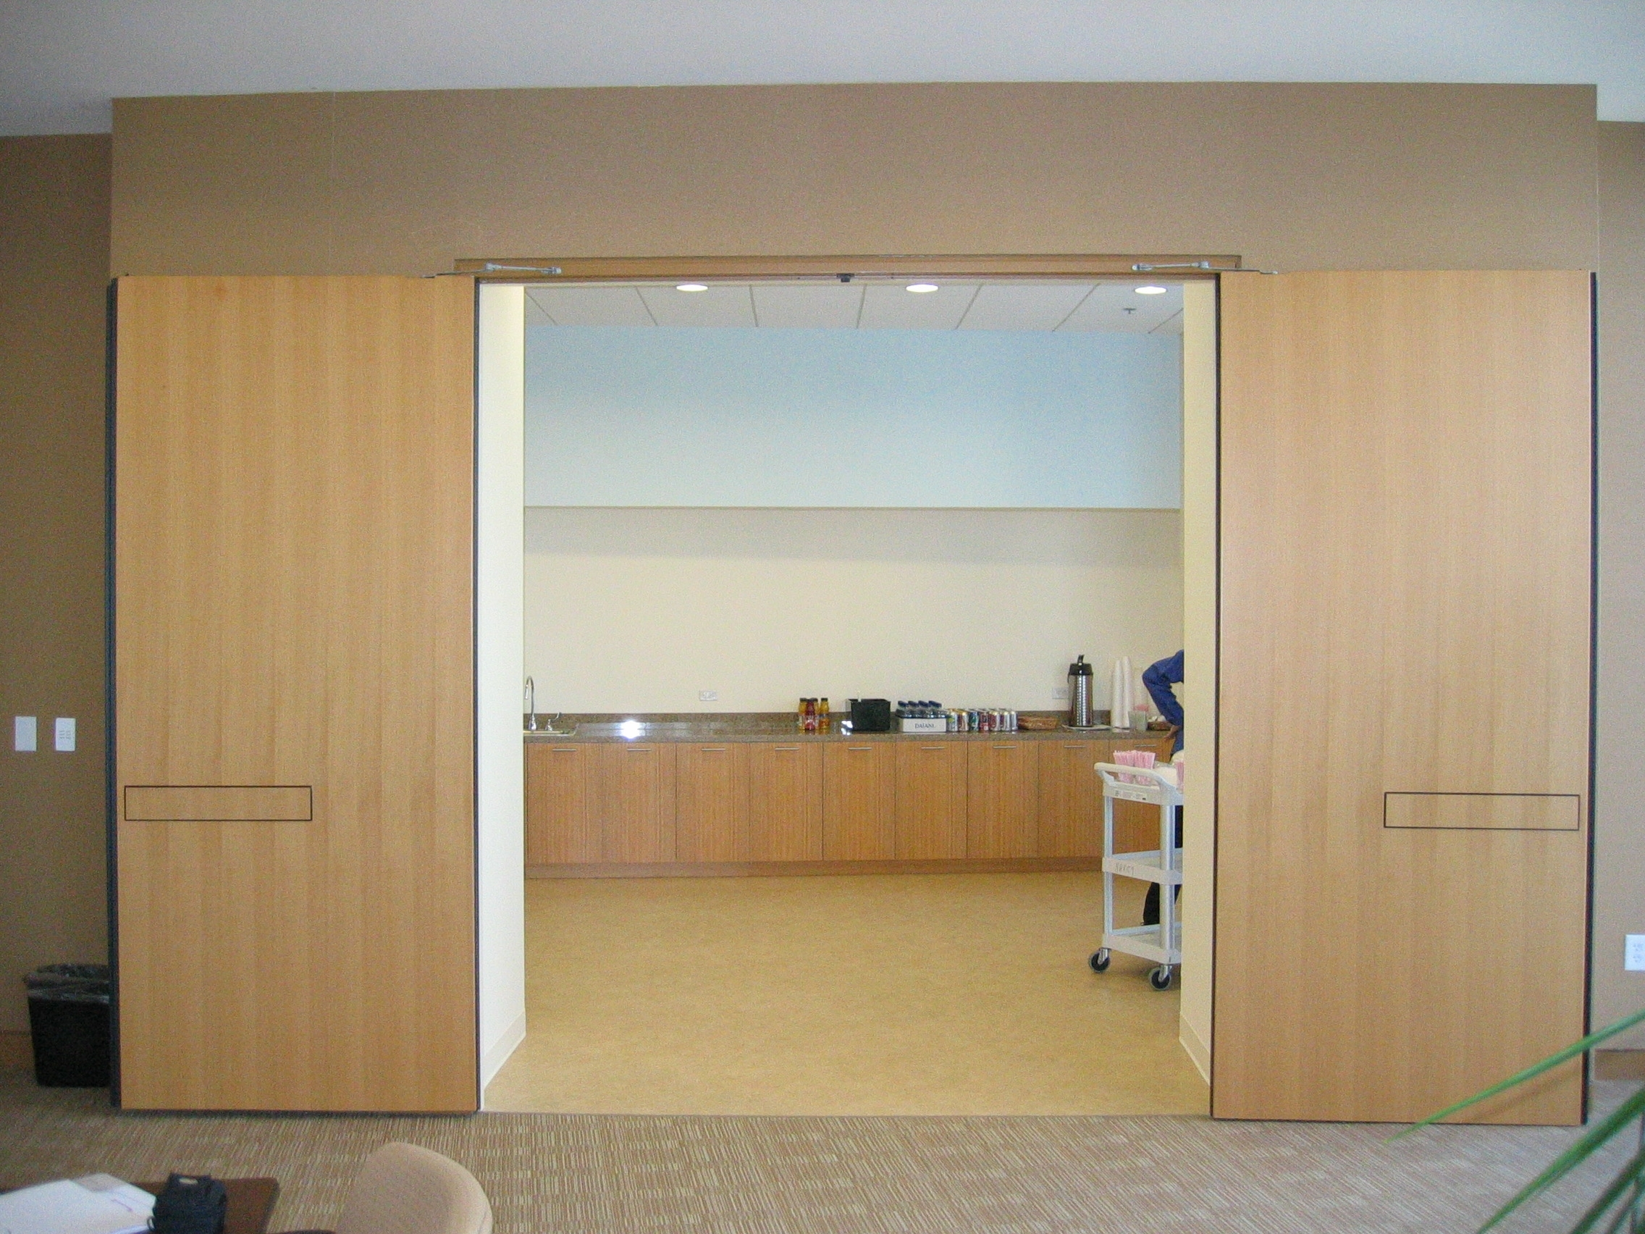
Number of Components
PARTS | STANDARD DOOR | INTEGRATED DOOR SYSTEM
Hinges | 42 | 19
Mortise locks | 75 | 28
Exit Device | 148 | 13
Kick Plates | 13 | 1
Total parts | 278 | 61
Relative % | 100% | 22%
Notes:
The number of components in an integrated door system compared to a conventional door is 22%. Down to every screw, an integrated door system will have 61 parts versus 278 parts for a conventional door and hardware. Because integrated door systems do not require all those parts, you are reducing potential maintenance time, installation time, and potential for something not to work.
Standard doors could require up to 10 manufacturers and 4 trades. This can blur the responsibility of proper installation and function. With one manufacturer for an integrated door system that provides all the materials and does the installation, the functioning is on them for the entire opening.
Integrated door systems are freed from the restrictions and limitations of other types of doors and hardware.

Slide 12
Cost Savings
Notes:
Conventional doors include pieces and parts that are not necessary to the system. You are paying for more than what you need and increasing the potential need for maintenance. Eliminating those extra parts brings you a cost savings and increases performance. Installation is typically included with a system, so make sure you ask about that. With time savings, comes cost savings.
In this quick video you will see the conventional door hardware that is eliminated and the refurbished look of an integrated door system.
CLICK
Let us watch as the bulky hardware is removed, the astragals, the coordinators, and the surface mounted closers. Then see a cleaner, streamlined look.
Do not pay for a fire door that comes with extra pieces and components but does not have all the necessary certifications. We are looking for complete code compliance.
Integrated door systems are tested to over 1 million cycles. And for traditional doors and hardware many of the components will not even come close to 1 million cycles.

Slide 13
Avoided Costs
Exit device Only (conventional door)
Savings per leaf
Mean time to failure – 7 ½ years “quality installation”
Exit device cost to owner = $750
Owner labor to replace exit device – 5 hours @ $75/hr. = $375
Total avoided maintenance costs = $1125
Reduced labor on door – 3 hours @ $75/hr. = $225
Material price differential – exit device only = $550
Initial material and installation labor savings = $775
Life cycle cost analysis: $1900 saved
Notes:
So, lets look at an example of avoided costs. We can talk about advantages of an integrated door system all day, but what does it mean if you do not use one?
On a conventional door, if only the exit device fails, which the mean time to failure is about 7 ½ years, then you are looking at the cost of the new exit device, let's say $750 dollars and the cost of labor, let’s say $375. Totaling, $1125 dollars.
You are looking at an almost guaranteed extra over $1000 spent on a door in a few years that could have been avoided with an integrated door system.
For an integrated door system, you are initially looking at reduced labor time. Plus, with less components comes costs savings, for a total life cycle cost analysis savings of $1900. Or the avoidance of paying part of that later.
Flush bolts and coordinators only have a life cycle count of 100,000. So, you are avoiding those maintenance costs as well.
There is a reason that doors and hardware are 2-3% of the projected cost of the entire project but also 20% of the entire maintenance costs. You have the ability to avoid that.

Slide 14
A Compliant System
UBC 7-2 – Uniform Building Code – replaced by UL10C
UL 10C – Positive Pressure Fire Tests as an assembly
UL 1784 – Standard for Air Leakage Tests of Door Assemblies and Other Opening Protectives
CAN/ULC S104 – Standard Methods of Fire Tests of Door Assemblies
NFPA 252 – Standard Methods of Fire Tests of Door Assemblies
Notes:
Integrated Door Systems are a completely compliant system. So, either the individual components are compliant, or the entire system is.
UBC 7-2 is in the uniform building code and one of the first codes to require positive pressure testing.
UL 10C is for positive pressure testing. This evaluates the ability of a door assembly to remain in an opening during a pre-determined test exposure.
UL 1784 is air leakage testing, as tested as a complete system.
CAN/ULC S104 is the Canadian standard for fire tests for door assemblies.
NFPA 252 outlines methods of fire testing door assemblies that manufacturers can use to determine the degree of fire protection.

Slide 15
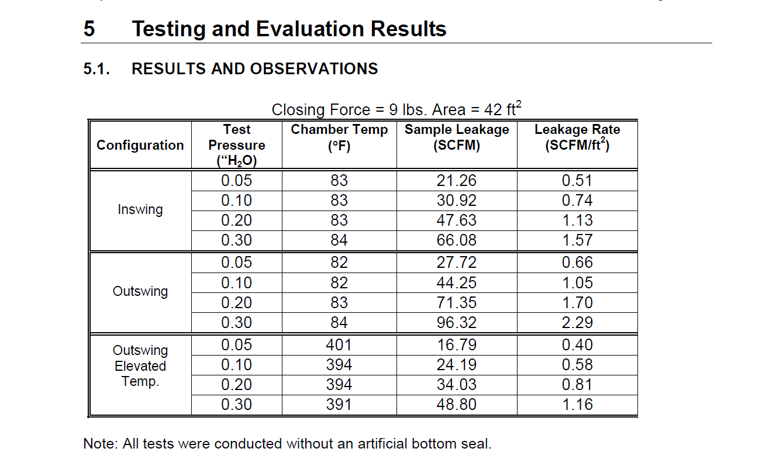
UL 1784
Notes:
UL 1784 is the standard for air leakage tests. Doors that are for an elevator lobby or in front of an elevator shaft are required to be tested to UL 1784 without an artificial bottom seal. Being tested without an artificial bottom seal means that the air leakage rate of the door assembly is tested. This is from 716.2.2.1.1. The air leakage rate should not exceed 3.0 cubic feet per minute per square foot of door opening at .10 inch of water for both the ambient temperature and elevated temperature tests.
You should ask for testing and evaluation results for UL 1784, and it will look something like what you see on the right side of the screen.

Slide 16
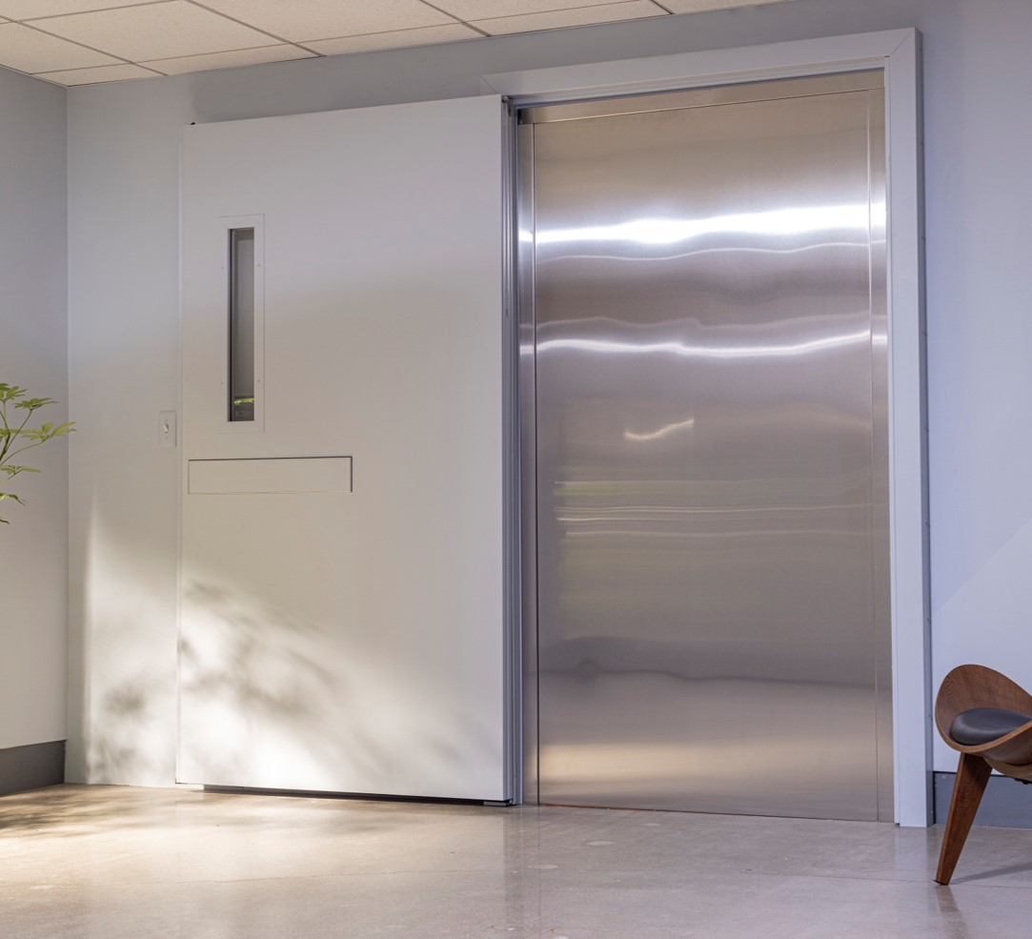
UL 1784
Standard for Air Leakage Tests of Door Assemblies
Without an artificial bottom seal
716.2.2.1.1 – Smoke and Draft Control
Air leakage rate of the door assembly
Notes:
UL 1784 physically tests for smoke and measures specifically how much smoke travels through the jambs and the header. In the past, fire labs would place an artificial bottom seal on the bottom of the doors where there was typically an undercut. The labs were only measuring how much smoke traveled through three sides of the door opening. And what was this artificial bottom seal? Well, it was a piece of duct tape on the bottom of the door. I don’t know about you, but a piece of duct tape is not found on a door in the field… so, the IBC recognizes that this does not reflect reality. This is one of the only places in the IBC where it actually tells you HOW you have to test and not just what you have to test to. Fire labs now must test all four sides of the opening without an artificial bottom seal. UL 1784 needs to be tested as a complete assembly with a bottom seal that is part of the system.
The components of the door must all be tested TOGETHER, and a conventional door sweep cannot be added later.
This is typical for doors protecting elevator shafts and lobbies in a building.

Slide 17
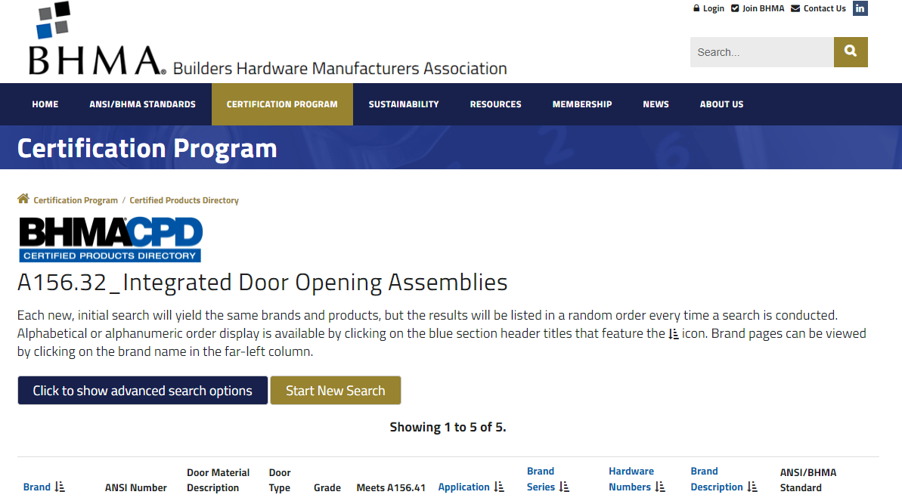
BHMA 156.32
Notes:
BHMA is the Builders Hardware Manufacturing Association. They set the standards for performance that specifically impact builders' hardware.
Standard 156.32 is for Integrated Door Opening Assemblies. You can visit the BHMA website and search any standard. All companies certified to that standard will be listed. Limited products are certified to BHMA 156.32 because it is extremely hard to pass. It can take months to successfully test and pass! There are twist, preload, impact, force tests, and more. These are very strenuous on the doors AND after all that, the doors must pass 1 million cycles. To be considered an integrated door system, you must test to this standard.

Slide 18
UL EPD
Environmental Product Declaration
Documents how a product, throughout its lifecycle, affects the environment.
Transparency and clarity.
Informed purchasing decisions.
Notes:
Environmental Product Declarations or UL EPDs documents how a product, throughout its life cycle, affects the environment. The goal is that architects and those buying the products can make informed decisions. This is replacing what used to be LEED, which I am sure most of you are familiar with. Sustainability is becoming more and more important. As buildings work to cause less stress to the environment, a UL EPD will break down all the materials that go into the door from start to finish. If your company can achieve this, then you are considered a leader in material health.
You could have one UL EPD for an entire integrated door system, or you could have, for example, 10 different UL EPD and LEED documents for every piece of hardware and component.
Environmental Product Declaration (EPDs) | UL

Slide 19
HPD
Notes:
Health Product Declaration Collaborative - Welcome - HPD Collaborative (hpd-collaborative.org)
Over 700 manufacturers have a HPD or health product declaration. The goal is to provide material transparency. The HPD will compare product contents to associated health information. And while 700 manufactures seems like a lot, there are still many more to go. If a company has this, they will have a certification of proof that they can supply.
So, do you want one document for an entire system, or a bunch of documents? And who is going to maintain all of the documents you have?
This is part of the time savings that will come with an Integrated Door System.

Slide 20
Red List Items
Version 3.1 of the Living Building Challenge Red List
816 items
Notes:
There are 816 items on the red list. If your project has no red list items, then your building is considered “living building status”. This list was created to protect occupant health. Companies that do not contain these red listed items will be aware and able to confirm. Examples that are well known on this list include mercury and lead. There are typically alternatives to the listed items, so the goal is to encourage manufacturers to look into those alternatives.
Product and Building Materials Red List - Green Building Alliance (go-gba.org)

Slide 21
Paper and More Paper
Notes:
Time is money. Collecting documents, waiting for responses, finding out that it doesn’t meet your expectations. That all costs money.
A single source for certifications and testing will save you that time. And the time it would take to maintain it. Integrated Door Systems are deigned to make every aspect of the project easier.

Slide 22
Smoke and Draft Control
Section 716 Opening Protectives
716.2.1.4 Smoke and Draft Control
“Fire door assemblies that serve as smoke and draft control door assemblies shall be tested in accordance with UL 1784.”
716.2.9.1 Fire Door Labeling Requirements
“Fire doors shall be labeled showing the name of the manufacturer or other identification readily traceable back to the manufacturer, the name or trademark of the third-party inspection agency, the fire protection rating, and […] the maximum transmitted temperature end point” if necessary.
Notes:
Integrated door assemblies are smoke and draft control doors.
What are smoke and draft control doors?
Those doors must be tested in accordance with UL 1784 as a complete system. This is where the measurement for the air leakage rate comes in again. We drive the importance of that code in this presentation because without the proper protection, lives are at stake. These doors must also be labeled with the letter “S” indicating the smoke rating.
Smoke and draft control doors are required in corridors and smoke barrier walls. So, when required, smoke and draft control doors must ultimately be tested as an assembly or complete system and not as separate components.

Slide 23
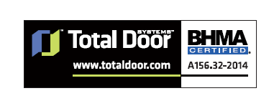
Door Labeling
Fire labels
BHMA performance label
Fire tested doors labeled with the appropriate test results (IBC 2012 & 2015 716.5.7)
Show name of manufacturer
Name of trademark of third-party inspection agency
The fire protection rating and, where required, the maximum transmitted temperature end point. (IBC 2012 & 2015 716.5.1)
Name
Manufacturer
Standard & Year
Doors located in fire service elevator access lobbies MUST be tested in accordance with UL1784 without an artificial bottom seal tested as an assembly
Notes:
Section 716 covers labeled protective assemblies. Fire door assemblies shall be labeled by an APPROVED agency. The labels shall comply with NFPA 80 and shall be permanently affixed to the door or frame. This will make it simple for code officials and fire marshals when inspecting.
Further, fire doors shall be labeled showing the name of the manufacturer or other identification readily traceable back to the manufacturer, the name or trademark of the third-party inspection agency, and the fire protection rating. Smoke and draft control doors complying with UL 1784 shall be labeled as such. Labels shall be approved and permanently affixed. Lastly, the label shall be applied at the factory.

Slide 24
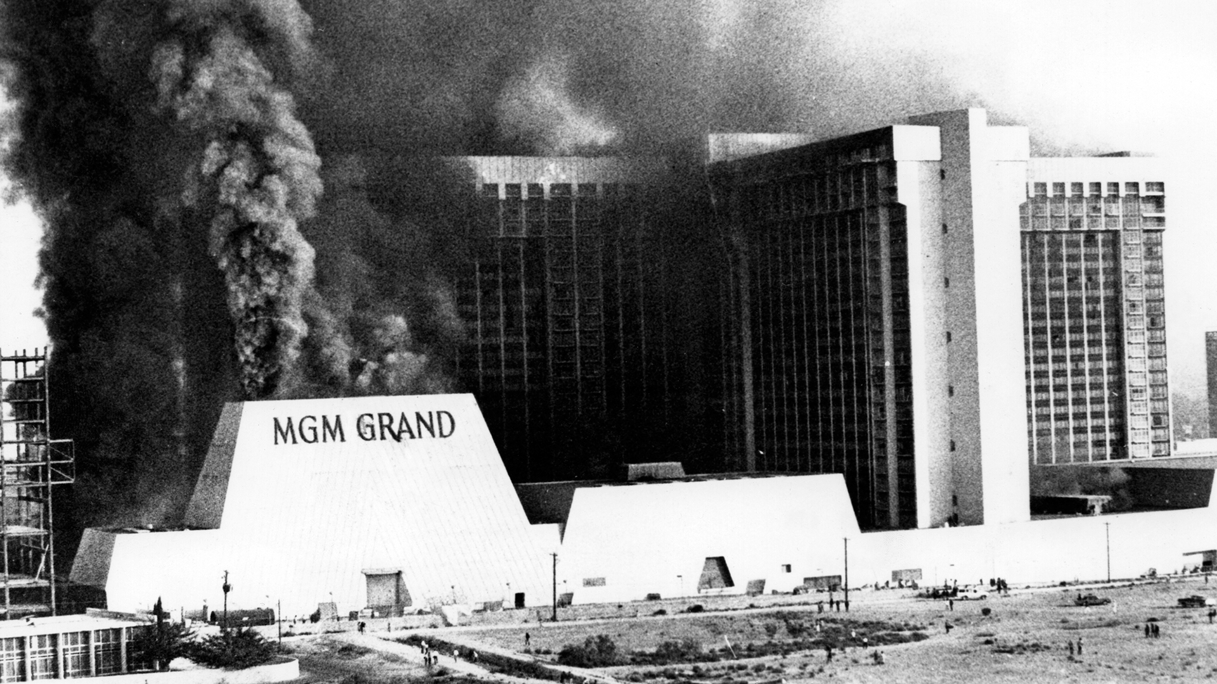
Assessing Risk
Measurability
Developing recommendations
Conducting risk assessments based on data
Smoke accounts for 76% of damage and injuries
Notes:
Protection at openings is about assessing risk and protecting people.
Metrics and measurability are used to forecast potential threats and the associated impacts. This is all based on data. Smoke accounts for 76% of damage and injuries.
On a well-known insurance company’s website​, we found information for managing risk for general liabilities.
It said, for example, “A manufacturer of power meat slicers is sued alleging that the safety guard on the slicer failed to perform, resulting in partial amputation of a right thumb and finger. The manufacturer is found liable. General Liability would respond to the $250,000 loss.” (Chubb Insurance)
If the loss of two fingers is up to $250,000, then the cost of a lost life would be substantially higher.
So, what would a building that failed to provide safety according to code at the elevator shaft cost you? And what would it cost the people inside the building?
The MGM Grand fire in 1980 in Nevada took the lives of 85 people. What's the cost of that?
When you know the code, you know how to protect people and property.
It is up to you, as an architect, as a spec writer, to specify the proper protection. It starts with you. If its missed, it may not be caught later and will result in a non-safe space.

Slide 25
Cost of Non-Compliance
January 2020- A small electrical fire on the 5th floor fills the building with smoke. The entire building is evacuated.
Smoke damage cost as much as $7.5 million.
Tenant loss and fines cost several million more.
Notes:
The Penobscot Building in Detroit, MI is the perfect example of absence of elevator shaft smoke protection in the event of a fire. In January of 2020, there was a fire that started on the fifth floor as an electrical fire. Witnesses said they saw the smoke all the way above the 40th floor by the time the fire department got there. The following quote is from Click on Detroit: “There was smoke billowing out of the freight elevator, but we don’t know how far it spread. There was smoke on every floor.” After the fire, many of the building’s tenants moved out, which is more revenue lost. The building owner is now facing fines for not being compliant or safe (for many reasons). This could have been avoided with proper protection at the elevator shafts.
The average smoke damage cost is over $7 dollars per square foot, based on our research. The Penobscot building is 996,000 sf. That would make the estimated cost of repairs over 7 million dollars… more than what the owner bought the building for.

Slide 26
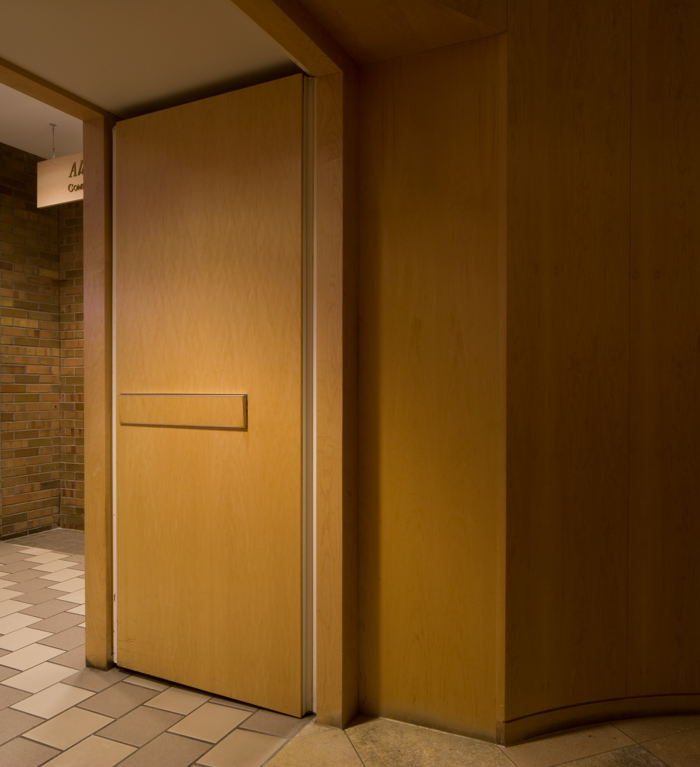
Fire Rated Door Locations
Fire partitions, smoke partitions, smoke barriers, fire walls, exit enclosures, exit passageways, horizontal exits, and means of egress doors.
Corridors
Cross Corridors
Stairway Doors
Area of Refuge
Elevator Lobby
Elevator Shaft
Security Applications
Mechanical Rooms
Between Adjacent Buildings
Classrooms
Offices
Psychiatric Applications
Trash/Laundry Chutes
Notes:
Now that we have established why we need to know code and what to use to protect people and buildings, we can look at where to use these integrated door systems.
Fire and smoke rated doors are required for openings in fire partitions, smoke partitions, smoke barriers, fire walls, exit enclosures, exit passageways, horizontal exits, and means of egress doors.
The slide shows locations where fire and smoke rated swinging doors may be required.
So, knowing the occupancy levels, egress plans, and wall ratings will help identify when integrated door systems are needed.

Slide 27
Applications
Elevator Lobby
3006.2 – Hoistway Opening Protection
3006.2.1
Supersedes 3006.2
Rated corridors need protection
Hospitals
Residential
High-rise
Rated Corridors
Government
Schools
Notes:
Now that we have talked about fire door locations, we can talk about applications. Elevator lobbies are an application for fire and smoke rated doors.
Doors creating elevator lobbies are required be tested to UL 1784 without an artificial bottom seal. This again, is that vertical protection focusing on the air that is able to leak through the opening.
Section 3006.2 covers hoistway opening protection.
Elevator lobbies can be found in many buildings and need some sort of protection from smoke for compartmentalization.
And Section 3006.2.1 covers the need for protection in a rated corridor regardless of the number of floors. 3006.2.1 will supersede any of the provisions or exemptions from 3006.2. That means, and this is a huge code, that if the elevator is on a rated corridor, regardless of the number of floors, that elevator needs protection.

Slide 28
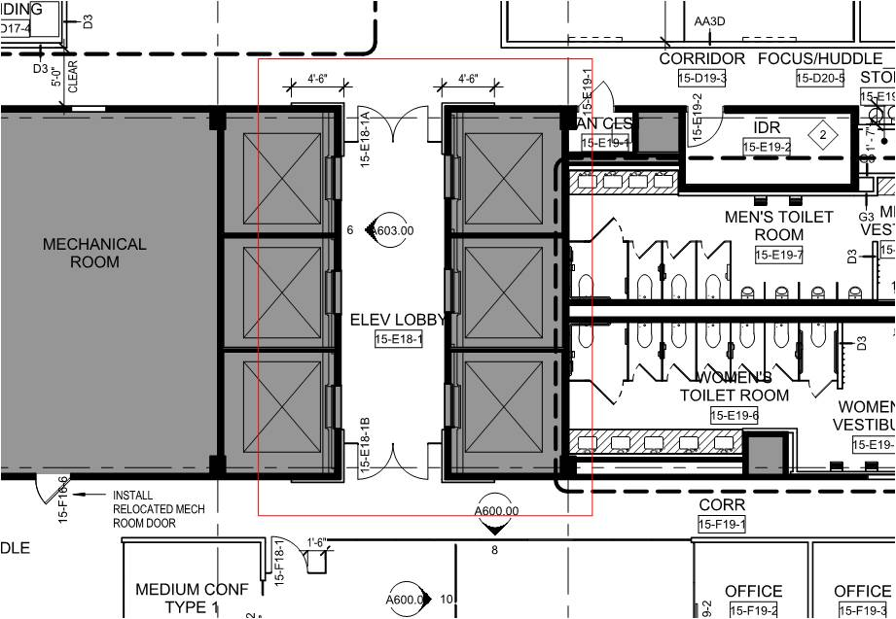
Elevator Lobby
Notes:
On the screen, there are two elevators and a pair of same swing doors that are creating a lobby space for compartmentalization. These lobby doors when tested to UL 1784 without an artificial bottom seal, meaning that all the components of the door must be tested together, and not as separate components brought together are compliant. This lobby would then comply with code.

Slide 29
Applications
Elevator Shaft
Hospitals
Residential
High-rise
Rated Corridors
Government
Schools
Notes:
Additional doors at the elevator shaft are another way to provide compartmentalization for elevators.
The additional doors at the elevator shaft must be “tested in accordance with UL 1784 without an artificial bottom seal”.
If you do not have space to build an elevator lobby, this is a great alternative. The additional integrated door system can easily mount around the elevator shaft and will close in the event of a fire.

Slide 30
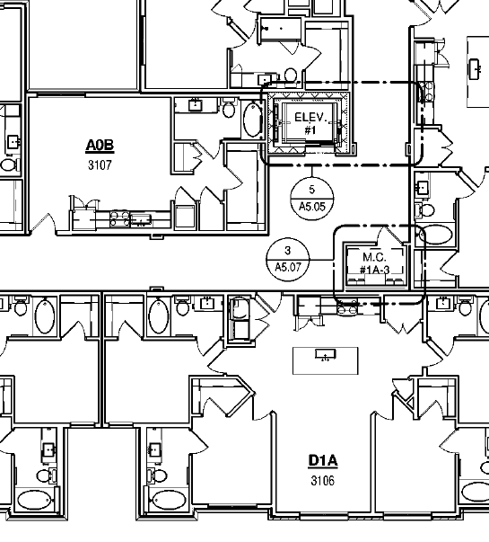
Elevator Shaft
Notes:
This elevator shaft on the screen would need protection because it is opening into a rated corridor across from sleeping units. In order to build a lobby, they would have to build walls around the elevator, which would be an added cost. A simple fix would be to put a rated assembly right at the elevator shaft. No lobby build out would be required and the building would still be up to code.

Slide 31
Smoke Containment Comparison
With smoke protection
Without smoke protection
Notes:
CLICK With smoke protection, the door system closes, containing the smoke inside the elevator shaft. The door system is triggered by the smoke alarm and closes and latches on its own. CLICK Without smoke protection, it will take just seconds to have very little visibility. Those are precious seconds assuming you already heard the smoke alarm. Assuming you already knew there was a fire. Assuming you were ready to escape. So, if you were mere seconds too late, without smoke containment you wouldn’t be able to see at all. With proper protection, you can see the exit signs and escape safely. ​

Slide 32
Applications
stairwell
Residential
High-rise
Schools
Hospitals
Government
909.20.3.2 – “door assembly” complying with section 716
403.5.4 – interior exit stairways shall be smokeproof
405.7.2 – required stairways shall be smokeproof
Notes:
You may find smoke and fire doors in stairwells.
The difference between specifying doors that are tested to UL 1784 without an artificial bottom seal and not specifying tested doors is the opening is either protected OR it becomes a chimney.
Section 909.20.3.2 states that “where access to the stairway or ramp is by way of a vestibule, the door assembly into the vestibule shall be a fire door assembly complying with Section 716.” It is important to note that in 716, the IBC calls out an assembly door for smoke and draft control for air leakage rates.
Section 403.5.4 says that Every interior exit stairway serving floors more than 75 feet above the lowest level of fire department vehicle access shall be a smokeproof enclosure. So, smoke protection is needed in this case.
Section 405.7.2 says that Every required stairway serving floor levels more than 30 feet below the finished floor of its level of exit discharge shall be a smokeproof enclosure. This also indicates that smoke protection is needed.

Slide 33
Stairwell
Notes:
In the past, many doors in interior exit stairways and exit passageways were temperature rise cores. While this is still a requirement, according to IBC section 716.2.2.3, the exception is that it is not required in buildings equipped with an automatic sprinkler system. We have certainly seen the need for temperature rise cores diminish as most buildings are sprinklered.
A stairwell is a vertical penetration spot in a building just like an elevator and therefore needs to be protected. In the picture you can see a stairwell that requires smoke and fire protection and is a means of egress.
This stairwell is a protected means of egress OR they become a chimney. You decide.

Slide 34
Applications
Cross corridor
Hospitals
Multi-Family
Museums
Schools
Compartmentalization of building sections
510.2 – Horizontal Building Separation Allowance
Notes:
The purpose of cross corridor doors is to compartmentalize areas of a building. The last thing you would want is to route someone into another smokey area. If there is no way to get out of the building, there needs to be a way to compartmentalize the area that is burning from a safe space. These cannot be just fire doors. If they were, you may not burn, but you would inhale all the smoke. You may see these doors in hospitals, schools, museums, or multi-family.
510.2 goes into horizontal building separation allowance. The area, building height, and occupancy classification will all come into play when determining where horizontal separation with assemblies is required.

Slide 35
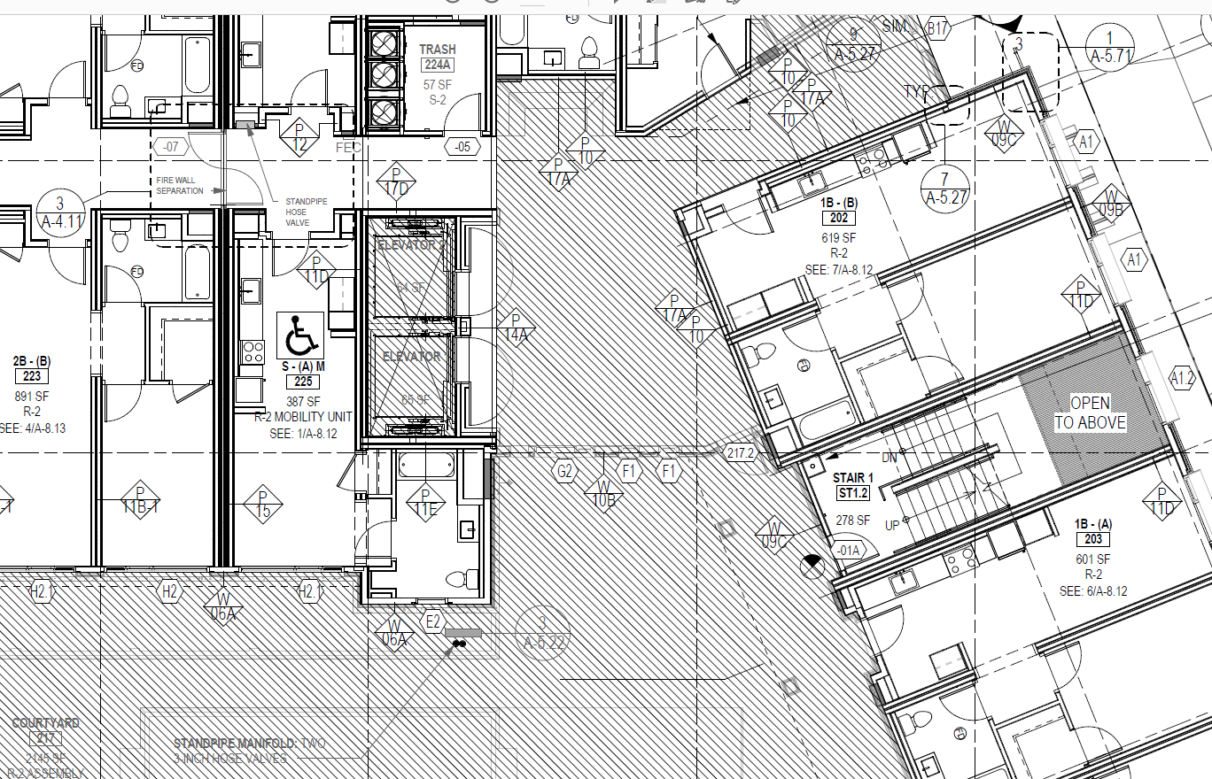
Cross Corridor
1009.6.4 – areas of refuge must be designed to limit smoke
Notes:
In the picture on the screen is a cross corridor double egress separation.
They needed both directions of travel to be available which is why the doors are swinging in opposite directions. The doors are separating two different occupancies in the building. They are pocketed into the wall and designed to be held open most of the time and out of the way.
Without these smoke and draft control doors, if there were smoke in one area, the smoke would easily travel through the opening and into the “safe area”.
In 1009.6.4 for separation, if someone cannot use a stairwell, they need an area of refuge that MUST be designed to minimize intrusion of smoke.

Slide 36
Vertical Markets
Healthcare
NFPA report - Fires in health care facilities
From 2011-2015, there were annually 5,750 fires in health care facilities
50.4 billion in property damage annually
Notes:
Now that we have gone through applications for integrated door systems, we can go through vertical markets.
With cross corridor doors and protection of elevator shafts and stairwells, we can compartmentalize the smoke migration. We mentioned earlier that smoke accounts for 76% of damage. Fires like this are costly and, in some cases, deadly. That is why protection is imperative.
In healthcare facilities, integrated door systems are a great fit for cross-corridor applications. Healthcare needs up to a clear 8’ opening, which can be achieved with pocketing and low-profile hardware. People are sleeping in hospitals and nursing homes, so protection of sections of the building could save many lives.

Slide 37
Vertical Markets
HIGH-RISE
NFPA report - High-rise building fires
From 2009-2013, there were 14,500 fires annually in high rise buildings
154 million in property damage annually
This is apartments, multi-family, hotels, dorms, office buildings, building for the sick
Notes:
High-rise buildings are of course subject to many more fires. They are typically multi-use and have multiple vertical openings, like elevator shafts and stairwells.
While high-rise buildings need compartmentalization, it is important to note that buildings less than 75 feet above ground level also need protection at times. We talked earlier about how people in sleeping units were dying and injured because they were asleep at the time of the fire… that is why there are extra provisions to the code where people are sleeping.

Slide 38
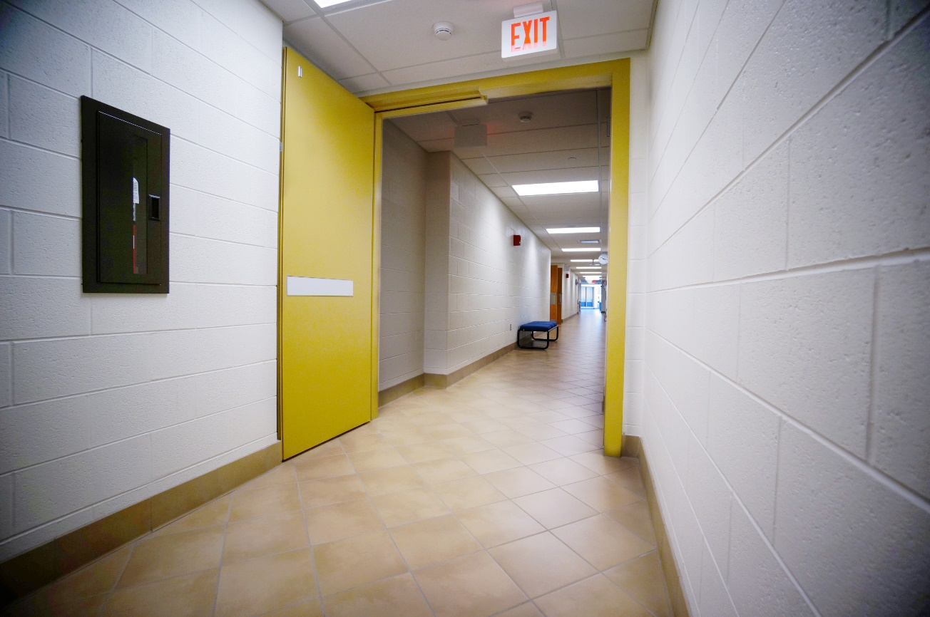
Vertical Markets
EDUCATION
NFPA's fire statistics for structure fire in schools
From 2014 – 2018 there were over 3,230 structure fires in schools every year
$37 million in property damage
Notes:
Most school fires occur between 8am and 4pm… when the students and staff are there.
Often, means of egress doors and stairwell doors are required in schools for protection.
There is hardware that is made for high-traffic and abuse situations. Students are always running and kicking doors. If they are held open, unless triggered by the smoke alarm, they will take less abuse.

Slide 39
Vertical Markets
Apartments/condos
NFPA statistics - Deadliest fires in apartment buildings
3006.2.1
Notes:
There will be people sleeping in apartments and condos. That means that the corridors are rated and will need elevator and stairwell protection. This comes back to 3006.2.1. That rated corridors will need protection at the elevator shaft. In apartments and condos, elevator shaft protection will be required even for buildings that are less than 75 feet high.
NFPA has a list of deadliest apartment building fires dating back to 1978. There is a fire from December 2017 that made the list, and I am sure that the latest Bronx fire in 2022 will as well. Code compliance is still being overlooked. Fires and smoke are still a threat without proper protection of an integrated door assembly.

Slide 40
Vertical Markets
Government/office
U.S. Structure Fires in Office Properties | NFPA
3,340 fires per year from 2007-2011
Annual average of 4 deaths and 44 injuries
Notes:
Government and office buildings also need stairwell protection. The idea is to have compartmentalization of smoke. Preparedness will save lives.

Slide 41
Vertical Markets
Hotels/hospitality
NFPA report - Hotel and Motel Structure Fires
3,520 structure fires in hotels and motels each year
9 civilian deaths, 120 injuries, $84 million in property damage
Notes:
Fires in hotels result annually in 9 deaths. While 9 deaths is not a high number in comparison to the population of the U.S., it is too high. One death is too high. That is why integrated doors systems can create spaces in a building that are safe from smoke and fire. And you can be sure about it.

Slide 42
Fire Door Options
Double Egress
Single
Same Swing Pairs
Notes:
In the openings we discussed previously, you may find single, double egress, or same swing paired doors. There are many options for how integrated door systems can go into these openings, so there is no excuse not to be safe and compliant. These door systems have varying degrees of swing and custom sizes to fit any opening.

Slide 43
Vision Lites
Resistance versus protection (716.2)
Included in an integrated door system
Notes:
Now we will talk about vision lites or lite kits. 716.2 covers fire resistance and fire protection guidelines for lite kits.
Vision and lite kits are included in integrated door systems as a part of the package. You are receiving everything you need for a code compliant opening with the 1 system.
According to ASME A 17.1, vision lites are required in the 1st quarter opening for doors in front of elevator hoistways so first responders can visually see.

Slide 44
Integrated Hardware
Low profile hardware maximizes clear opening width
Reduces damage
Reduces maintenance
Notes:
Hardware on integrated door systems allows for greater innovation. Since the hardware is designed and built with the door, it allows for low profile hardware. This maximizes the clear opening width and reduces possible damage. Less damages means less maintenance. The low-profile hardware is built into the door for maximum hide ability.
The hardware had been designed to work with that door system to maximize performance, so you cannot put the hardware on another door.
With a true integrated door system, their hardware has been designed so there is no templating, or prep required. So, say no more to filling out pages of templates and coordinating any prep for frames.

Slide 45
Finishes
Notes:
There are many finish options for integrated door systems. Integrated door systems are tested as a complete system so we know the rating will hold up on those doors no matter the finish. The idea is that the integrated fire door system will hold up in the event of a fire for the allotted time that it was tested to. The door system itself will still maintain the rating. CLICK That means that a multitude of finishes are available from paint to architectural film to wood veneer and more.
Now, you cannot slap any finish on a rated door. The method of application will also matter. These finishes are not to be field applied other than painting.
In order to put custom finishes on an integrated door, the company must be certified to do so in their factory by an approved testing agency. A certificate of compliance, for example, would state that a company has approval from a testing agency to do so.

Slide 46
Specifications for Integrated Door Systems
References
BHMA 156.32
UL 10C
NFPA 252
UL 1784 without an artificial bottom seal
Notes:
Integrated Door Systems specifications will be specific to doors being tested as a system.
Integrated Door Assemblies need to be written in their own CSI stand alone section, not as a part of general doors and hardware. They will be in section 081713 (eighty-one-seven-thirteen) for Integrated Door Assemblies and will be different in scope from standard hollow metal doors and hardware.
In the system requirements it should name BHMA 156.32, UL 10C for positive pressure, NFPA 252, and UL 1784 without an artificial bottom seal. Look for those system references to know the product is a true integrated door system. Products that are not a true integrated door system will not meet these requirements.
These references should be required in submittals.

Slide 47
Specifications for Integrated Door Systems
Integrated door system
Conventional door and hardware
Submittals
Submit UL EPD
Submit BHMA 156.32 certification
Certificate of Compliance
Submit copies of schedule in accordance with Division 1, general requirements.
Submit manufacturer’s product data
Submit shop drawings
Submittals
Submit copies of schedule in accordance with Division 1, general requirements.
Submit manufacturer’s product data
Submit shop drawings
Submit UL EPD
Submit BHMA 156.32 certification
Certificate of Compliance
Notes:
Once you identify the system references, there will be a section asking for submittals of the UL EPD, BHMA 156.32, and a certificate of compliance. Receiving these submittals will ensure that you are paying for a product that has the certifications necessary. Manufacturers that have the certifications will not hesitate to give them to you. BHMA 156.32, the UL EPD, and the certificate of compliance are required in specification submittals. You can always ask for more certifications as well, such as an HPD or UL 1784 without an artificial bottom seal certification. Do you really want to take the risk of not specifying code compliant and certified doors and hardware? And at what cost?
Conventional Doors do not require the performance certifications.

Slide 48
Specifications for Integrated Door Systems
Materials
Integrated Door Assembly
All components tested together as a complete assembly
Gasketing included and certified
Notes:
In order to be considered an integrated door system, all components must be tested together and not as separate components. The gasketing is included as well. Under the materials section, you would not find that the hardware and door are listed separately, you would find it states integrated door system and the hardware set would be located at the end of the specifications.
Under CSI division 8 there are different divisions for hardware, doors, and glazing, and integrated door systems is its own section that encompasses them all.

Slide 49
Specifications for Integrated Door Systems
Installation
Hang to maintain tolerances
Adjust for the doors to swing freely
Single source
Notes:
Installation of integrated door systems must conform to manufacturers published requirements. Installation is provided by factory certified installers to ensure performance and warranty. The integrated doors will need to maintain all tolerances, so they swing freely and properly. Best in class manufacturers will be able to provide the specifications and tolerances to you and will provide installer training to assure doors are properly aligned and fully operational.

Slide 50
Summary
Integrated Door Systems and their advantages
Money savings, less coordination
Simple specifications
Complete compliance and certified
Applications and Vertical Markets
Certifications
Case Studies that showed how important it is to talk about proper protection
Notes:
We want to provide safety in every building, for every person, every time. Integrated door systems ensure code compliance and performance. The responsibility for proper protection starts with design and specifications. And what better way to achieve that then with a single source?!
There is a cost savings from the beginning of the project to the end with integrated door systems. Sustainability is in their blood. You should expect more from a product that provides life safety. Preventing the migration of smoke and fire is imperative in all buildings and we have the source and ability to achieve that.

Slide 51
Integrated Fire and Smoke Door Systems: Specifying Your Own Safety Net
Questions? This concludes The American Institute of Architects Continuing Education Systems Course
248-623-6899
Notes:
This concludes the AIA portion of the presentation. Thank you so much for your time and attention today. If you have any questions, please feel free to ask them now and if I do not know the answer, I will happily find it for you.

