Slide 1
Installation Training Seminar

Slide 2
Test Your Awareness
First read the sentence enclosed in the box below
FINISHED FILES ARE THE RE- SULT OF YEARS OF SCIENTIF- IC STUDY COMBINED WITH THE EXPERIENCE OF MANY YEARS.
Now count the F’s in the sentence. Count them only once and do not go back and count them again.

Slide 3
Frames

Slide 4
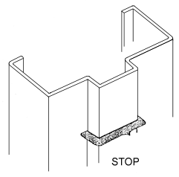
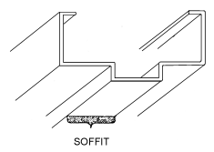
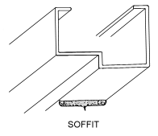
Frames
Stop
The “stop” is the part of the frame against which the door closes and gets its name from wood frames which often utilized an applied strip to stop the door from swinging throughout the opening. In a steel frame, this is an integrally formed part of the frame.
Soffit
The “soffit” is the underside surface of the stop on the head. When using the word “soffit” in conjunction with hollow metal, reference is made to the head member only.

Slide 5
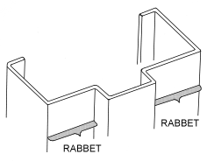
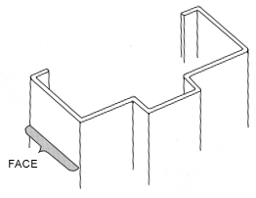
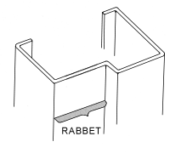
Frames
Rabbet
The “rabbet” is the part of the frame that is recessed to receive the door. The rabbet dimension will vary according to the thickness of the door used with the frame. Ceco produces double rabbet frames that are formed so one rabbet can be prepared to a 1-3/4” thick door of the opposite rabbet prepared to a 1-3/8” thick door. Small jamb depths are available as single rabbet frames and formed so the rabbet dimension will be correct for the door thickness to be used.
Double Rabbet Frame
Face
The “face” is the surface of the frame parallel to the face of the wall and is normally considered the trim.
Single Rabbet Frame

Slide 6
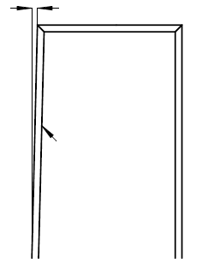
Frames
Out of Square
Out of Square
1/16”
1/16”
Latch Jamb
Latch Jamb
1/16”
Hinge Jamb
Hinge Jamb
Frame Opening Tolerance
Jamb Opening Height +1/16” to -1/32” overall
This measurement is set by the Door & Hardware Industry.
*It the frames are out more than this, you should ask to have them fixed before installing Total Doors.
Jamb Opening Width +1/16” to -1/32” overall
Notes:
Test Question: If a frame measures 3/16” +/-, what would be the proper way to check which leg is out? Use a Plumb Bob or level.

Slide 7
Frames
Frame measurements are crucial when determining what door size to order. *Field measurement of frames is crucial
What size door should you order?
Notes:
What size door should be ordered? Smaller dimension on width and height. 35-3/4” x 83-1/2” then specify undercut.

Slide 8
Door Handing

Slide 9
Door Handing
Doors swing in different directions and the way in which a door swings is called the “hand” of the door.
To determine the hand and swing of a door, view the door from the outside or keyed side. The side the hinges are on is the hand of the door.
Viewed from outside
Left Hand
(LH)
Right Hand
(RH)
Left Hand Reverse
(LHR)
Right Hand Reverse (RHR)
If the door swings away from the viewer, the hand is a regular hand, i.e., left hand (LH) or right hand (RH).
*Doors with exit devices are always reverse hand.
If the door swings towards the viewer, the door is reverse swing, i.e., left hand reverse (LHR) or right hand reverse swing (RHR).

Slide 10
Door Handing
Normally the outside of a door is the side from which it may be opened by a key – or the “key side”. The hardware, therefore, effects the hand of the door. To visualize this, examine the layout below of a possible door arrangement from a corridor to four separate offices. The corridor would be the outside because it is the key side.
Right Hand (RH)
Left Hand (LH)
Corridor
Right Hand Reverse (RHR)
Left Hand Reverse (LHR)

Slide 11
Hinge Side

Slide 12
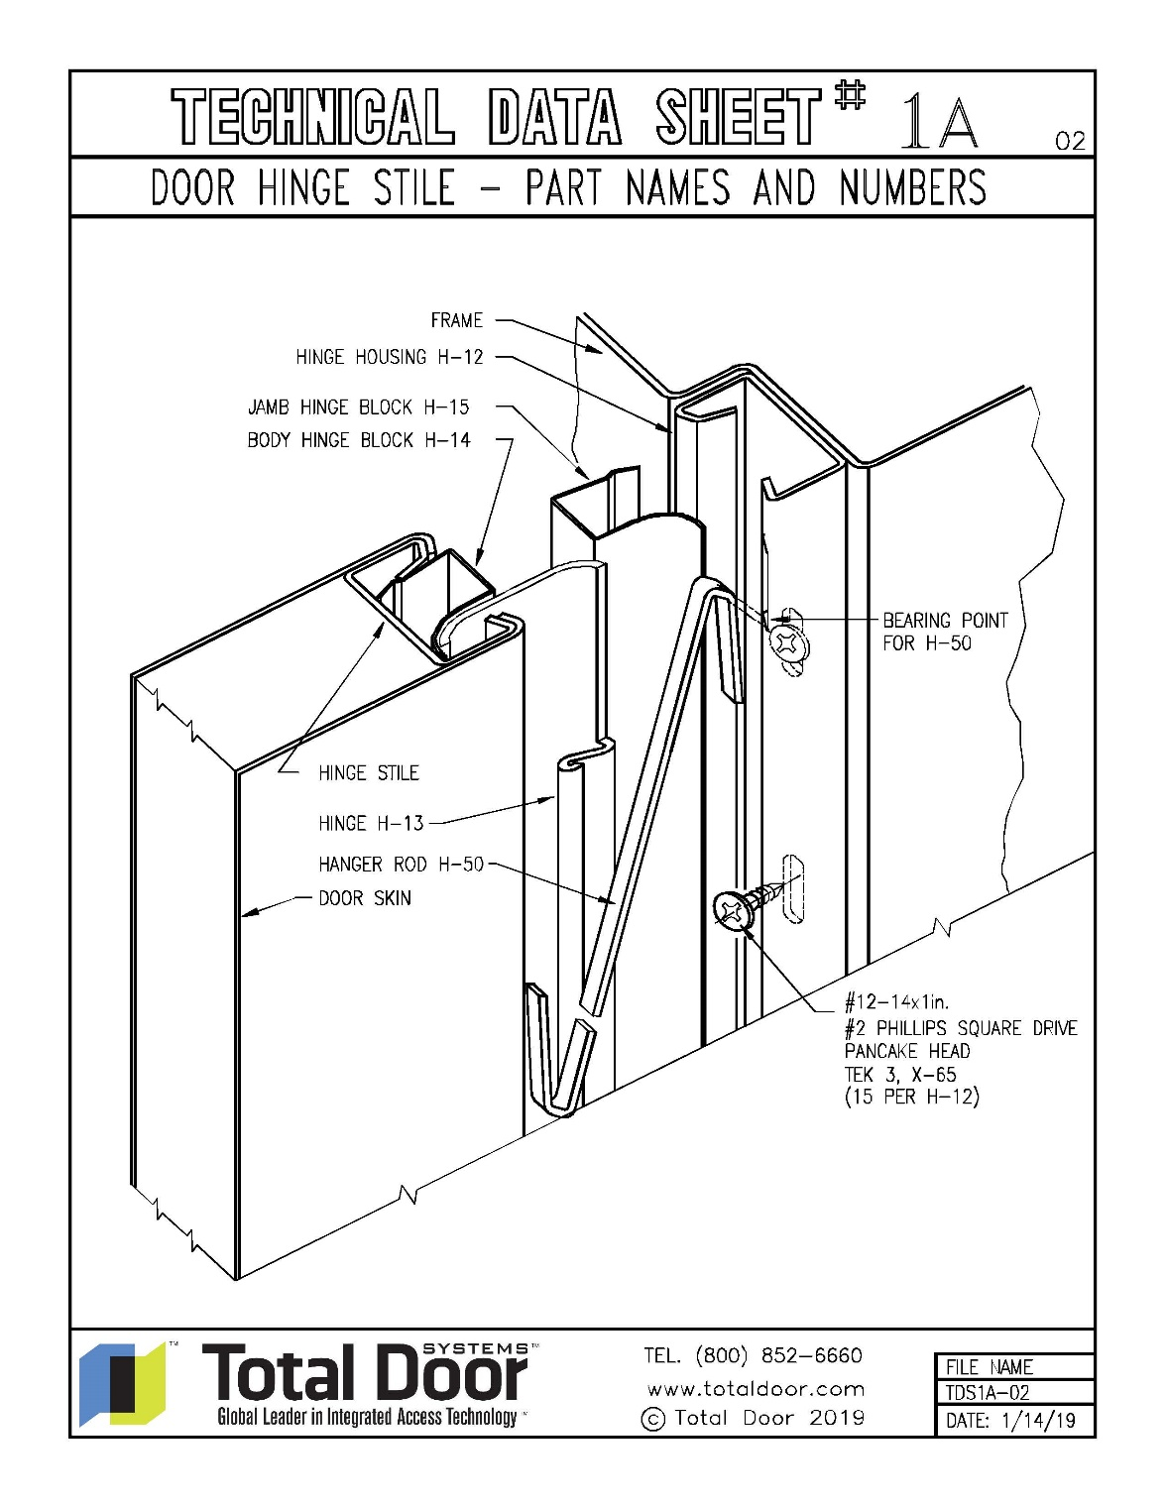
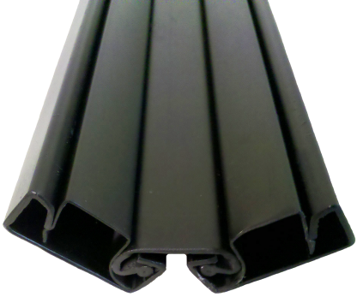
Hinge Side
Hinge side components:
H-12 Hinge Housing
H-15 Jamb Hinge Block
H-14 Body Hinge Block
B-14 Hinge Stile (built in the door body)
H-13 Hinge
H-50 Hanger Rod

Slide 13
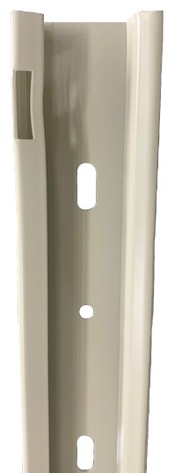
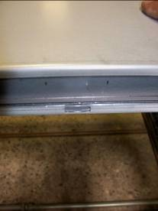
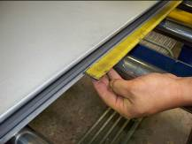
Hinge Side
Hanger rod notch:
Upper notch is for the older H-17 and H-30 hanger rods (pre 1999 to early 2000)
The lower notch is for the newer H-50
Current H-12 with one notch for H-50 hanger rod.
The H-13 is always punched out at the top and where the hanger rod hooks into the door body. This allows for clearance for the hanger rod when the door is opened and closed. (pre 1999 to early 2000, milled area is different based on which hanger rod is used)
The hanger rod notch is in the same location on every door. No matter what year it was built.

Slide 14
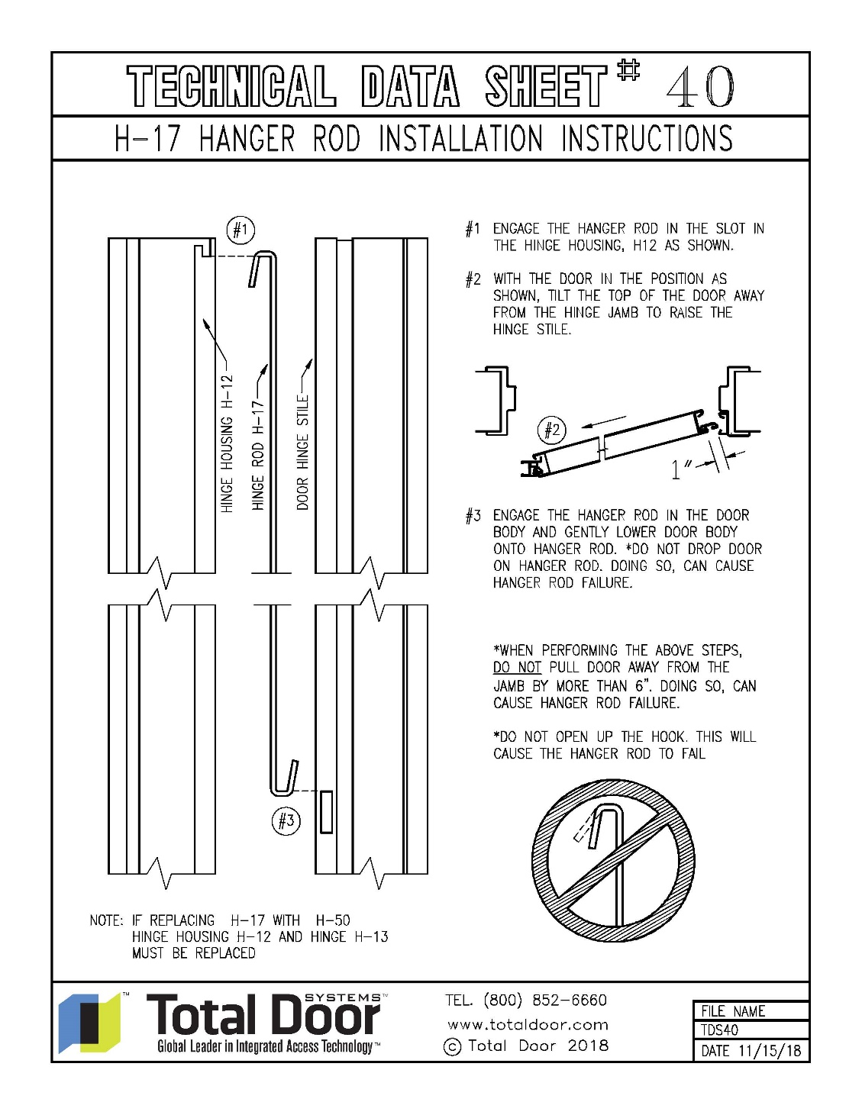
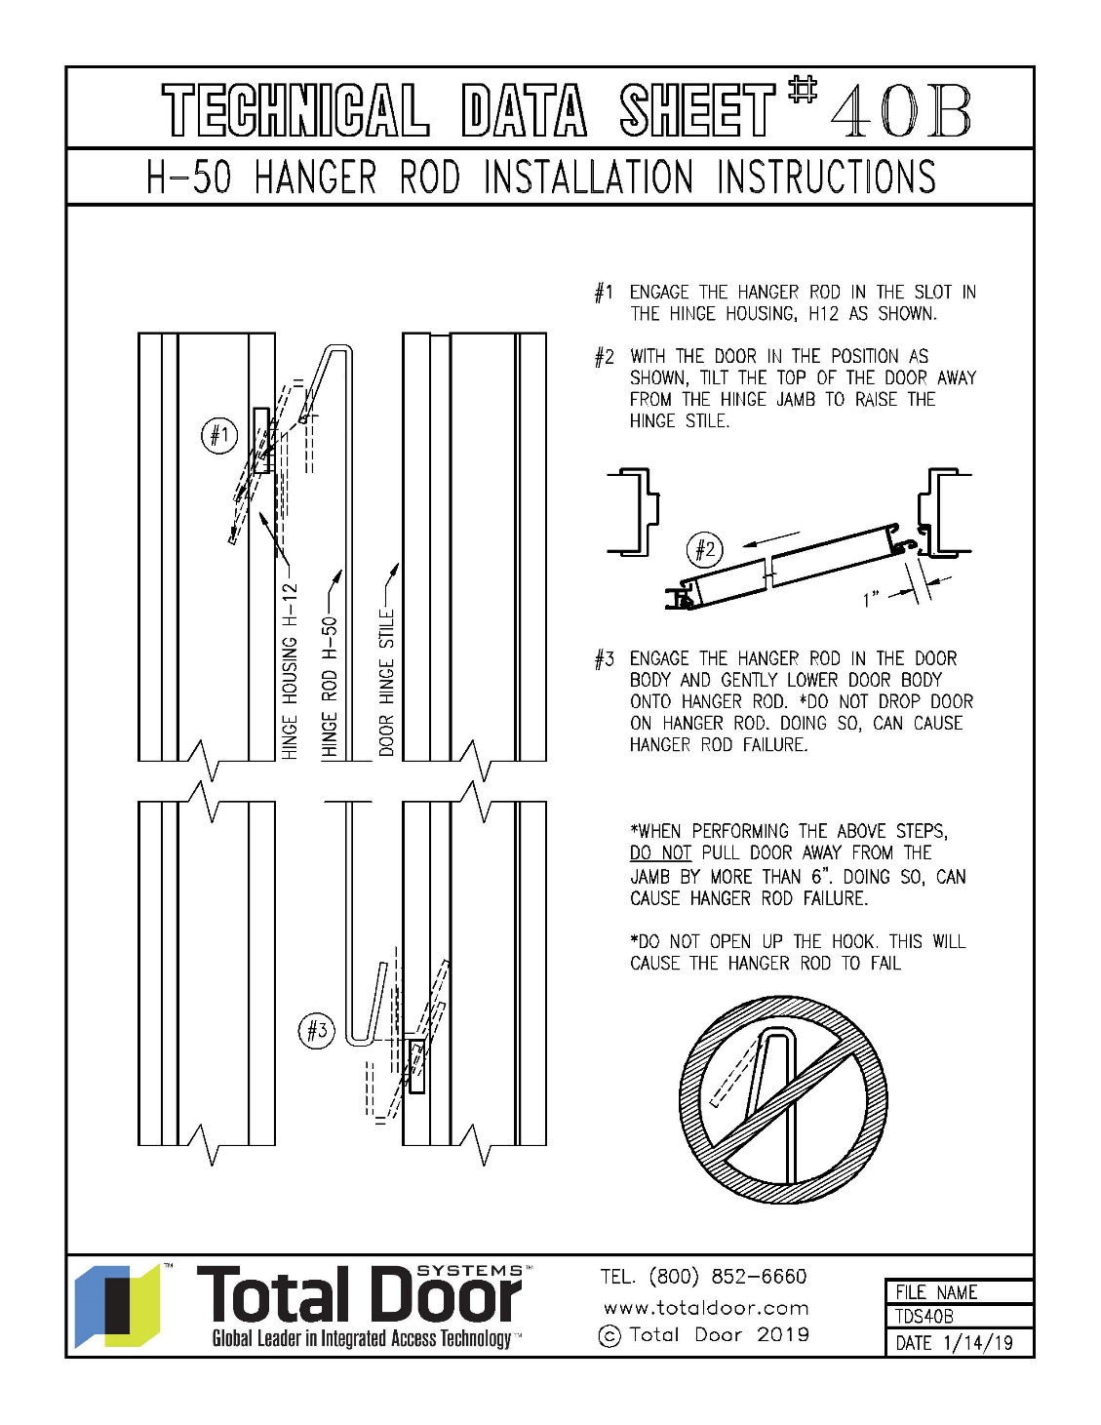
Hinge Side

Slide 15
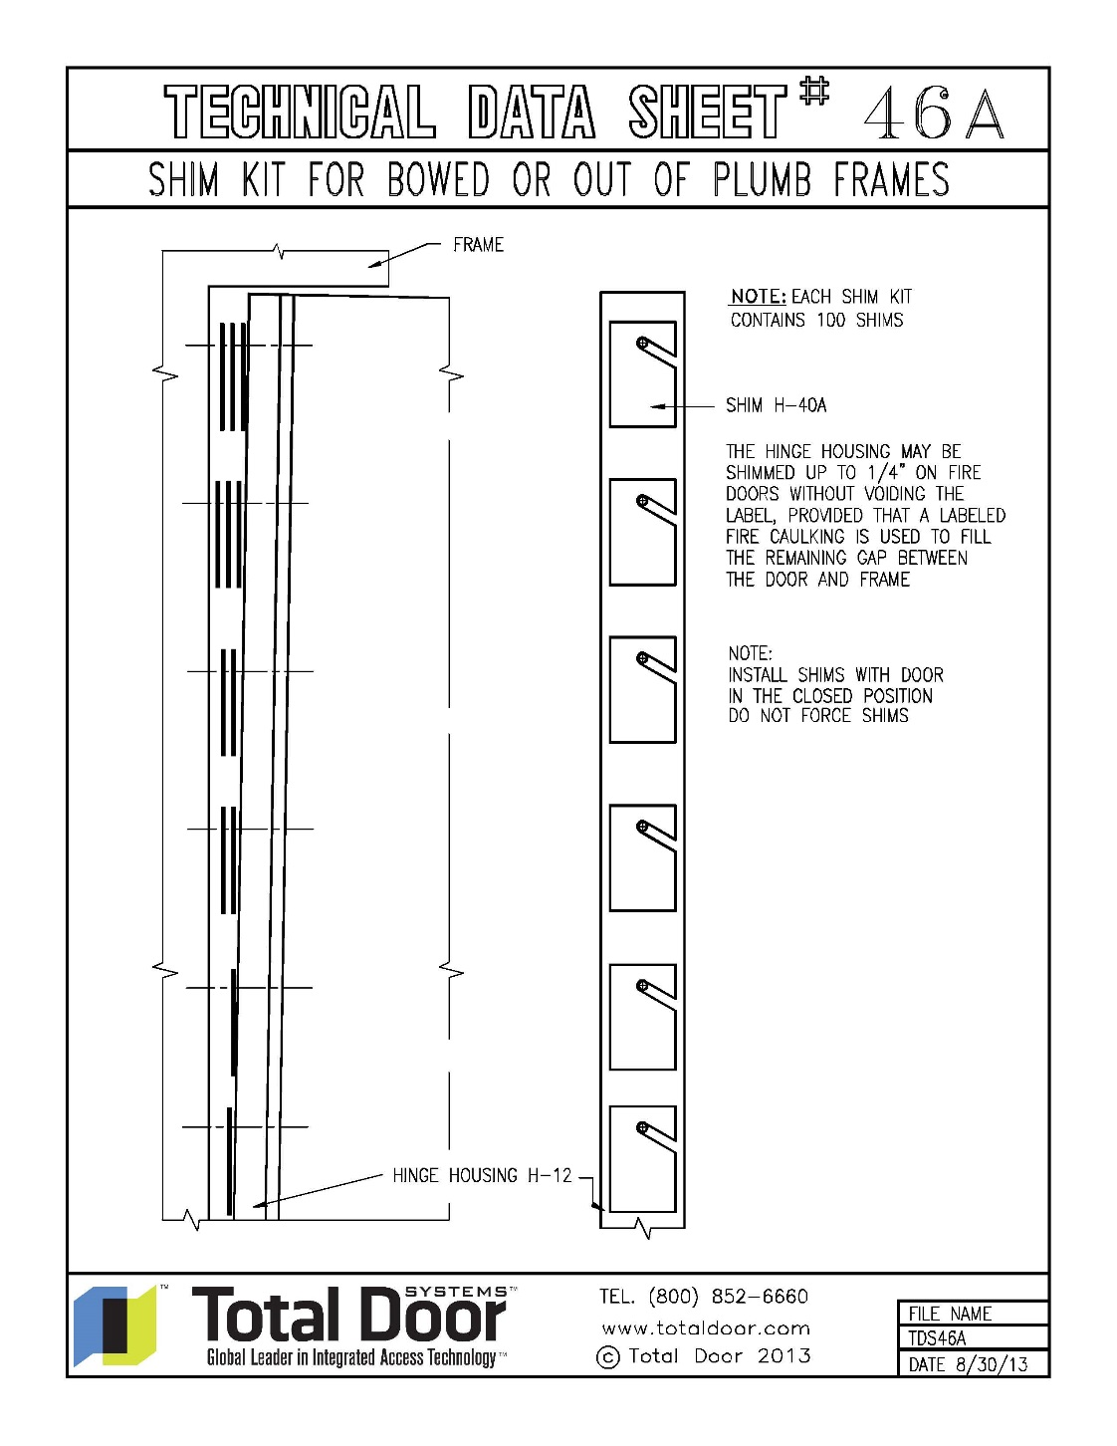
Hinge Side
Installation starts on the hinge side.
Now that the frames are in place and determined that they are square and plumb, hanging the doors can begin.
There may be times when shims will be needed. There is no pattern to shimming. You could have 1 at the bottom, 3 in the middle and 0 at the top. No matter what, the hinge housing (H-12) needs to be plumb.
No less than 15 screws are to be used when installing the H-12.
*Gaps up to 1/8” per leaf shall be filled with 100% silicone caulk. Gaps larger than 1/8” up to ¼” per leaf shall be filled with listed intumescent firestopping caulk such as 3M Fire Barrier Sealant CP 25WB+, Rectorseal Metacaulk, or equivalent.
Notes:
Demonstrate on the sample door and use the animations.
Explain the process on installing the H-12 using no less than 15 screws.
Also refer to tds #36 image 2 for minimum clearance.
Two (2) H-12’s are needed for pairs.
Test Question: How many screws must be put in the hinge housing? 15
Test Question: Is Fire Rated Caulk required on Fire-Rated doors between the frame and the shimmed hinge housing? YES
Test Question: What is the maximum allowed shimming on a fire rated door? ¼”
Test Question: Do hinge mounting screws that are installed between shimmed sections effect the performance of the hinge? YES- explain why and refer to the animation.

Slide 16
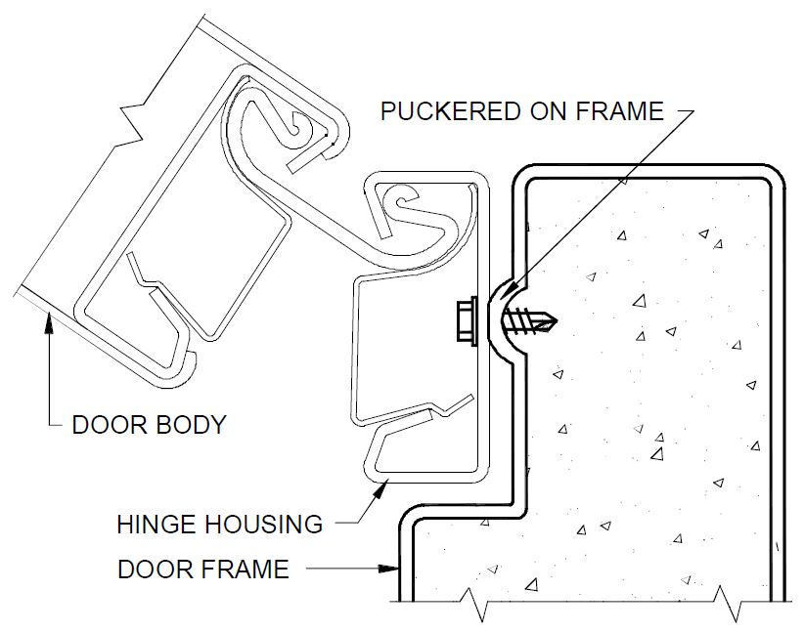
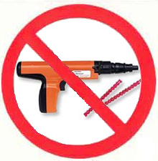
Hinge Side
Masonry Openings
When installing doors in a grouted frame, use a 1/8” masonry drill bit to pilot holes for installation screws. Tapcons are to be used for concrete openings with proper head clearance. Tapcons can be supplied by Total Door Systems.
Do not use explosive fasteners to anchor hinge housing to a fully grouted frame – impact causes concrete to pucker at fastener.
Notes:
Test Question: What type of drill bit would you use to pilot a hole for a frame that is grouted? 1/8” masonry bit.

Slide 17
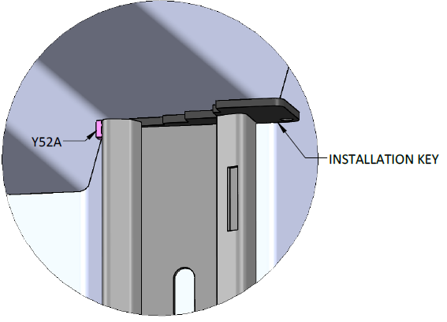
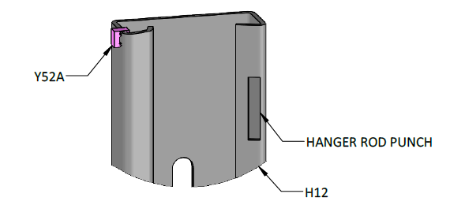
Hinge Side
Y52A Installation
The Y52A is a spacer that is installed on the H12 to ensure a minimum spacing from the head stop.
Install Y52A hinge stop spacer on the H12, opposite the hanger rod punch. Push the Y52A all the way down.
Move the H12 into position. Use the spacer as a guide between the head stop of the frame and the H12. Using the thickness of the installation key, position the hinge housing to the head of the frame. Install the H12 hinge housing as instructed.
Notes:
Test Question: What type of drill bit would you use to pilot a hole for a frame that is grouted? 1/8” masonry bit.

Slide 18
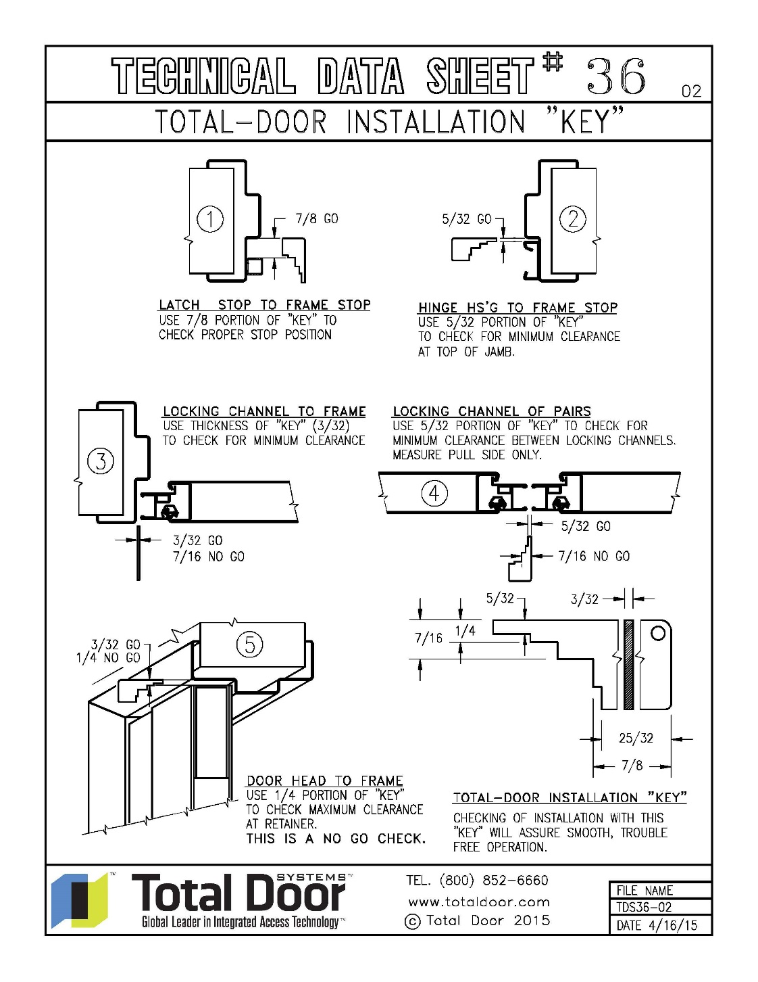
Hinge Side
Having the correct tolerances ensures the door will operate properly.
Check correct tolerances
Notes:
18
Explain why these are important and explain some of the MAX clearances allowed.
1. 7/8 min to ?? max
2. 5/32 (just over 1/8”) min to ?? max
3. 3/32 (just under 1/8”) min to 13/16 (approx 3/8”) max.
4. 5/32 (just over 1/8”) min to 13/16 (approx 3/8”) max.
5. 3/36 (just under 1/8”) min to 7/16 (just under ¼”) max.
Test Question: Is ¼” clearance at the retainer an acceptable tolerance? NO
Test Question: What is the minimum acceptable tolerance between the hinge housing and the stop edge of the frame? 5/32”.

Slide 19
Hinge Side
Advantages:
Hanger rod carries the weight of the door allowing for hinge to rotate freely.
Offers opportunity to plane door with the frame for a better fit.
Reduces air leakage.
Retrofit over reinforced hinge mortise.
Mounts to any surface.
Dual pivot-point, semi-wide throw hinge allows the door to open a full 180° and gives clear width.

Slide 20
Latch Side

Slide 21
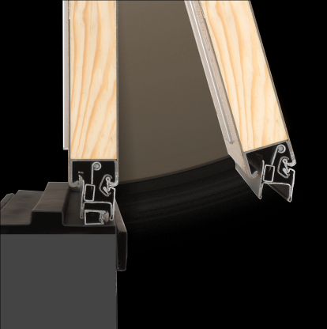
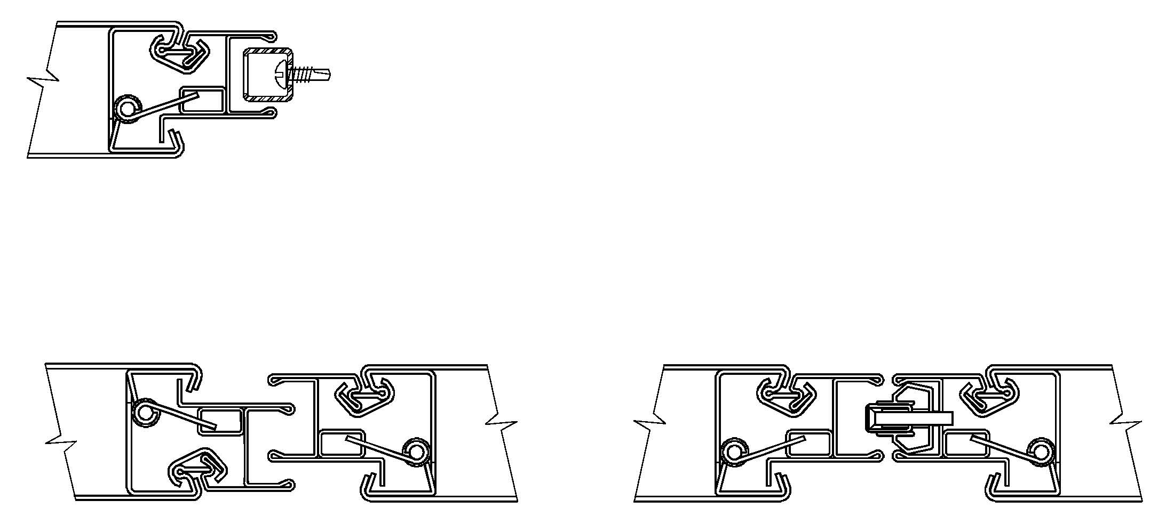
Latch Side
Latch side components:
L-11 Locking Channel
L-127 Clip
Y-13 Helper Spring
B-15 Latch Stile (built in door body)
R-12SA Retainer Assembly
Single doors have a latch stop that gets fastened to the jamb
Double Egress rotate into one another with ¼” min. overlap
Pairs have an adjustable tongue on the RH/LR leaf

Slide 22
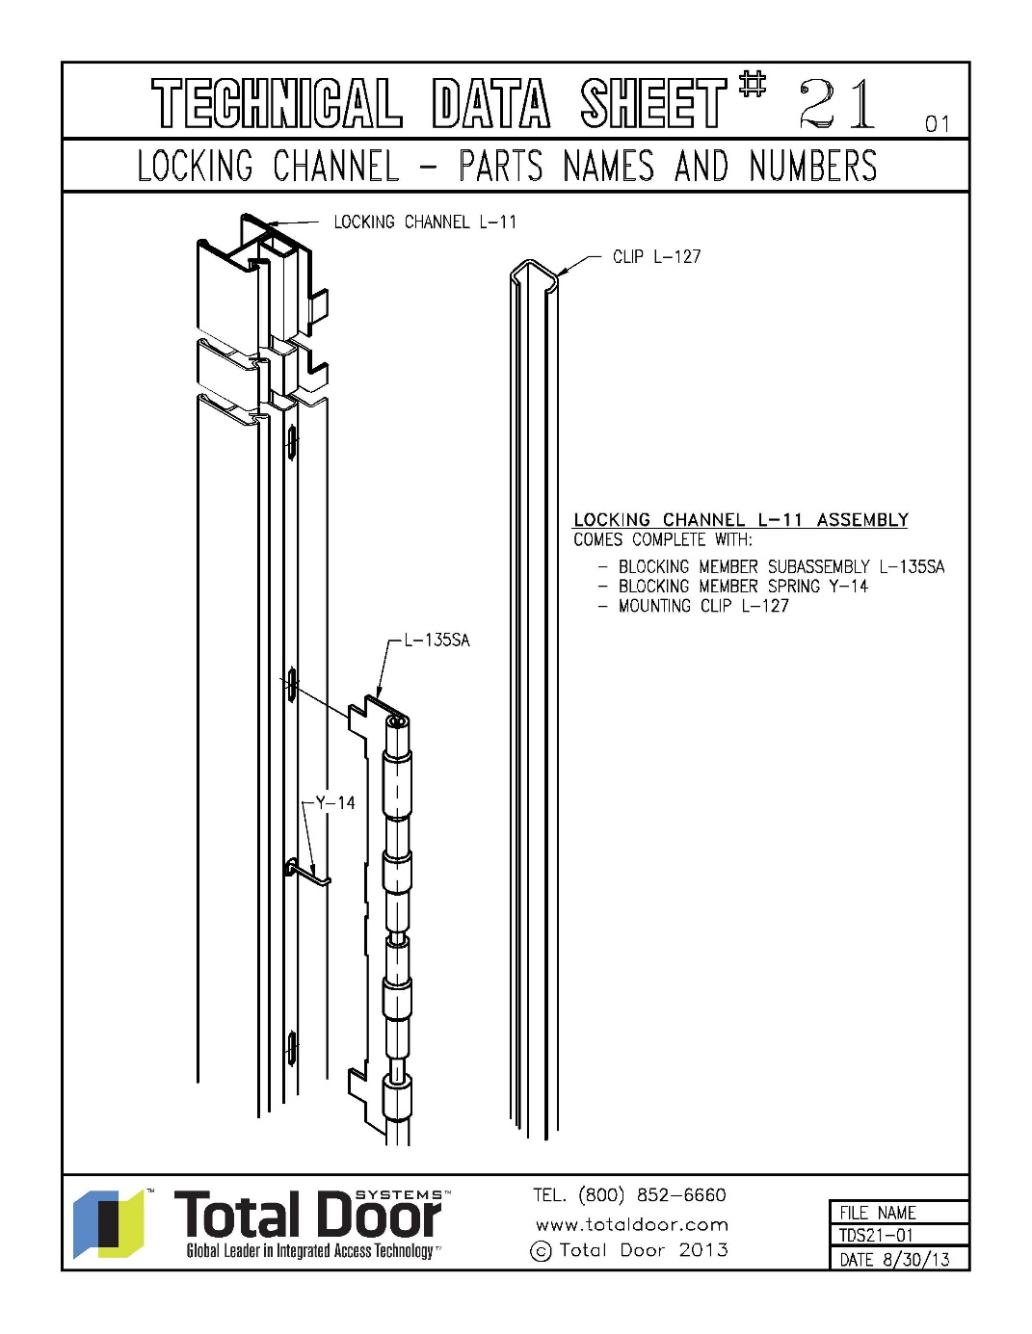
Latch Side
Locking channel is held on the door body with the clip (L-127).
The blocking member subassembly (L-135SA) does need to be installed correctly.
The round portion points opposite the flange of the locking channel.
Door closed
Actuator moves blocking member to new position
Door open

Slide 23
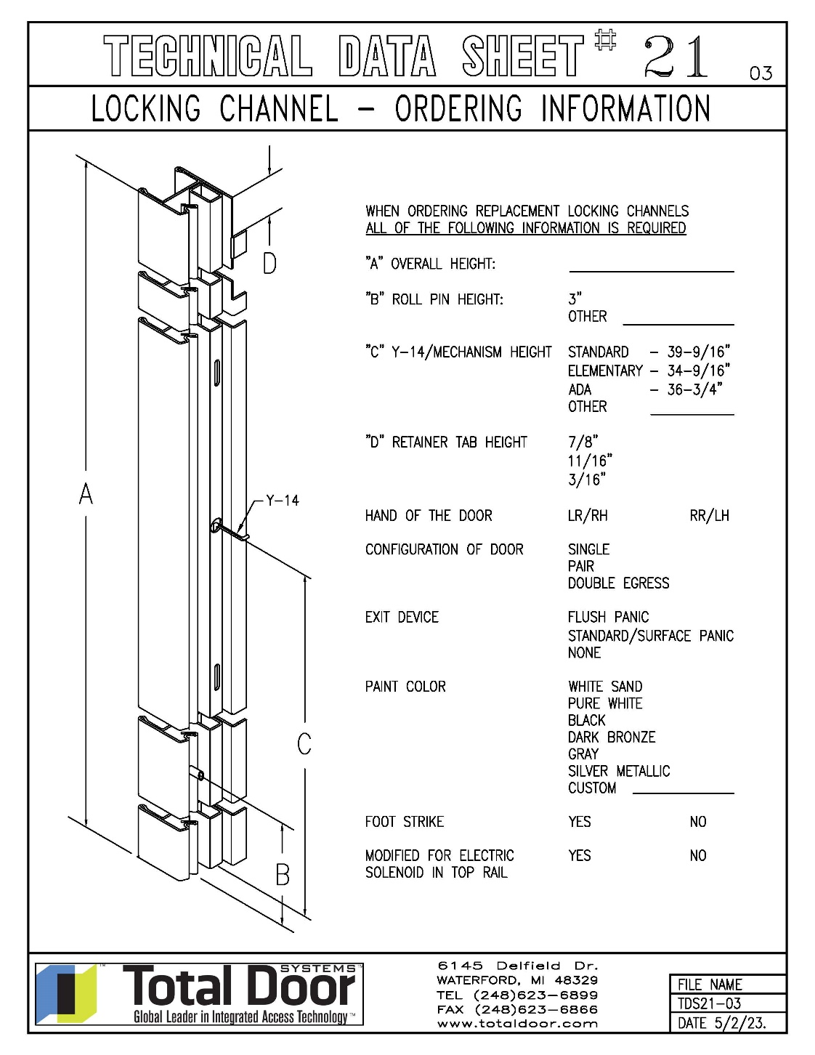
Latch Side
A roll pin on the locking channel (L-11), prevents the clip from falling out the bottom of the door. It also aligns with a corresponding notch in the door body. (always at the bottom location of the door)
The roll pin is 3” on center from the bottom. If that measurement is less than 3”, the door has been cut down in the field.

Slide 24
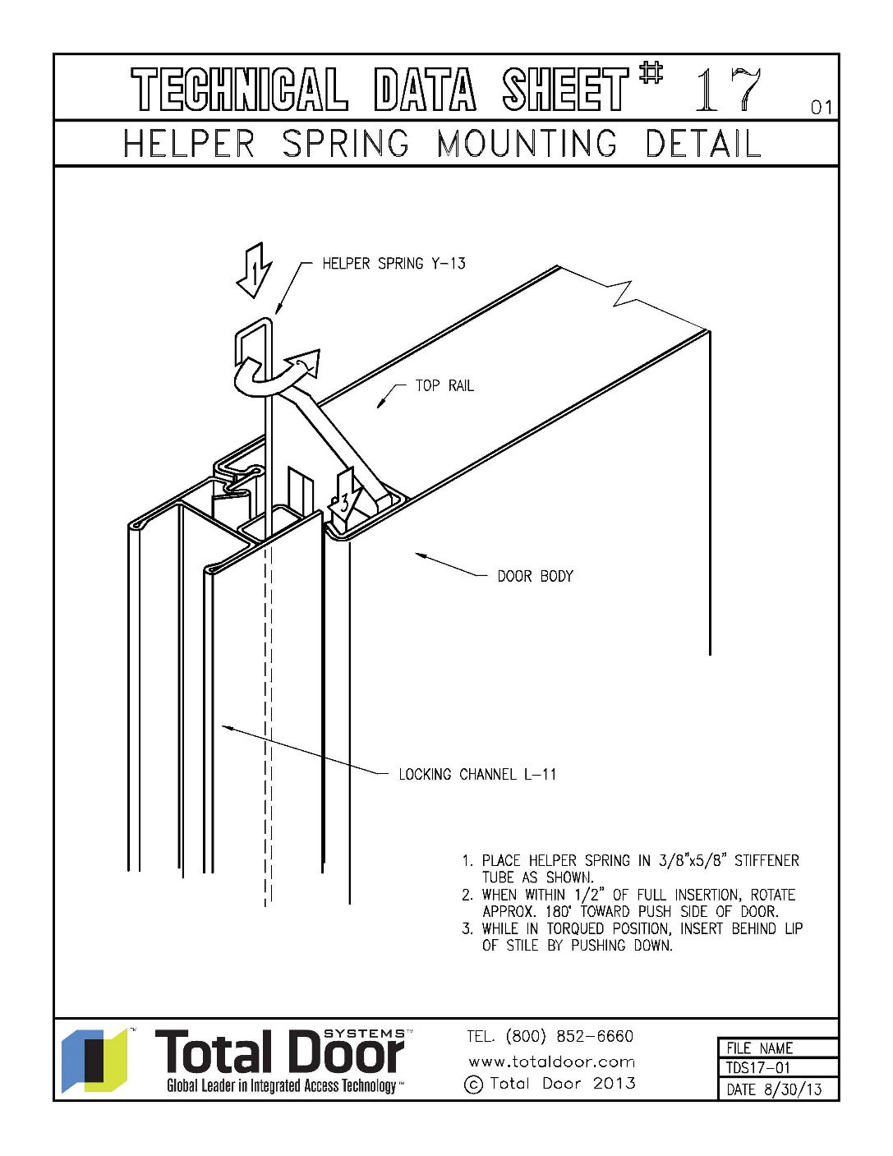
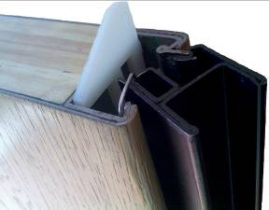
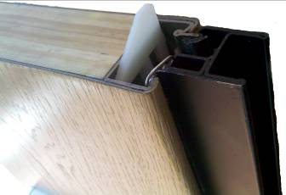
Latch Side
Helper Spring
Assist the locking channel to the unlatched position
Install and rotate to 90° on all hardware and up to 180° max only on flush panic. Preset from the factory.
Foam tape to keep spring from creeping up and to cut down on noise of the latching channel rotating.
Unlatched
Latched
Notes:
Test Question: When the door is in the open position, how do you rotate the locking channel to the latched position without closing the door? Depress the Retainer.

Slide 25
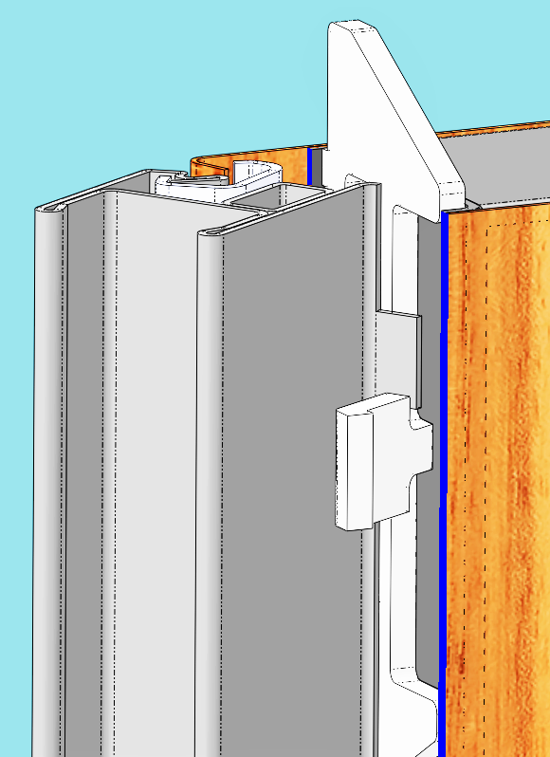
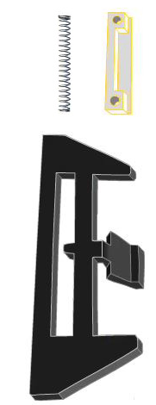
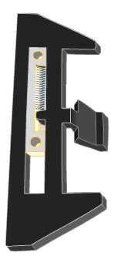
Latch Side
Retainer
Retains the locking channel in the unlatched position.
Tab on the locking channel engages on the tab on the retainer.
Retainer Assembly R12SA
Tab on locking channel
Tab on retainer

Slide 26
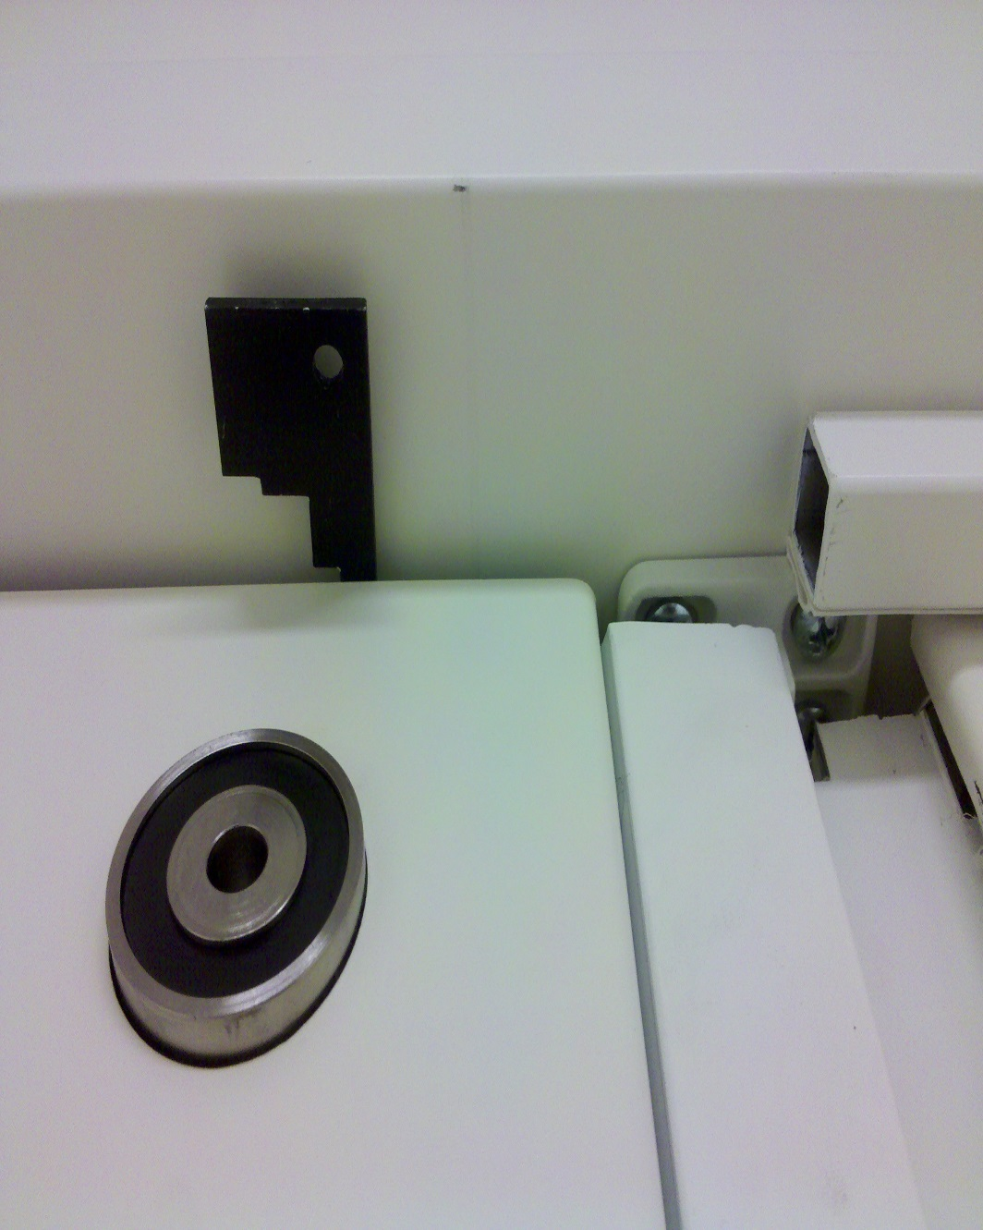
Latch Side
Notes:
On a pair of doors, what would be considered out of tolerance between locking channel pairs?
Less than 5/32”
More than 3/8”

Slide 27
Latch Side
Advantages:
Continuous latching channel provides exceptional security compared to typical single latch bolt door strike.
Eliminates vertical rods, floor hardware, coordinators, astragals and flush bolts on pairs and double egress doors.
Reduces air leakage.
Less moving parts.
Allows for less flex in the door body.
Notes:
Talk it up, add as many as you would like.

Slide 28
Mechanisms& Panics

Slide 29
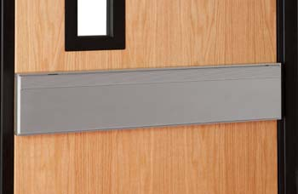
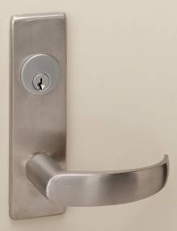
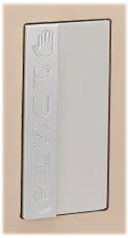
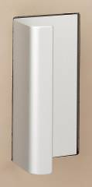
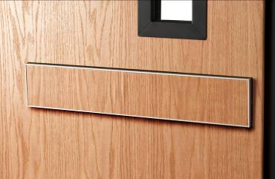
Mechanisms
Total Doors mechanism types.
Levers
Standard Panic
Flush Panic
Push/Pull Trim
Notes:
Say a little something about each of the mechanism.
Go over the different combinations that are available and how/where they can be used.

Slide 30
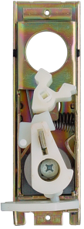
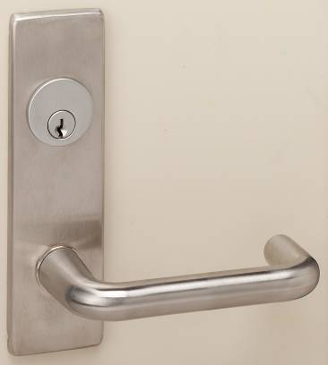
Mechanisms
Lever Mechanism
Installed at the factory requiring little or no field labor.
Three-hour fire rating and ADA compliant.

Slide 31
Mechanisms
PART NAME | PART NUMBER
Actuator – Lever Actuator – Panic | Q-17 Q-17 PAN
Cam | Q-15
Clutch Housing | Q-11
Dog – Single Dog – Double | Q-12A Q-12B
Dog spring | Y-49
Escutcheon | Q-19
Hub | Q-13
Hub Stop | Q-34
Lever Spring | Y-42
Pan Head Screw | X-21
Plastic Plug | Q-30
Plug Retainer | Y-104
Roll Pin | Y-12
Set Screw | X-24
Spring – handed | Y-22A
Lever Spring | Q-18
Star lock Washer | X-41
Turnpiece Hub | Q-14

Slide 32
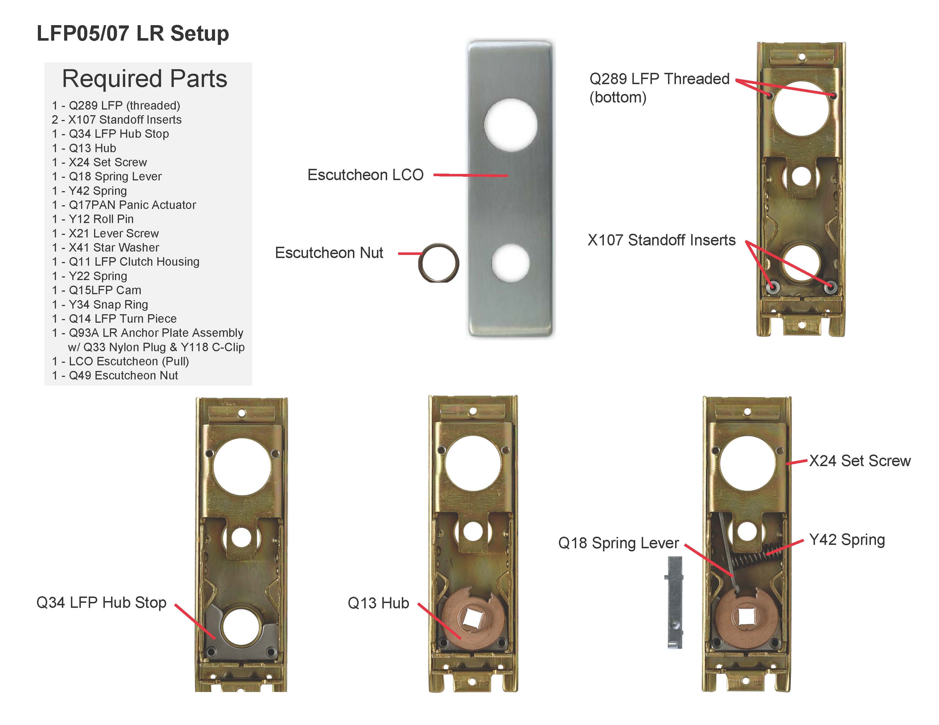
Mechanisms
Notes:
Stay on this slide until completing the Lever mechanism hands on.

Slide 33
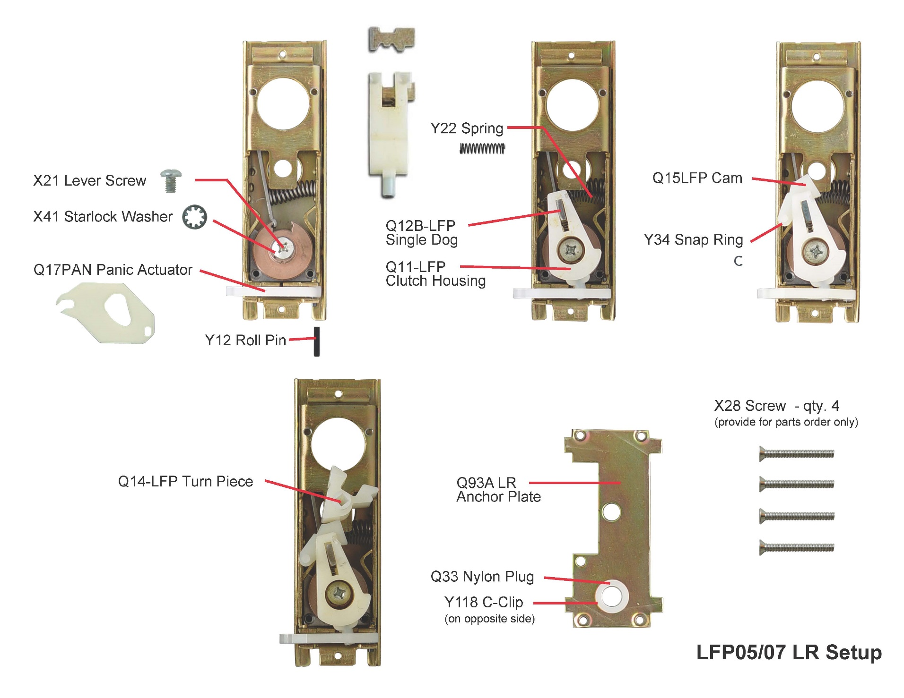
Mechanisms
Notes:
Stay on this slide until completing the Lever mechanism hands on.

Slide 34
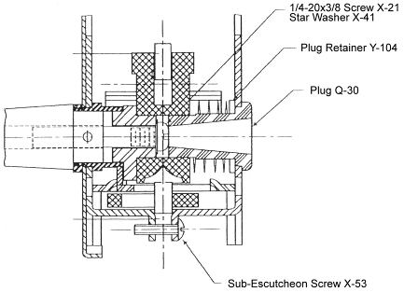
Mechanism Installation
Installation of Levers on Panic Doors Production dates after 1/12/03
Remove hinge end cap on panic and slide panic bar 6” toward hinge side of door. Refer to Tech Data Sheet 1F.
Seat lever into escutcheon.
Insert Phillips Head screwdriver through plug Q-30 and tighten screw to the lever spindle. Screw must be set tightly to avoid loosening.
Slide panic bar into position and check operations. Reinstall end cap.
Cylinder Installation
Remove the hinge side panic end plate and slide the panic bar back to access the mechanism. Hold hand over panic as you slide bar back to catch the panic button, which will pop out.
Loosen top screw in the mechanism housing, approximately six (6) turns and then loosen the bottom screw approximately one and one half (1-1/2) turns.
Tilt the top of the pull side lever mechanism outwards so that the cylinder setscrews on the side of the mechanism can be loosened.
Screw cylinder into lever mechanism. Make certain that cam leg points toward top of mechanism when key is removed. Tighten setscrews firmly against cylinder.
Re-tighten top and bottom screws in mechanism.
Slide panic bar back into position after replacing the panic button assembly and replace the hinge side panic end plate.

Slide 35
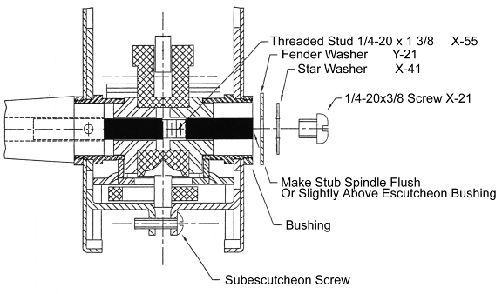
Mechanism Installation
Installation of Levers on Panic Doors Production dates before 1/13/03
Remove hinge end cap on panic and slide panic bar 6” toward hinge side of door. Refer to Tech Data Sheet 1F.
Remove screw and washers from trim set.
Install spindle into hubs – seat lever or knob fully into escutcheon.
Check stub spindle and adjust if necessary so that end of spindle is flush or slightly above inner escutcheon bushing. If lower than escutcheon bushing, remove from trim side and back off stub spindle, then reinstall.
Install star washer and screw as shown. NOTE: Screw must be set tightly to avoid loosening – if after tightening there is no end play in lever, remove lever and back off stub spindle 1/4 or 1/2 turn and reinstall.
Slide panic bar into position and check operation. Reinstall end cap.

Slide 36
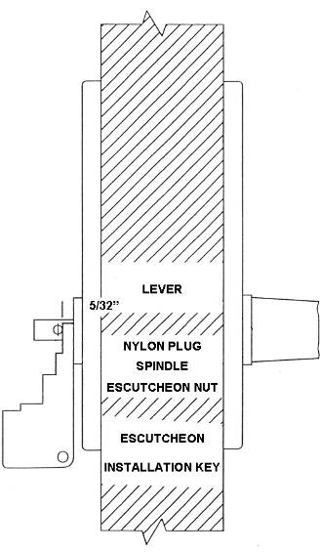
Mechanism Installation
Lever Handle and/or Cylinder Installation
The lock mechanism with escutcheons are installed at the factory. The lever handles are shipped in a separate container with the door.
Customers cylinders may be factory or field installed. Any mortise cylinder (not longer than 1-3/8” nor shorter than 1-1/8” with standard cam) may be used. See Tech Data Sheet #25 REV 05.
Cylinder Installation
Loosen setscrew and remove inside lever. Then remove outside lever.
Remove escutcheon nut from escutcheon plate on the non-secure side with tool provided. Then remove the escutcheon plate.
Loosen top screw in the mechanism housing, approximately six (6) turns, then loosen the bottom screw approximately one and one half turns (1-1/2) turns.
Tilt the top of the lever mechanism outwards so that the cylinder set screws on the side of the mechanism can be loosened.
Screw cylinder into lever mechanism. Make certain that cam leg points toward top of mechanism when key is removed. Tighten setscrews firmly against cylinder.
Re-tighten top and bottom screws in mechanism.
Re-install escutcheon plate and levers.
Levers Installation
Install the outer lever complete with swivel spindle. Make certain that the swivel spindle is adjusted so that the distance from the nylon plug to the face of the escutcheon nut is 5/32”. The nylon plug must be horizontally positioned to receive the lever setscrew.
Install the inner lever and tighten the setscrew firmly. The setscrew must seat into the nylon plug.
Test operation of levers.

Slide 37
Mechanism Installation
Lock Replacement
Remove existing lock
Loosen setscrew on lever. Remove both lever handles.
Use spanner wrench to remove escutcheon nuts. Remove both escutcheons.
Remove the two screws located at the top and the bottom of the lock unit and remove lock.
Install new lock
Remove top and bottom screws from the new lock mechanism. Separate the two halves of the lock carefully so that all parts stay in place.
With the locking channel in the open position, insert the half of the lock containing the Actuator (Part # Q-17, see Parts Section 1-3) on the pull side of the door. Make sure that the actuator grips the Flipper (Part #L-135SA, shown on Tech Data Sheet # 21) as it is installed. Once the first half of the lock is in place and the actuator is seated on the flipper, install the second half of the lock. Once seated, secure the top and bottom screw.
Reinstall escutcheon plates and levers. Follow the instructions provided on the previous page.

Slide 38
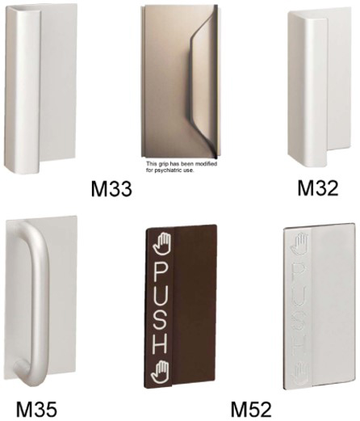
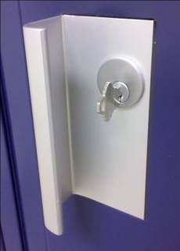
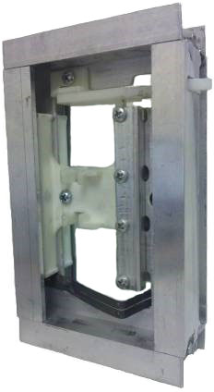
Mechanisms
Push/Pull Mechanism Assembly
Installed at the factory requiring no field labor.
Three-hour fire rating and ADA compliant.

Slide 39
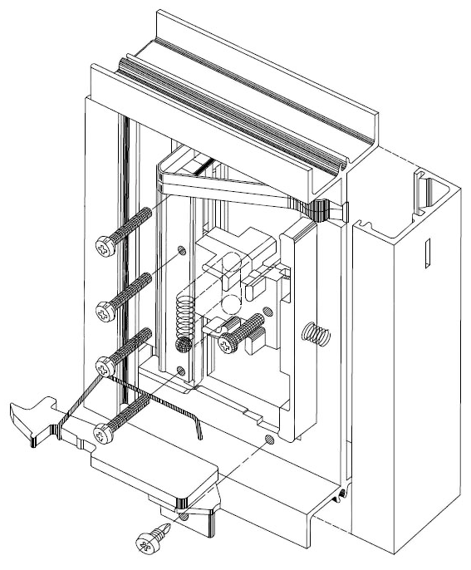
Mechanisms
Push/Pull Mechanism Assembly
PART NAME | PART NUMBER
Actuator Assembly | M22SA
Slide Block Assembly - (includes screws, slide blocks, springs, ball bearing & locking bar) | M24SA
Puller Rod | M28
Face Spring | Y24
Y24
M24SA
M28
M22SA
Notes:
Stay on this slide until completing the Grip mechanism hands on.

Slide 40
Mechanism Installation
Removal of Grips (Factory Installed)
NOTE: The push side must be removed first.
Open door and depress retainer R-12 located at top of door on latch side (this action releases a tab holding the locking channel L-11 in the unlatched position) and rotate locking channel L-11 to latched position (in plane with door body).
In base of locking channel, at grip height, locate the hole (approximately 1/8” in diameter) for access wire.
Take access wire tool Y-39A and place long end into hole in locking channel. Feel for corresponding hole in door stile.
“Lip” of Push Plate
Slide Block
When wire is through both holes, it meets the slide block member of the mechanism. Push access wire toward hinge side of door, pushing the slide block to rear of mechanism.
Grasp Push-Side grip in one hand while holding access wire fully depressed with other hand. Push the hinge side of the grip inward at the same time pulling the entire grip out of mechanism cutout.
The grip will come free on latch side. Pull grip out of door.
To remove Pull-Side grip, return locking channel L-11 to the unlatched position. Use access wire to lift puller-rod free of actuator arm, M22.
Remove Pull-Side grip in same manner as Push-Side.

Slide 41
Mechanism Installation
Installation of Grips
The Pull Plate is distinguished by having a Puller Rod, which attaches to the Actuator in the mechanism. The Pull Plate must be installed before the Push Plate.
Place the Pull Plate in the mechanism as shown.
Push the Pull Plate against the Slide Block and slide both toward the hinge side of the door (in direction of the arrow) until further motion is impossible. Using the access wire provided, reach through the mechanism from the Push Side and pull up the Puller Rod over the Actuator.
NOTE: During this operation, the Pull Plate must be held in the “pushed in” position.
“Pushed In” Position
Slide Block
Actuator
Puller Rod
Access Wire

Slide 42
Mechanism Installation
Push the Actuator, allowing the Puller Rod to snap over the Actuator. Remove access wire.
Push Actuator in this direction
Return Actuator to position shown. Keeping the Slide Block in the full “pushed in” position from the push side, seat the Pull Plate in the pivot groove. Holding the Pull Plate in the seated position, allow the Slide Block to return, thereby capturing the Pull Plate in the pivot position.
Pivot Groove
Note: Puller Rod Hooked
Over Actuator
Note: Plate is captured in pivot groove by slide block

Slide 43
Mechanism Installation
Install the two Plate Springs in the mechanism. Hook the leg of the spring that is closest to the center of the mechanism under the lip of the Pull Plate. Hook the other spring (for Push Plate) over the Pull Plate side of the mechanism web. Test the operation of the Pull Plate by opening and closing. Check cylinder or turn piece operation, if applicable.
“Lip” of Pull Plate
“Leg” of Pull Plate Spring
“Leg” of Push Plate Spring
Pull Plate
Place Push Plate in mechanism as shown.
Push Plate

Slide 44
Mechanism Installation
Slide Push Plate from hinge side and seat Push Plate in pivot groove.
“Lip” of Push Plate
Slide Block
Wiggle both Pull and Push Plates until Slide Block returns, capturing both plates.

Slide 45
Mechanism Installation
Push-Pull Grips/Cylinders (May be Factory Installed)
When cylinders are not factory installed, TOTAL DOOR SYSTEMS® provides one each knurled cylinder nut and one each blocking ring for each cylinder type grip.
Preferred Installation
The TOTAL DOOR® is designed to work with all cylinder up to 1-3/8” long, without collars or blocking rings under the head.
1-3/8” Max
Knurled Cylinder Nut
Cylinder Installed with Blocking Ring Under Knurled Nut
If the cylinder is not sufficiently threaded, use blocking rings under the knurled cylinder locking nut.
1-3/8” Max
Knurled Cylinder Nut
1-1/4” Max. Dia. Blocking Ring

Slide 46
Mechanism Installation
Cylinder Installed with Blocking Ring Under Head
If the cylinder is more than 1-3/8” long, use blocking rings under the head. Never use cylinder collars on TOTAL DOOR SYSTEMS® grips. Installation of the grips in the mechanism will be very difficult or impossible.
Cylinder Collar
1-3/8” Max
Knurled Cylinder Nut
Proper Cylinder Cam and Orientation a
Cylinder cam must be A/R cam.
(See Tech Data #25 REV05)
Orientation: Cam of cylinder must be closest to center of mechanism.
Cylinder on one side of door
Cylinder on bottom of one side if both sides have cylinders

Slide 47
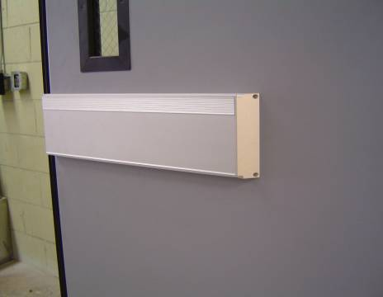
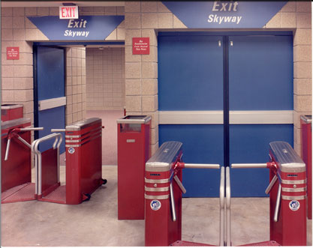
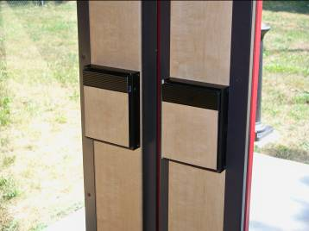
Panics
Standard Panic
1-5/16” projection allows a 32” clear width in a 36” opening. Comes in a standard 24” width. A smaller version (SP14) of our surface exit device is available for non-egress applications.
Notes:
Note: Panic edge protector.

Slide 48
Panics
Standard Panic
X15-1
PART NAME | PART NUMBER
Panic Bar Assembly | P14SA
Panic Base | P11SA
Panic Button Assembly | P16SA
Base End Plate includes screws | P13
Base End Plate – Dogging includes screws | P18
Screws for base end plate | X15-1
Screws for Panic Base latch side (2 ea.) | X14
Screws for Panic Base mid & hinge side (4 ea.) | X18
Panic Foam | W41A
P11SA Panic Base
X18
P13
W41A
X15-1
X15-1
X14
X18
P16SA
X14
X15-1
P18 -Dogged P13 -No Dogging
P14SA Panic Bar Assembly

Slide 49
Panics
Standard Panic
Adjusting the panic button P-16
The panic button is able to be adjusted for proper door function. If the panic button is adjusted too long, the door will not latch. If the panic button is adjusted too short, the door will have difficulty opening.
Panic Dogging, What is that?
A non-fire rated panic bar may have what is known as a dog down feature. This allows the door to be put into the unlatched position allowing the latching channel to rotate freely. This is accomplished by inserting a special key (also known as a dog down key) and turning the key to secure the panic bar in an unlatched position. This allows the door to open by either pulling on the mechanism or pushing on the door without touching the panic bar. When the door needs to be latched again, use the key to release the panic bar and the door will then latch. When the panic is in this position, it would then be necessary to use a key on the outside of the door to enter or operate the bar on the inside to egress out.
Notes:
Test Question: Is the panic button adjustable? YES
Reference the other way to dog the panic from the previous slide.

Slide 50
Panics
Flush Panic
Our Flush Panic fire exit device offers the smallest projection in the industry at a mere 1/8”, with the door in the open position.

Slide 51
Panics
Flush Panic
PART NAME | PART NUMBER
End Cap w/ actuator Latch Side -Includes Screws | PF201SA=L
End Cap Hinge Side -Includes Screws | PF201SA=H
Panic Par – PEO | PF204SA-PEO
Panic Bar – Grip | PF204SA-Grip
Panic Bar – Lever | PF204SA-Lev
Actuator for Grip -Includes Screws | PF221BSA
Actuator for Lever -Includes Screws | PF221B-1SA
Puller Rod -Grip Only | PF225
Face Spring -Grip Only | PFY24
End Cap Button | Y96
Flush Panic end cap with actuator PF201SA-L-GR/PEO
Flush Panic bar with Grip - PF204SA-GR
Flush Panic end cap with actuator PF201SA-L-LEV
Flush Panic bar with Lever - PF204SA-LEV
Flush Panic end cap with actuator PF201SA-L-GR/PEO
PF225 Puller Rod
Flush Panic bar exit only - PF204SA-PEO
Flush Panic Actuator Lever PF221B-1SA
Flush Panic Actuator Grip/PEO PF221BSA
Notes:
Inside of the panic can be matched to the door body.

Slide 52
Closers & Mags

Slide 53
Closers
TDC 96
The TDC96 is a concealed closer that utilizes a track instead of a compound arm which results in high latching pressure and at the same time allows for easing opening.
On this application, the closer track acts as the head stop as well.

Slide 54
Closers
TDC 96p
On a pocket application, the track is attached to the wall at the back of the pocket. This would be used in a cross corridor where the door is held open and flush with the walls of the corridor.
Notes:
Discuss the ideal location for this closer (tdc 96p).
Discuss other brands of closers for comparison.
Discuss back check, closing forces opening forces 5-15-5??

Slide 55
Closers
TDC 5051
Great use on exterior doors, schools, higher traffic and abuse applications.
Notes:
55

Slide 56
Closers
TDC 8907
180° hold open application. Great use on fire/smoke doors for elevator shaft protection.
Notes:
56

Slide 57
Mags
TDH 100 Mag Holder
The TDH 100 Mag Holder moves the electronics from a potential problem area in the wall space to a completely integrated component of the door itself.
Notes:
Pre-wired to eliminate the outlet box and coordination with the electrician.
Can be used with other manufactures’ labeled sensors and detectors.
57

Slide 58
Mags
TDH 200 Mag Holder
The TDH 200 Mag Holder is surface applied allowing for alternative mounting locations.
Notes:
Alternative location is due to the closer body mounting on the pocket wall. Closer body will be in the way.
58

Slide 59
SafeFrame

Slide 60
SafeFrame
Notes:
60

Slide 61
SafeFrame
Notes:
61

Slide 62
SafeFrame
Notes:
62

Slide 63
SafeFrame
Notes:
63

Slide 64
Installation

Slide 65
Installation
ATTENTION
DOOR INSTALLER(S)
INSTALLATION MUST BE PERFORMED BY FACTORY TRAINED INSTALLER(S)
INCORRECT INSTALLATION AND/OR NON-FACTORY TRAINED
INSTALLER(S) WILL VOID WARRANTY
IF YOU HAVE ANY QUESTIONS OR CONCERNS CONTACT:
TOTAL DOOR SYSTEMS
6145 DELFIELD DRIVE
WATERFORD, MI 48329
PHONE: (248) 623-6899
service@totaldoor.com
FAX: (248) 623-6866
Notes:
65

Slide 66
Installation
Order arrival
All shipments are FOB Waterford, MI.
Unload pallet with extended forks the long way on the pallet.
Inspect the pallet for any freight damage before signing the Bill of Lading.
Check plastic for tears, punctures and/or brakes.
Make sure nothing is/has been placed on the center of the doors.
Look over the packing list on the pallet.
Check that boxes/components are with the order.
Unpack pallet and inspect doors.
Report any damages and/or missing components immediately.
Notes:
We offer 2 options for the pallets, crated or not crated. All orders, west of the Mississippi River, are crated due to the chance of freight damage which is from the multiple times the pallets are loaded/unloaded.

Slide 67
Installation
Door Locations
Before installing doors, check for the door number on the A100 order form.
Cross check that number with the sticker on the top of the door to make sure you have the correct door for each opening.
Notes:
Test Question: If the doors on a job are the same style, do you need to use the A-100 form to distribute the doors? YES

Slide 68
Installation
Having the correct tolerances ensures the door will operate properly.
Check correct tolerances
2
5
Notes:
Explain why these are important and explain some of the MAX clearances allowed.
1. 7/8 min to ?? max
2. 5/32 (just over 1/8”) min to ?? max
3. 3/32 (just under 1/8”) min to 13/16 (approx 3/8”) max.
4. 5/32 (just over 1/8”) min to 13/16 (approx 3/8”) max.
5. 3/36 (just under 1/8”) min to 7/16 (just under ¼”) max.
Test Question: Is ¼” clearance at the retainer an acceptable tolerance? NO
Test Question: What is the minimum acceptable tolerance between the hinge housing and the stop edge of the frame? 5/32”.

Slide 69
Installation
Total Door® Pre-Installation Check List
A TOTAL DOOR® should never be installed in a frame that is not within stated tolerances.
A TOTAL DOOR® installed incorrectly or in a frame that is not within stated tolerances becomes the installer’s responsibility. It is not covered by the Total Door® Performance Warranty.
Thus, it is especially important in both replacement/renovation projects and new construction that frames be checked for size, straightness, and plumb.
Field adjustments, including re-setting the frame, should be complete prior to installation of TOTAL DOOR®.
TOTAL DOOR SYSTEMS® Dimensional Tolerances:
(Note: These tolerances should never be exceeded)
1/16” Max. out of square
Latch Side
Hinge Side
Nominal Size Plus & Minus 1/16”, Max
1/16” Max. bow
1/16” Max. bow
Max. out of plumb
One leg to the other
1/4” Max. for single doors
1/8” Max. for pairs of doors
PLUMBNESS
SIZE LIMITATIONS
STRAIGHTNESS

Slide 70
Installation
Total Door® Installation Instructions
HINGE SIDE
Pry out hinge block H-15.
Hinge housing H-12 may now be removed.
Make certain hinge block H-14 and hinge H-13 remain securely seated in door stile.
Hinge Block
H-15
Start here with putty knife
Hinge Block
H-14
Hinge Housing
H-12
Hinge H-13
Door Body
NOTE: Use putty knife only to begin removal of hinge block H-15. Use prying action of fingers along full length “ROLL” out the H-15. Do not strip out or rip out the H-15, as this will deform the member.

Slide 71
Installation
Top of housing H-12 is mounted
1/16” from head of frame. Use
Thickness of gauge key as a guide.
Place hinge housing H-12, flat against jamb and 1/16” from frame head, with notch on the pull side. Allow 5/32” clearance between H-12 and rabbet (In a cased opening, H-12 may be flush to 1/16” from edge of jamb on pull side). Use installation key, which is provided, to insure proper tolerances.
Hold hinge housing H-12, in position and install 3 #10 Tek (X-65) screws, one at the top ROUND hole, one in the middle slot, and one at the bottom slot. The Tek screws, which are installed in the middle and bottom slots, should be at the bottom portion of those slots.
Hinge Housing
H-12
5/32”
Frame
NOTE: Some frames, especially old grouted frames, have mortar so hard that the Tek screw alone is not sufficient to securely mount a TOTAL DOOR.
We have found the following procedure for installation to be fast, secure, and economical.
a) Use a 1/8” masonry drill bit to drill holes 3/4" deep.
b) Install the 3 #10 Tek (X-65) screws supplied with the door.

Slide 72
Installation
Stand door up. Place it at approximately 30° angle to the door jamb at the hinge housing H-12.
Tilt hinge side of door upwards* to facilitate seating the top hook of the hanger rod in the rectangular slot in the top of the hinge housing H-12.
Insert lower hook of stainless steel hanger rod in the rectangular notch on the pull side of the door stile about 24” from the top of the door. The door is now suspended from the frame by the hanger rod.
Door Body
*Tilt door so that hinge side is raised off floor and then hook hanger rod H-50 on the hinge housing H-12
*When tilting the door, the space between the top of the door and the jamb, SHOULD NOT exceed 6”
This can cause
hanger rod failure
Hanger rod H-50
Hinge housing H-12
Note: See Technical Data Sheet #40B for installation of H-50

Slide 73
Installation
Lift the latch side of the door so that the hinge side is vertical and parallel to the hinge housing H-12.
Move the door towards the hinge housing H-12 mounted on the jamb and engage the bulb of the hinge H-13 inside the near lip of the hinge housing H-12
Frame
Hinge H-13
Hinge housing H-12

Slide 74
Installation
Assure the bulb of the hinge H-13 remains securely seated inside the lip of the hinge housing H-12 by opening the door to its maximum open position. Use the short sections of hinge block material supplied with your parts and snap them into place. This secures the door in the frame while allowing the door to be adjusted either up or down. If there is an adjustment to be made to allow the door to fit in the opening, remove the top screw from the round hole and loosen the middle and bottom screws. Slide the hinge housing as required and re-secure the top screw in the new hole. Tighten middle and bottom screws. Once the door is in the proper location in the opening, install the remaining 12 Tek screws in the remaining slots for a total of 15. Take out the short sections of hinge block material used for adjusting and snap the hinge block H-15 into place along the full length of the door— starting at the top without deforming the hinge block (if more than hand force is required, use only a rubber mallet, do not use a hammer or other hard object). The door is now installed.
Frame
Door
Hinge Block
H-15
Hinge Housing
H-12

Slide 75
Installation
Installing Latch stop
Single doors need a latch stop installed on the opposite side of the frame opening.
Make sure you install the top screw first, keeping with the 7/8” minimum clearance at the head.
Notes:
75
Demonstrate on the sample door.

Slide 76
Installation
Head Strikes
Standard Pair
Double Egress Pair
Notes:
Explain how the locking channels work with the head strikes.
May want to explain that you cannot change a pair into a DE and vice/versa.
Test Question: Explain completely the procedure for installing a double egress head strike?
Test Question: Explain completely the procedure for installing a standard pair head strike?

Slide 77
Installation
Locking channel tolerance
Refer to Tech Data Sheet 36, Installation “Key”
3/32 GO
7/16 NO GO
Single
5/32 GO
7/16 NO GO
¼” MIN OVERLAP
Double Egress Pair
Standard Pair
Notes:
Test Question: On a pair of doors, what would be considered out of tolerance between locking channels?

Slide 78
Installation Inspection Form
This form may be obtained on our website or by calling the service department.

Slide 79
Installation
Removable Mullion Installation Instructions
Aluminum Section with Integral Latch Stops
Place open side of L-39, 1/8” back from the edge of stop on soffit at the exact centerline of the opening between the two leafs. Attach L-39 using one screw in slot.
Pry Bar Trap
Removable Mullion – L-38SA
Attach sill base L-40 to the floor at exact centerline and plumb as above, using appropriate screws.
Head Cap L-39
Sill Base
A. If floor is concrete or tile, install L-40.
B. If threshold is used, it must be notched to allow L-40 to be installed directly on floor. The aluminum latch stop section must be notched as well to sit on top of threshold.

Slide 80
Installation
Frame
Measure distance from underside of soffit to the floor (measurement X). Cut bottom end of the center mullion.
IMPORTANT! The mullion must always be cut at the bottom.
Place the bottom end of mullion over the sill base L-40. Be sure mullion is forced down to the floor. Swing the top end of mullion into the head cap L-39. Be sure mullion is forced tightly against stop in head cap L-39 and check fit.
Holding the mullion against the stop in head cap L-39, line up holes on the head cap and steel tube and install 1 screw at the back. Test operation of both doors simultaneously while holding the mullion in position. If mullion is in correct location, remove mullion and install remaining screws on the head cap L-39.
Set the mullion back in place and insert the two set screws at the back of the head cap L-39 and tighten securely.
Head Cap L-39
Measurement X

Slide 81
Electrical

Slide 82
Electrical
With these simple steps you also may field inspect
and ensure doors are functioning properly.

Slide 83
Electrical
Electrical Door Functions.
Electrical Unlatching (E-UNL)- Power to the solenoid unlatched the door as long as the power is on. Power off allows the door to revert to its previous mode.
Used on doors with auto operator (Typical). No need to use trim for entry or exit.
Ex: keypad, card reader, or wheelchair access push pad.
Electric Safe Locking (E-SAF)- Power interruption, intentional or accidental, puts the mechanism into an unlocked mode.
Power out/ fire alarm, door unlocks for entry/exit. Not typically used on exterior exit.
Electric Remote Locking/Fail Secure (E-SEC)- Power interruption, intentional or accidental, puts the mechanism into a locked mode
Power out, door remains locked securing area. Used to keep exterior doors locked from outside entry due to power outage/fire.
Electric Panic (E-PAN)- Panic is locked by 24 volt D.C., 6.0 amp power source. Interruption of power unlocks the panic.
Door always locked with power on. Power off/fire alarm, door is unlocked. Ideal for nursing homes.
Electric Flush Panic / with Grip or Lever. Can also be used with Grip by Grip or as Flush Panic Exit Only (FPEO). (Functions available as EUNL. All electrical components are in top rail.)
Notes:
83

Slide 84
Electrical- Meters & Meter Reading
Ohms
1. Disconnect Power
2. Connect the BLACK lead from the meter to the BLACK screw on the terminal strip.
3. Connect the RED lead from the meter to the WHITE screw on the terminal strip.
a. The primary coil reading should be 4.5 – 5.0 ohms +/- 10%.
b. Depress the plunger to check the secondary coil: this reading should be 43 – 50 ohms +/- 10%.
* Values less than above, the solenoid should be replaced.
* The above procedure applies for E-UNL, E-SEC or E-PAN.
* For E-SAF refer to Tech Data Sheet 19E4 for Ohms reading.

Slide 85
Electrical- Meters & Meter Reading
Ohms

Slide 86
Electrical- Meters & Meter Reading
Amps D.C.
1. Connect the RED lead from the meter to the disconnected BLACK wire at the terminal.
2. Connect the BLACK lead from the meter to the BLACK screw on the terminal strip.
a. Read amps under load while preventing the plunger from seating. Minimum of 3 amps is required.
b. The amperage reading when the plunger is seated is ½ amp. Check wiring to the door is values are less than noted above
* The above procedure applies for E-UNL, E-SAF, E-SEC or E-PAN.

Slide 87
Electrical- Meters & Meter Reading
Amps D.C.

Slide 88
Electrical- Meters & Meter Reading
Volts D.C.
1. Connect the RED lead from the meter to the BLACK screw on the terminal strip.
2. Connect the BLACK lead from the meter to the WHITE screw on the terminal strip.
a. Read voltage under load while preventing the plunger from seating. The voltage reading should be 22 – 19 volts under load.
If readings are under 19 volts, check wiring to the door.
* The above procedure applies for E-UNL, E-SAF, E-SEC or E-PAN.

Slide 89
Electrical- Meters & Meter Reading
Volts D.C.

Slide 90
Electrical Technical Data

Slide 91
Electrical Technical Data

Slide 92
Electrical Technical Data

Slide 93
Electrical Technical Data

Slide 94
Electrical Technical Data

Slide 95
Electrical Technical Data

Slide 96
Technical Data Sheets

Slide 97
Technical Data Sheets
Tech Data Sheet Index
Door Hinge Stile – Part Names & Numbers 1A02
Push Pull Mechanism – Part Names & Numbers 1B01
Door Latch Stile – Part Names & Numbers 1C01
One Piece Latch Stop – L55 1D02
Panic Device – Part Names & Numbers 1F01
Standards for Pairs of Doors 201
Pairs of Doors – Head Strike Weather Sealing 2A01
Gasket Options – Single Door 301
Gasket Options – Pair of Doors 401
Double Egress Pair Detail 501
Removable Mullion Details 1302
Helper Spring Mounting Detail 1701
Mortise Electro-Magnetic Holder – TDH 100 19V
Locking Channel – Part Names & Numbers 2101
Locking Channel – Ordering Information 2103
Cylinder Stds. & Modifications – 07,09 & ESAF 2505
Field Door Preparation for Standard Panic 2701
Apparent Pivot Point of Hinge 2901
Spindle Fastening Details 3303
Trim Dimensions and Projections 3504
Total Door Systems Installation “Key” 3602
Standard Panic Device, P-14 37A
H-17 Hanger Rod Installation Instructions 40
H-50 Hanger Rod Installation Instructions 40B
Packaging Standards 4201
Shim Kit for Bowed or Out of Plumb Frames 46A
Installation of Escutcheons w/ Concealed Fasteners 5101
Rigidized Hinge 5205
TDC 96p Detail for Hold Open Pocketed Doors 58E
TDC 96 Detail for Concealed Closer 58F
Summary of Total Door Weights 6601
Double Egress L11 Preparation for 3-step Frame 7001
Flush Panic Bar Projection 72
Standard Panic Bar Projection 72B
Flush Panic Bar & Trim Removal 75
Lever Designs 80
TDC 96 Concealed Closer (1 of 2) 76A
TDC 96 Concealed Closer (2 of 2) 76B

Slide 98
Technical Data Sheets

Slide 99
Technical Data Sheets

Slide 100
Technical Data Sheets

Slide 101
Technical Data Sheets

Slide 102
Technical Data Sheets

Slide 103
Technical Data Sheets

Slide 104
Technical Data Sheets

Slide 105
Technical Data Sheets

Slide 106
Technical Data Sheets

Slide 107
Technical Data Sheets

Slide 108
Technical Data Sheets

Slide 109
Technical Data Sheets

Slide 110
Technical Data Sheets

Slide 111
Technical Data Sheets

Slide 112
Technical Data Sheets

Slide 113
Technical Data Sheets

Slide 114
Technical Data Sheets

Slide 115
Technical Data Sheets

Slide 116
Technical Data Sheets

Slide 117
Total Door Systems® Warranty

Slide 118
Contact Information
6145 Delfield Drive
Waterford, MI 48329
Service:
248-623-6899
866-781-2069
service@totaldoor.com

