Slide 1
Identifying and Reading Smoke and Fire Containment Applications

Slide 2
Candace
Kitchen
Sherry
Harbaugh
Notes:
Introductions:
CK: I am Candace Kitchen. I am the Customer Service Specialist at Total Door. I have been here for 5 years! I started my career in human resources, so I have both internal and external customers. If you call the factory, there is a good chance you will reach me. I am happy to be a resource to anyone - if I don't know the answer, I will figure it out.
SH: I am Sherry Harbaugh and have been an independent specifier for the last 30 years. Most recently I have turned my focus to educating construction teams to become more comfortable using specifications and increase communication on teams. I provide coaching and workshops around specifications and quality assurance and I am excited to have this opportunity to present with Candace today on identifying code requirements and solutions based on your designs.

Slide 3
Learning Objectives
1 . Identify design decisions that trigger code requirements surrounding elevator smoke and fire control applications.
2. Recognize in plans and drawings where to find common fire and smoke openings.
3 . Understand code considerations for various applications and scenarios.
4 . Specify products that meet design requirements for identified openings.
Notes:
C: In this course we will identify critical considerations for fire and smoke protection specific to vertical openings in a building. We will walk through keynotes, drawings, and details while diving into the codes and exploring implications and solutions surrounding design decisions for elevators and stairwells. Lastly, we will cover product selection and submittal requirements for your opening protection.

Slide 4
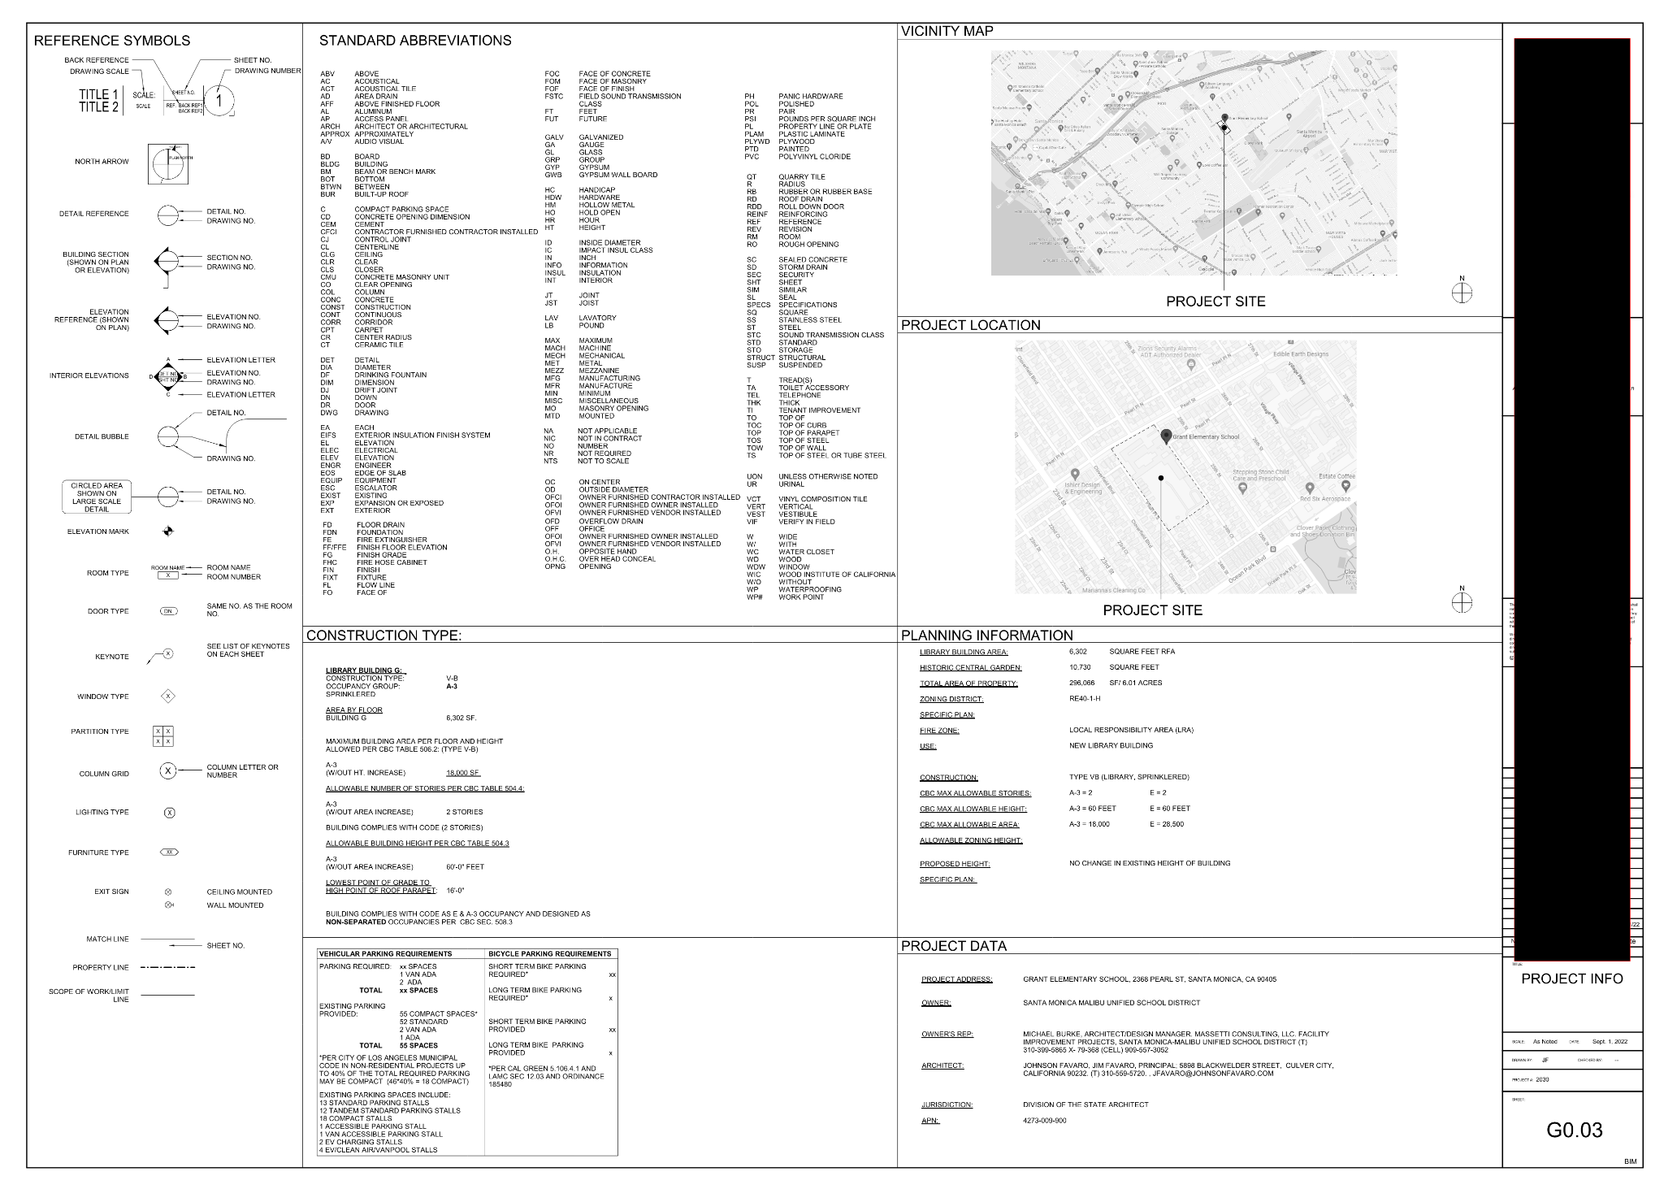
Drawings
Notes:
SH: When we get a program from an owner, we start to visualize how the space is going to lay out. Once we apply the code to those spaces, it requires things such as exiting and fire rated corridors to address life safety issues.As a specifier, I usually don’t get involved with the project until after the design is pretty settled. The drawings I receive have a life safety plan indicating one and two hour rated walls, corridors and closures, etc. I rarely get a door schedule until later in the process.
I find it’s helpful to understand how the codes apply to your project and in which situations. Especially because we are pricing our sets before the building department review and often overlooked are the expensive items required to be added to meet life safety. Such as fire or smoke rated doors. And let’s not forget coordination issues that accompany adding items last minute. Worse than having to add an expensive door is now having to figure out how to get power to it.
Clearly We will be talking a lot about codes today. Construction Documents hold vital clues for elevator safety and compliance with fire control. Understanding them can unveil crucial design decisions that impact elevator smoke and fire control requirements.
Each Drawing Set includes the parameters shown here and are typically found in the G Sheets at the beginning of the set which hold the General Information that apply to the entire Project.

Slide 5
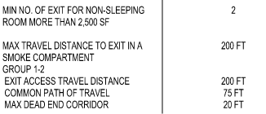
Drawings Breakdown
Occupancy Group
Building Construction Type
Building Height
Automatic Sprinklers
Notes:
SH: What we are looking for in these sheets are occupancy group, building construction type, height of the building, and if the building is sprinklered. These items in particular are clues to determining what the fire ratings are going to require for your design with respect to fire and life safety.

Slide 6
Drawings Breakdown
3006.3 - pressurization
I-1, I-2, I-3 Occupancy
120’ - Fire Service Access Elevator Lobby
420’ - Occupant Evacuation Elevator Lobby
3006.2 #1 If a building is more than 3 stories and has no sprinkler system, protection is required.
3006.2 Exception 2 Protection is not needed at the level of exit discharge if that level has an automatic sprinkler system
1009.6.4 - areas of refuge must be designed to limit smoke
Notes:
Here are some codes to consider when it comes to the basic drawing information.
CLICK CLICK
There are some expectations in the elevator code when it comes to I occupancies.
Group I-2 is the only occupancy you cannot use pressurization - 3006.3
3 stories or greater and I-1, I-2, or I-3 occupancy = needs elevator protection
CLICK CLICK
Building Height
120’ - Fire Service Access Elevator Lobby
420’ - Occupant Evacuation Elevator Lobby
Is it an addition or new build?
In the case of an addition, there are different thresholds on when elevators and fire and smoke protection need to be updated
CLICK CLICK
Type 1 requires the highest level of fire-resistance protection - typical for a high rise, usually trying to keep fires at bay in specific rooms or floors
CLICK CLICK
Automatic sprinkler system
3006.2 #1. Elevators connecting more than 3 stories are required to be enclosed when a building is NOT protected with an automatic sprinkler system
3006.2 Exception 2. Protection of elevator hoistway openings is not required at the level of exit discharge provided that level is equipped with an automatic sprinkler system
Smoke Compartmentalization in a building.
1009.6.4 Areas of refuge must be designed to limit the intrusion of smoke. Area of refuge is defined as if someone cannot use a stairwell, there is a temporary area that is contained from smoke.
The maximum distance to exit in a smoke compartment can indicate where you need horizontal smoke separation

Slide 7
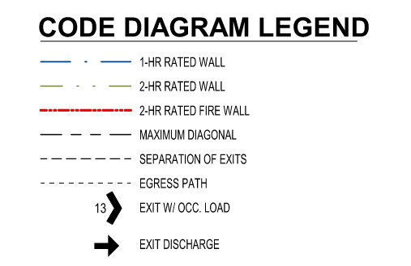
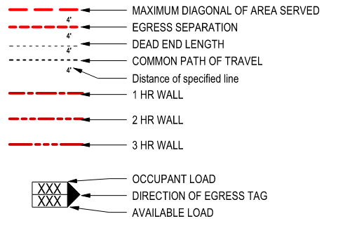
Legends
Notes:
SH: Architectural firms have several ways in which to identify wall ratings and egress paths. Recognizing code implications stemming from design choices is essential for aligning with safety regulations in elevator smoke and fire control applications.

Slide 8
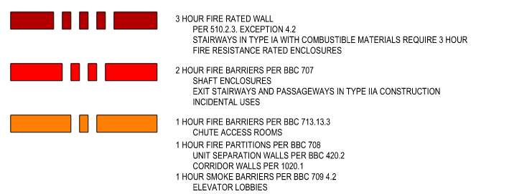
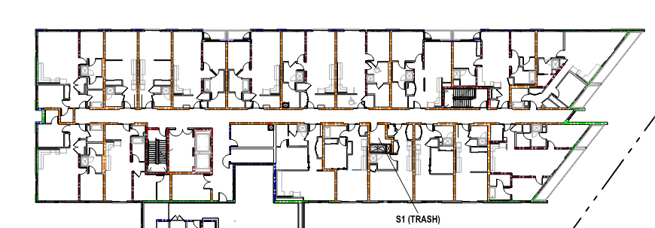
Legends
Notes:
SH: Legends will be identified on Life Safety Plans, or Fire Ratings Sheets also included in the front G or General Drawings. The other location you will find wall rating information is on the Floor Plans in the form of a Key Note.

Slide 9
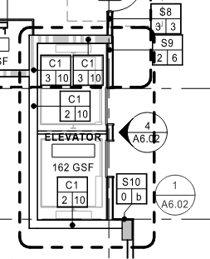
Legends - Symbols
S= Steel Framing
2= Fire Rating
4= Framing Size
Notes:
SH: This Example uses Assembly types to tell us the components of each wall assembly.
Notice also in this example the wall hatch marking for the wall at the top of the page. That also is an indicator of a rated wall. We will touch on this in more detail later in this presentation.

Slide 10
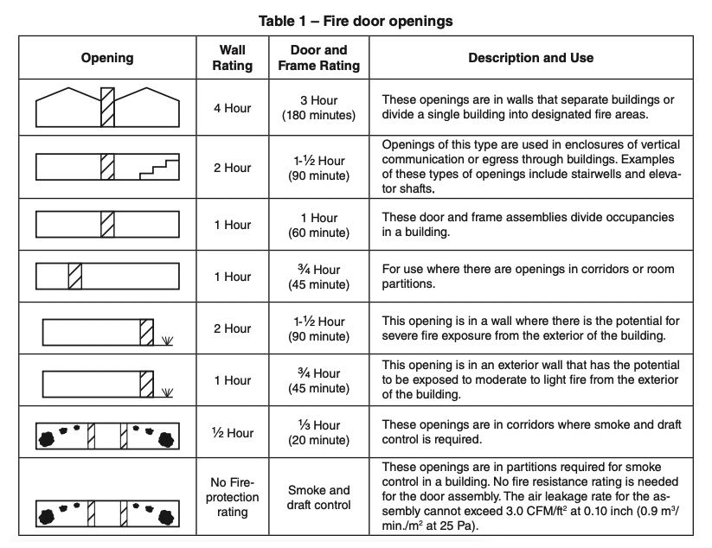
SDI
Steel
Door
Institute
Notes:
C: SDI is the Steel Door Institute. SDI 118- 2021 version shows this table in relation to fire door openings
Fire rated doors are typically rated for ¾ of the surrounding walls.
Typical ratings for doors include:
A label - 3 hour
B label - 90 minute
C label - 45 minute
20 minute
Plus, you have Smoke and Draft Control
Having this chart will help you to determine what ratings you may need for doors and frames, versus the wall ratings.

Slide 11
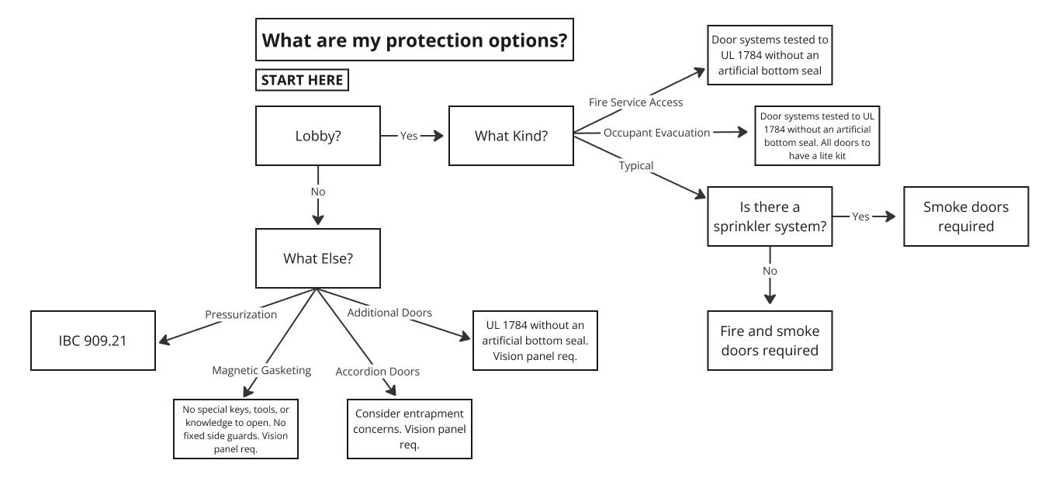
Notes:
CK: First we will begin by looking at what the protection options are for elevator smoke and fire protection.
The first thing most of us think of when protecting elevators is by creating a lobby!

Slide 12
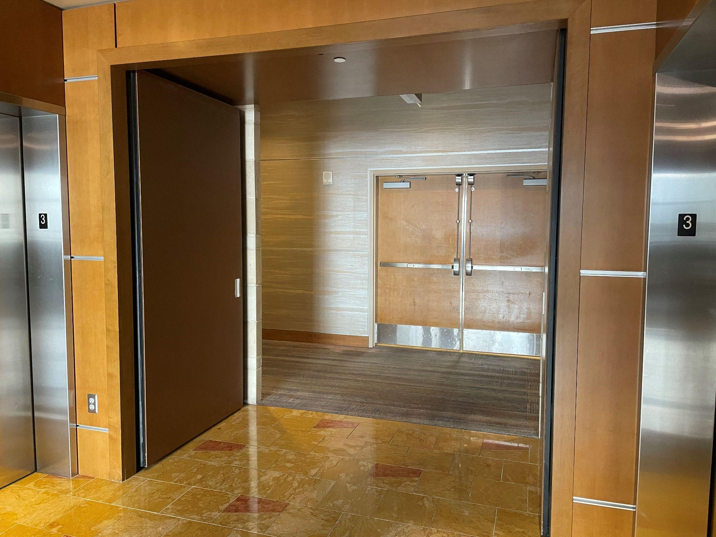
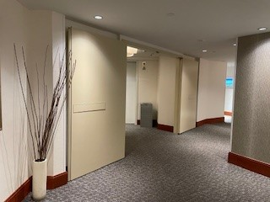
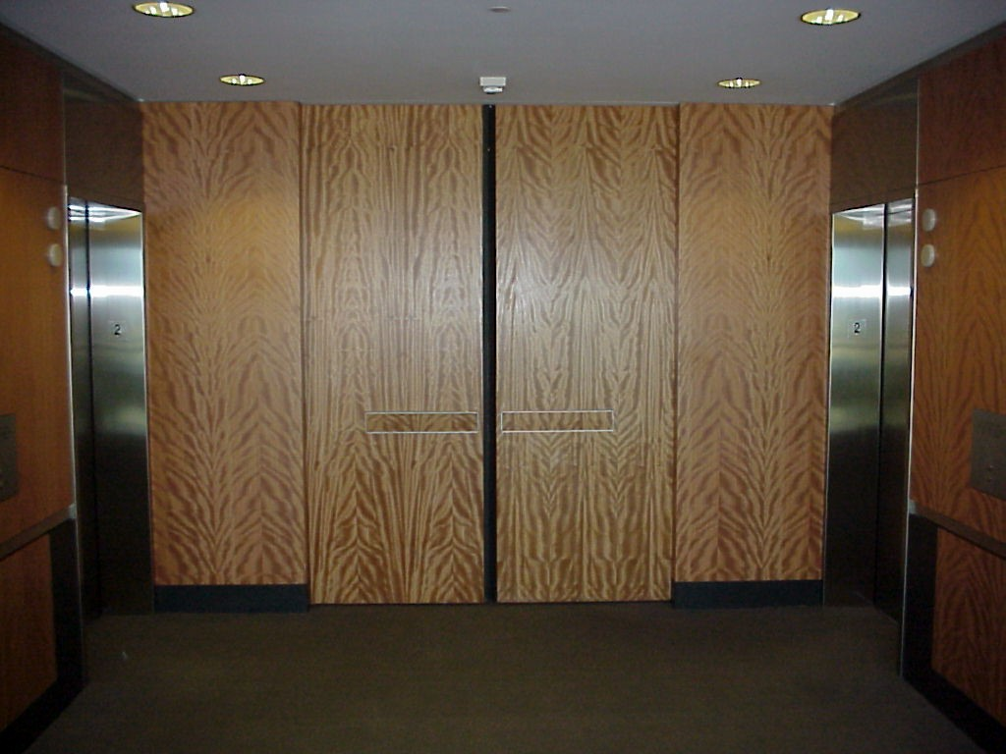
Elevator Lobby
Notes:
CK:
When creating an elevator lobby, you can hold the doors open or have them closed. Match them to the surrounding wall finish or pocket them into the surrounding wall, you can create a very nice lobby that protects against smoke travel.
Gasketing and sweeps will be the most important code consideration for elevator lobbies. With a Total Door, gasketing is automatically included. Sweeps can be chosen based on the opening. If the doors are closed, a mortised sweep might be best. If the doors are open, a surface mounted sweep will likely be best.
A Total Door integrated door system is a great option to create a lobby because we can match it with surrounding walls, pocket the doors, and create a seamless integrated look. Ensuring you have a compliant opening is easy because all the hardware, accessories, and gasketing are included under a single testing label from a single source.

Slide 13
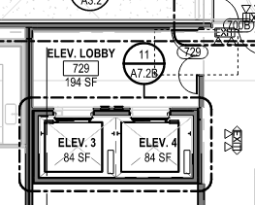
Elevator Lobby
3006.2
# 1 and # 2
DOOR SCHEDULE
Notes:
S: This is an example of what I would normally see on the Drawings showing an Elevator Lobby. The Architect has designated a space called Elevator Lobby. The doors are swinging into the lobby and they are indicated as only requiring a 20 minute rating.
Candace, what do I need to know about these doors to make a good decision. Can this just be a hollow metal or wood door?
CK: This pair of doors is swinging into the elevator lobby, so you would want to identify the occupancy level for the lobby space. If it is no more than 50 people, then that is acceptable.
According to code, elevator lobbies must have a 20 min fire rating at a minimum.
3006.2 number 1: You may protect the lobby using fire doors. These doors need to be tested in accordance with UL 10C which is the positive pressure fire test.
3006.2 number 2: You may use a smoke partition in lieu of a fire partition as long as the building is sprinklered. Sprinklers for the control of fire, the smoke partition for the control of smoke.
You may use hollow metal doors that meet UL 10C and smoke requirements. I do, however, recommend using Total Door because you know the entire system will be compliant and you do not need to get hardware and the door from various sources. Factor in the ease of a Total Door installation, and the pricing will be very comparable to conventional doors and hardware.

Slide 14
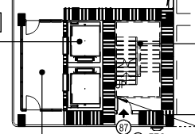
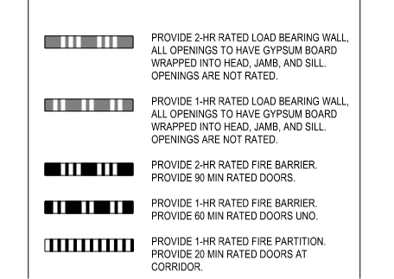
Elevator Lobby
Notes:
S: This drawing shows a 2 hour rated barrier around the elevator and stairs. This legend also shows the requirement for 90 minute doors. Candace, is this correct?
C: Yes. Surrounding the elevators is a 2-hour rated barrier, so a 90 minute door is perfect. That is ¾ the surrounding wall. It is based on the surrounding wall, not the shaft rating.
This building is sprinklered, it it more than 75 feet tall, and this lobby is on the fourth floor.
Based on that, I could conclude that this elevator WOULD need protection.

Slide 15
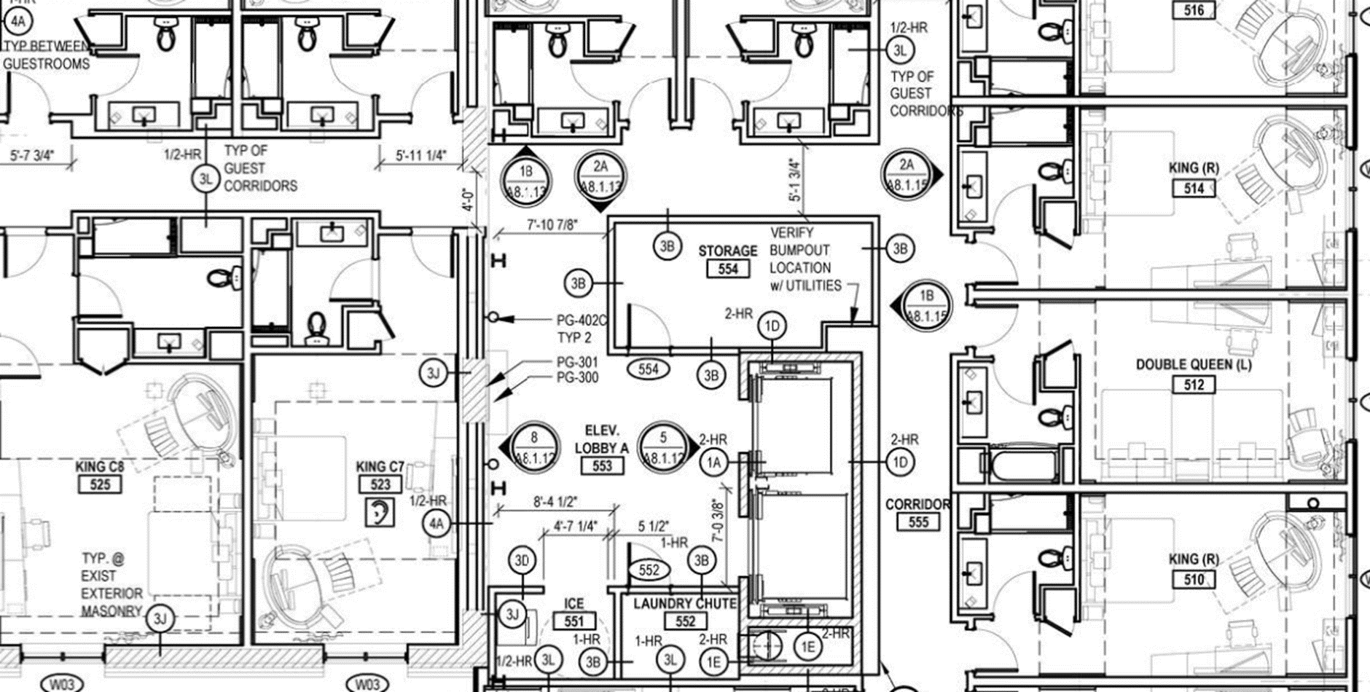
Elevator Lobby - Continuity
3006.2.1 Continuity in a corridor
Notes:
S: On this drawing there is an elevator lobby called out, but there are no doors that enclose it to create the lobby enclosure.
C: This is a rated corridor. 3006.2.1 covers corridor continuity on a rated corridor. With that being said, you would need to enclose the elevator lobby.
S: Could I just use a smoke curtain in front of the elevator openings?
C: Certainly! As long as this is not a fire service access elevator lobby or an occupant evacuation elevator lobby - which we will talk about later, then you could use a curtain as an alternative.
S: It sounds as though I need to look at my options again.
C: We will go through your product options over the next few slides. As an overall, your options will be heavily based on the space you have and the look you are trying to achieve. For this area, you could go with lobby doors as we talked about, additional doors in front of the elevator shaft, curtains, pressurization, accordion doors.
Designing a pocket for a Total Door paired 90° application would make for a seamless, pocketed opening and provide the protection you need to create an enclosed lobby!

Slide 16
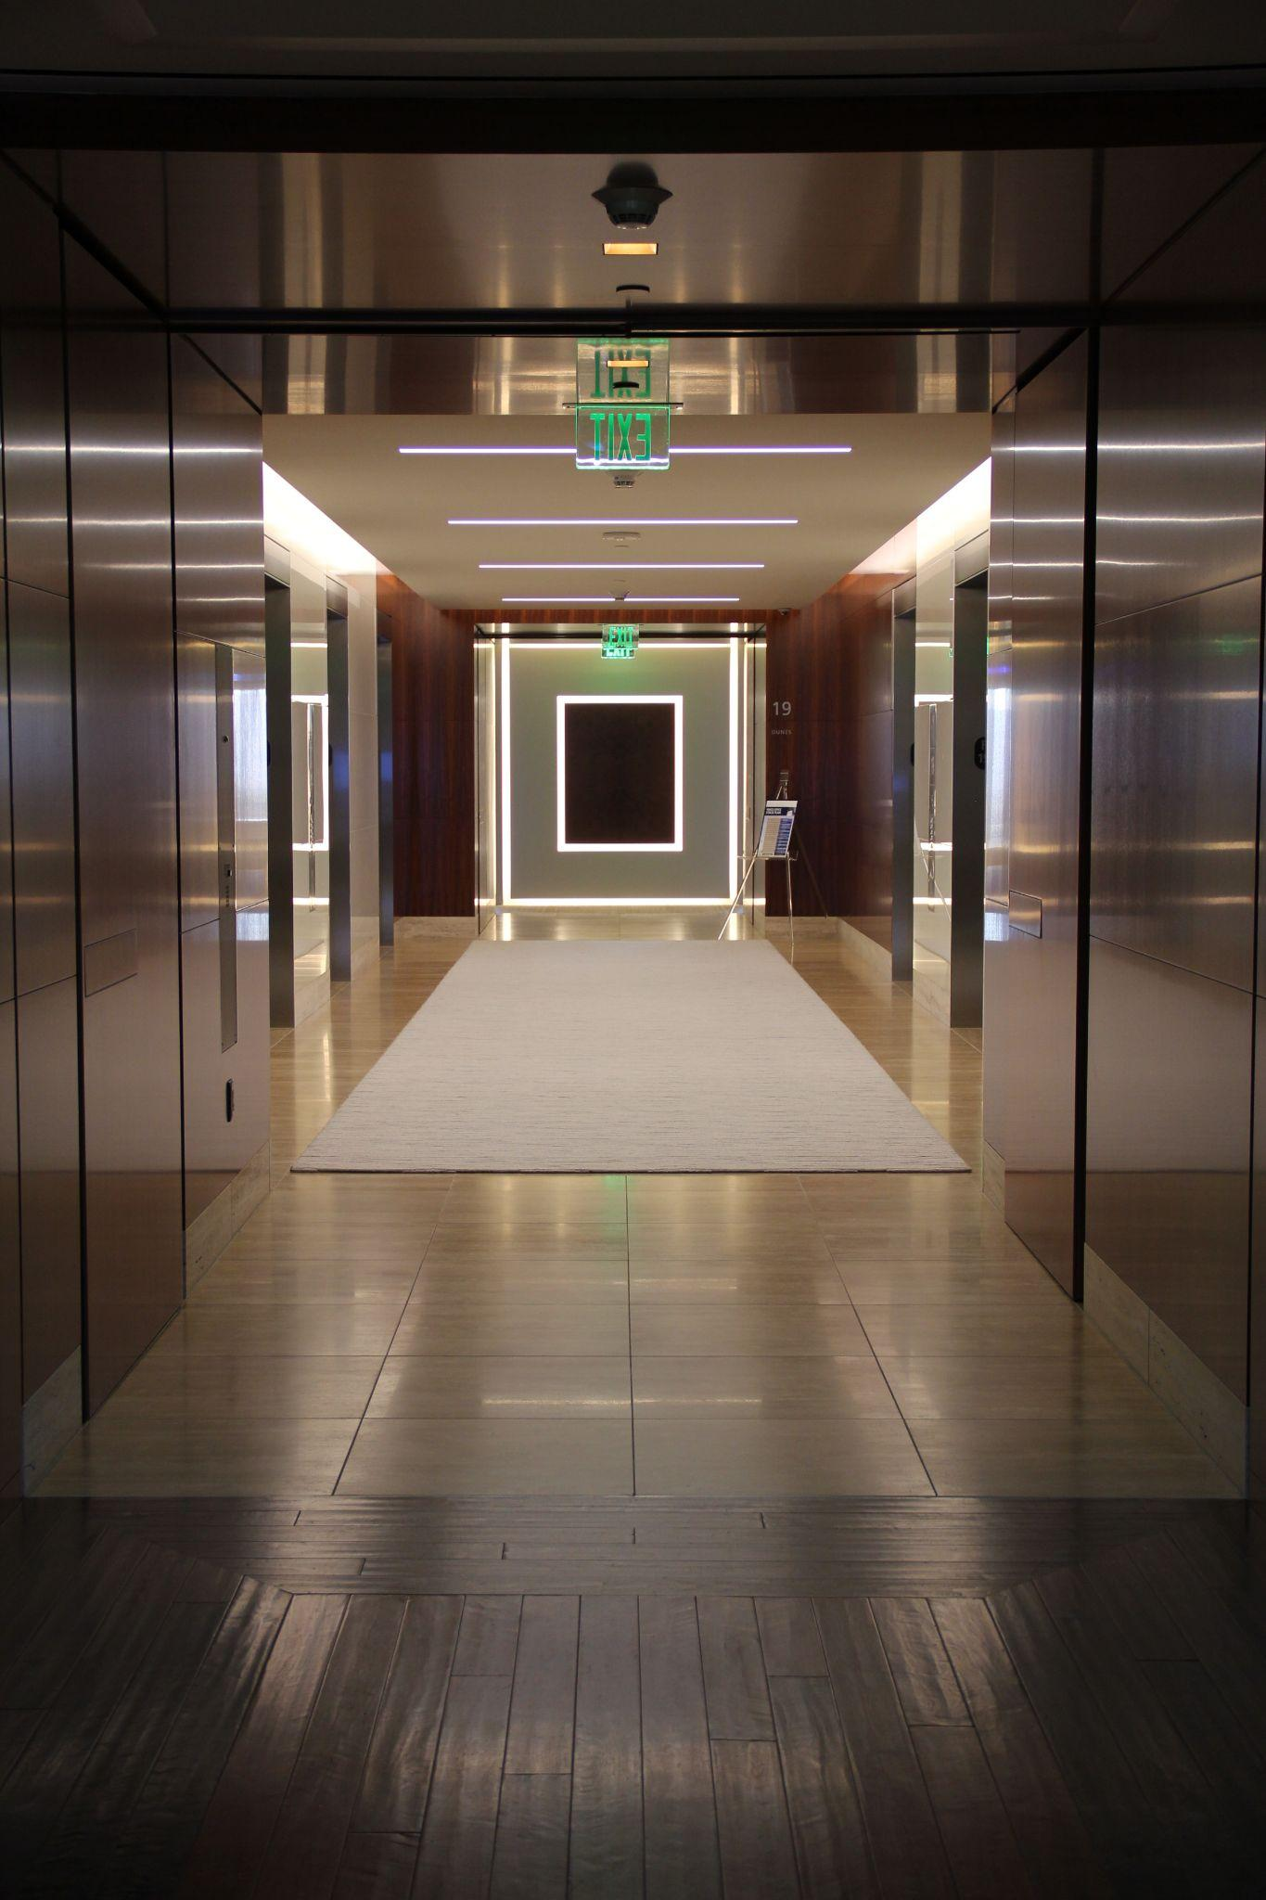
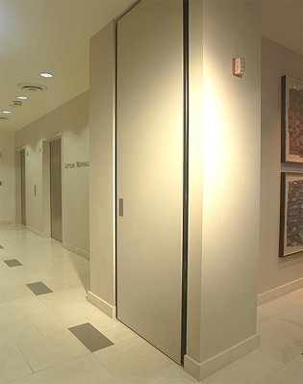
Elevator Lobby
Notes:
Here are two examples of Total Doors creating elevator lobbies. They are pocketed into the wall and designed to be held open and out of the way unless triggered by the local fire alarm.
You’ll note in the left picture, the push side device is a push pad and the on the right picture, panic egress bars. When it comes to fire exit hardware, you will want to look at path of egress, occupancy type and occupancy load to determine if you need panic hardware for the opening.

Slide 17
ASME A17.1
Notes:
S: I imagine there are some other options if I don’t have space for an elevator lobby.
C: If you do not have the space for a lobby or choose to go with an alternative option, there are some things to consider. We will go through each option, but first, let's recognize a universal code that is important to each alternative solution.
ASME A17.1

Slide 18
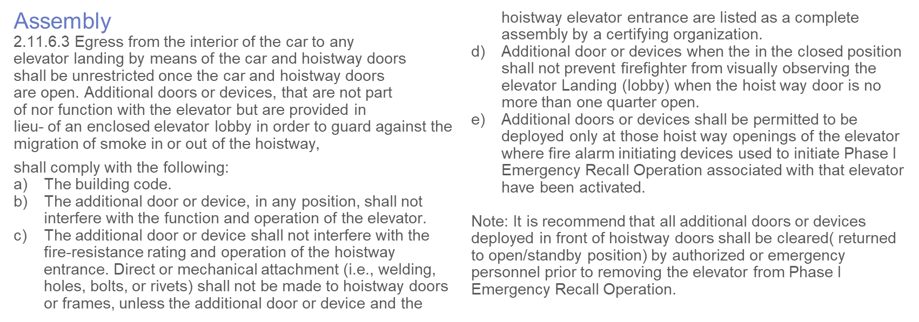
ASME A17.1
Notes:
ASME A17.1 refers to additional doors or devices in directly front of the elevator shaft. It says: the additional door or device, when in the closed position, shall not prevent firefighters from visually observing the elevator landing (lobby) when the hoistway door is no more than one quarter open.
Let's look at this visually.

Slide 19
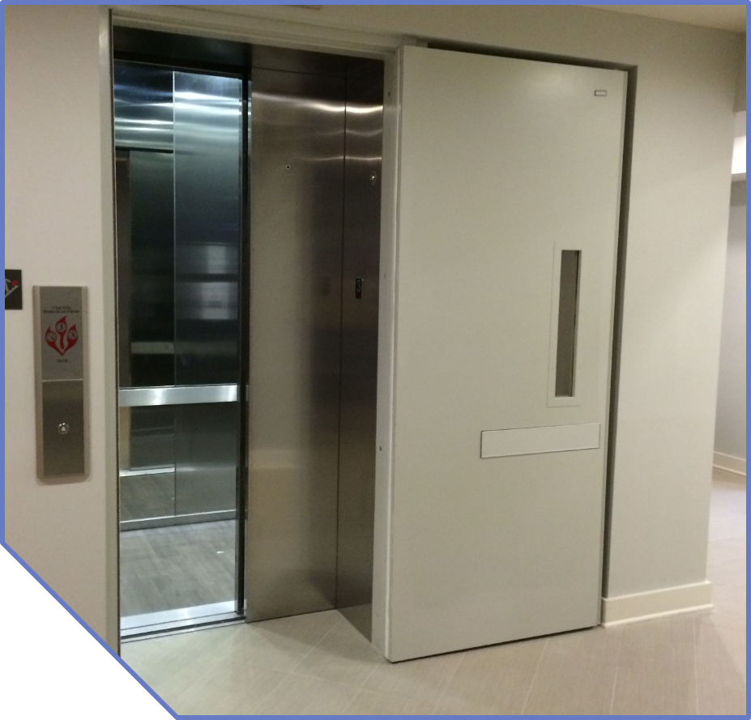
ASME A17.1
Notes:
C: This elevator is opening from the left side of the screen to the right side of the screen.
Use your imagination and close the additional door in front of the elevator shaft. That would make the lite kit in the first quarter opening.
S: Why is that so important?
C: If there is a first responder and they need to see two things: 1. does someone need my help? and 2. has this corridor been compromised? they need to take a crowbar to the cab door and only want to open it ¼ of the way. That is precious time when considering life safety and the lite kit in the wrong spot can cause a large hindrance.
SO… additional doors or devices must have a vision panel AND it must be in the first quarter opening.

Slide 20
Notes:
SH: Okay, let’s cover those other solutions we can use when there isn’t room to add an elevator lobby.
CK: Let’s start with additional doors in front of the elevator shaft.

Slide 21
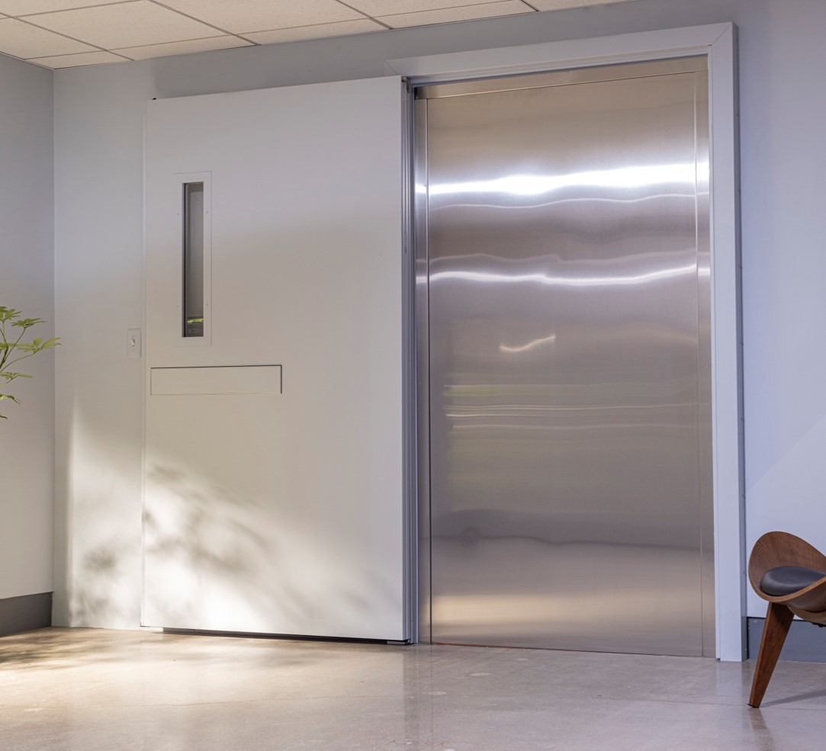
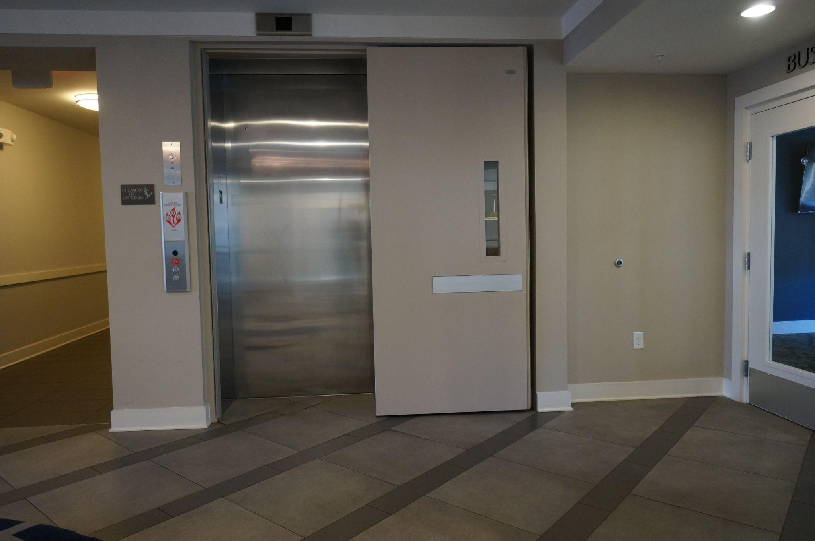
Integrated Door Systems
Additional Doors
Notes:
C: Here are Total Doors that are directly in front of the elevator shaft. You will notice they do have lite kits for the code ASME A17.1. They are providing smoke and fire protection for the shaft opening. You can pocket the door, like the picture on the left, or you can use a surface mounted frame that mounts around the outside of the elevator shaft like the picture on the right. No pocket building is necessary and all the hardware fits behind the door.

Slide 22
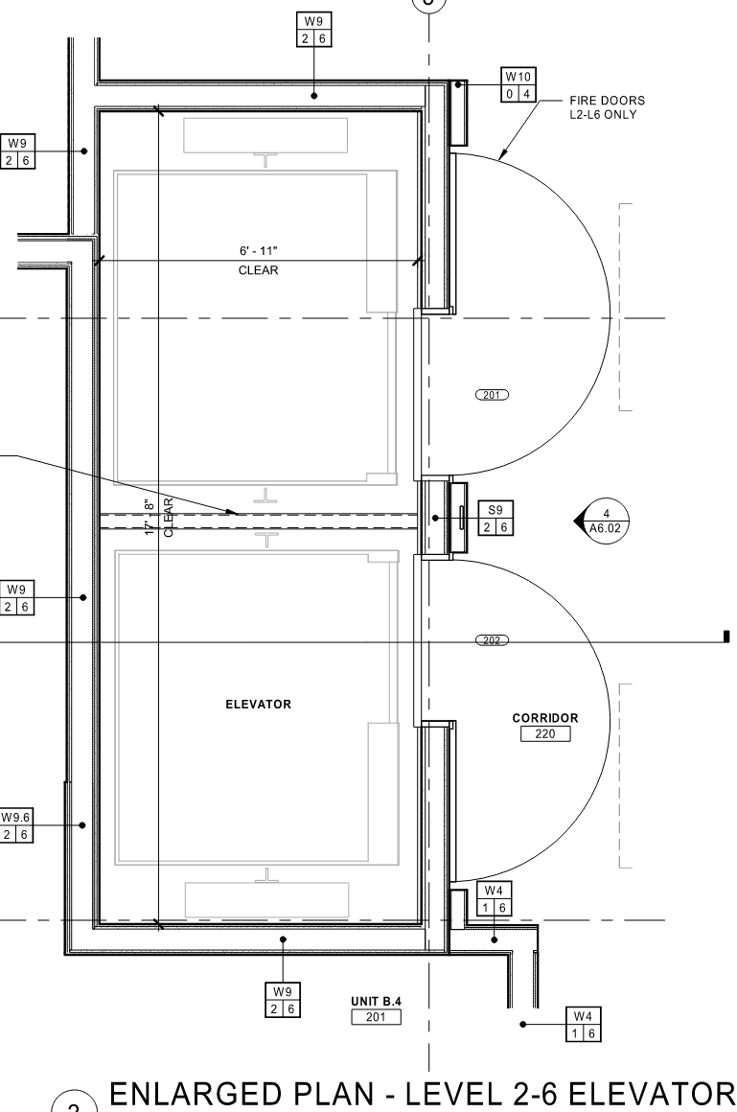
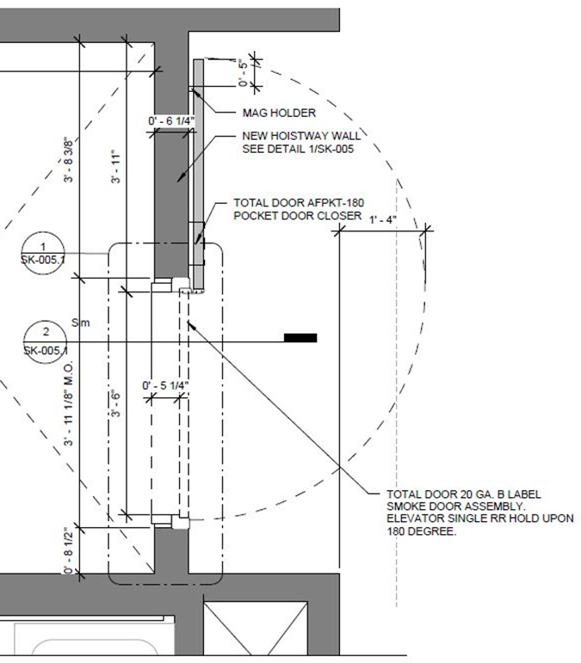
Integrated Door Systems
Additional Doors
UL 1784 without an artificial bottom seal
Notes:
S: I think these 2 examples are plans similar to the pictures you just shared. The elevators open into a corridor. The Drawing on the right indicates an additional door in front of the elevator shaft for smoke control at the Levels 2-6. I looked at the Door Schedule for these Door Numbers and the architect called out an “Elevator smoke door”. But this Drawing calls out a fire door. Candace, which is the correct term? What does the Architect mean by this and what would I specify?
C: The BEST way to say it would be an additional smoke door in front of the elevator shaft. Unfortunately with doors and hardware, terminology gets mixed and crossed all the time. The important thing to note about this opening is that you would need a SMOKE door here.
S: What are the requirements for this additional smoke door?
C: This additional door needs to be tested to UL 1784 without an artificial bottom seal.
In horizontal openings smoke and draft control doors are often called out and the testing requirement doesn’t measure how much smoke travels through the bottom of the opening because the idea is that hot air and smoke rises. In these vertical openings, it requires that the additional doors be tested as a complete system under a single testing label and without an artificial bottom seal. So adding a door bottom later or drop seal is not compliant.

Slide 23
Additional Door Solution
Notes:
S: How will I know if the additional door is a tested system?
C: Find the label on the door in the field and look at it. Every label should be extremely easy to read. This is an example of a Total Door label here stating certified to UL 1784 without an artificial bottom seal. When specifying, you should ask for a Fire Certificate of Compliance and that will state the performance standards.

Slide 24
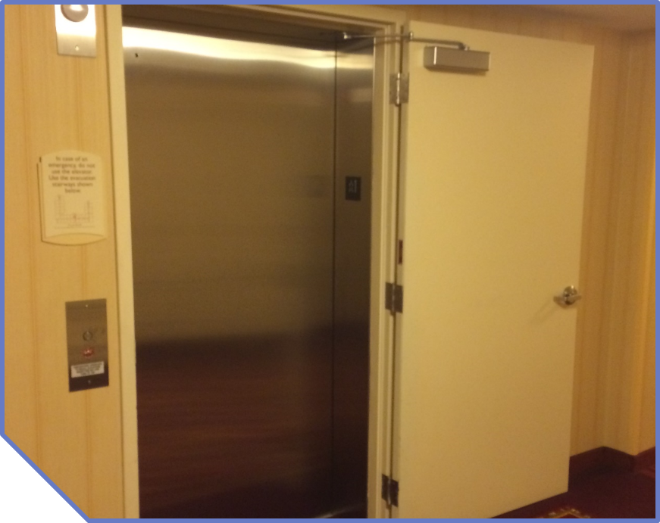
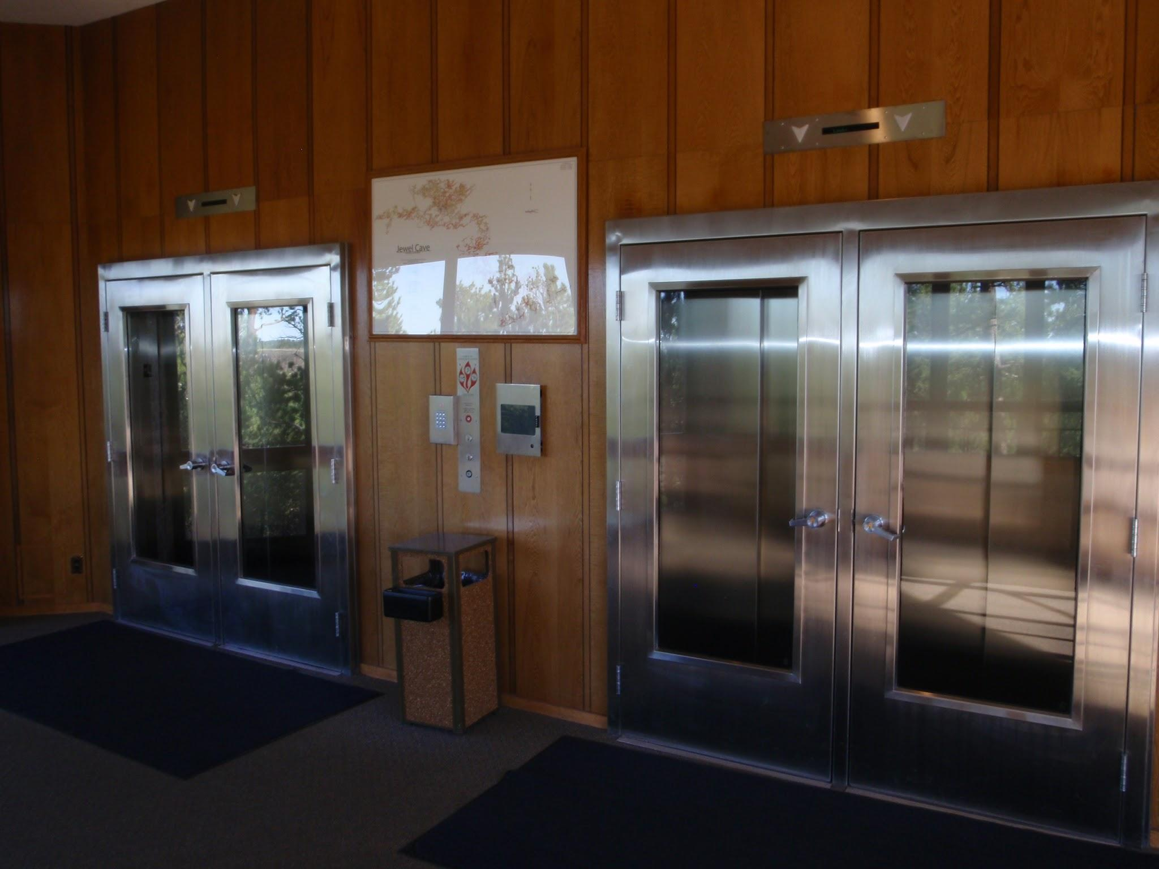
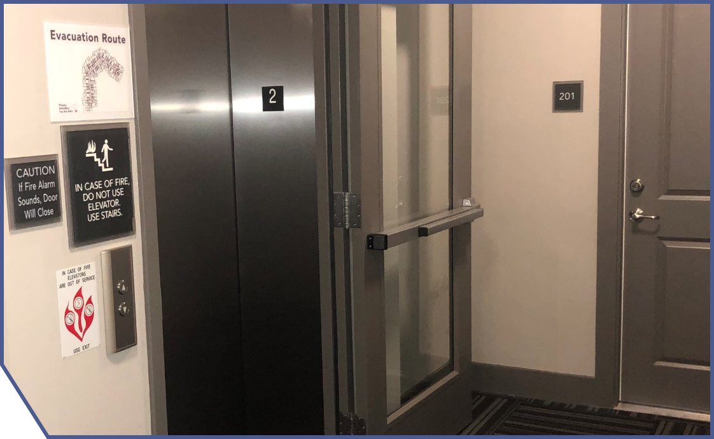
Non Compliant Examples
Notes:
C: These examples are non compliant because the doors are not tested to UL 1784 without an artificial bottom seal. Visually, the only way to know is to look for the label that identifies code compliance.
As it stands, Total Door is the only swing door that has been tested to UL 1784 without an artificial bottom seal.

Slide 25
Notes:
S: And if I don’t have the space for an additional door, what is my other option?
C: You may consider pressurization.

Slide 26
Pressurization
Notes:
C: Pressurization involves large fans at the top of the building that inject large quantities of air into the shaft pushing the smoke into a cavity below the building.
Pressurization has no true way to be tested and can fail as much as 35% of the time. According to NFPA 252 there is a ⅜” gap allowance between the actual elevator cab door itself and the elevator frame. That adds up to about 9” by 9” and that pressure level is going to fluctuate constantly.

Slide 27
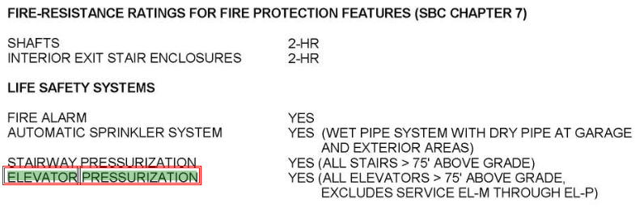
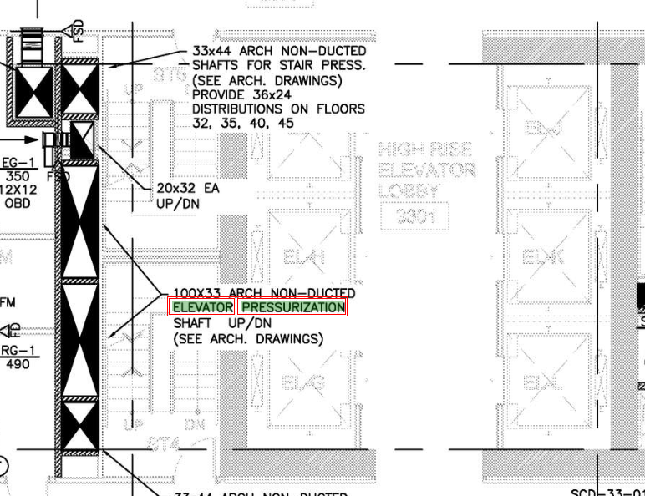
Pressurization
909.21 Pressurization
Notes:
SH: I see very few projects with pressurization but that doesn’t mean they aren’t out there. The clue here is found in the code summary notes on the General Drawing Sheets. If you have access to the mechanical plans, you may find the reference there as well as shown on the Drawing on the right.
C: Information on pressurization can be found in IBC 909.21.
Eighth and Howell Hyatt Hotel - Seattle, WA - code summary page

Slide 28
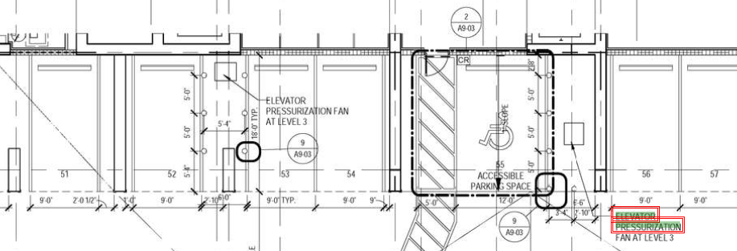
Pressurization
Notes:
SH: You can see here pressurization is simply called out on the floor plans.
One Saint Petersburg, St. Petersburg, FL - level three floor plan

Slide 29
Notes:
C: Another option is magnetic gasketing.

Slide 30
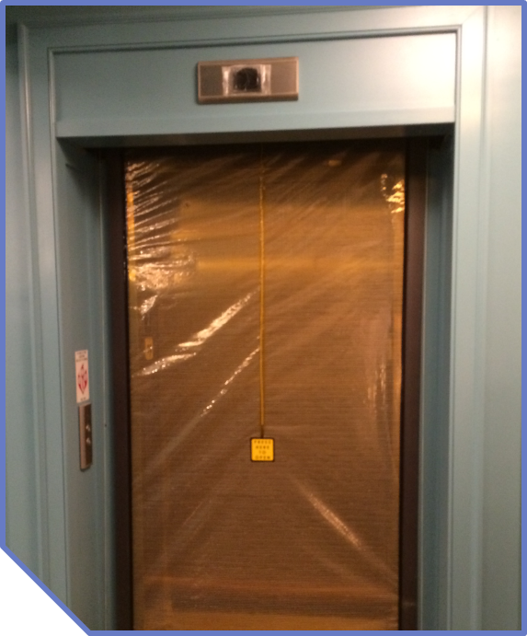
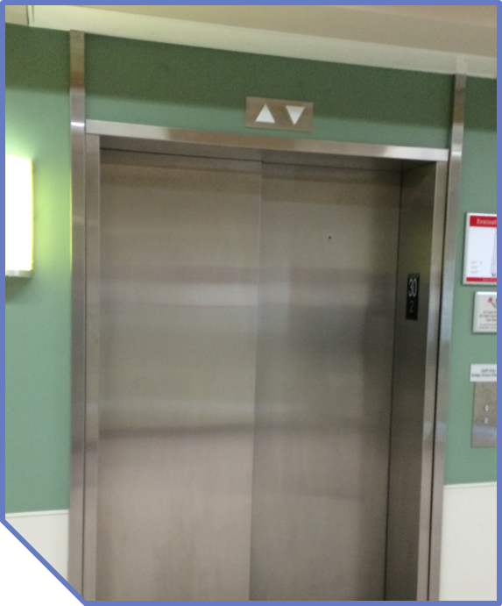
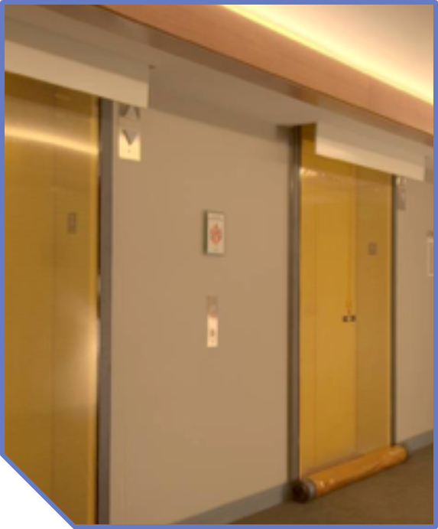
Magnetic Gasketing
Notes:
SH: Magnetic gasketing.. Is that the code term for Smoke Curtain?
C: Magnetic gasketing is the true technical term and other terminology could be referring to a brand name or a specific type of curtain.
S: I’ve always called it a smoke curtain, but that makes sense and I am a big fan of keeping generic terminology on the Drawings. What should I know about magnetic gasketing?
C: Magnetic gasketing rolls down a magnet on the side of the shaft. There are other curtains out there that have weighted iron rod bottom bars, are captured in fixed side guards, they are opaque and you cannot see through - so they do not comply with ASME A17.1. Or they may require special knowledge to open.
Typically, magnetic gasketing is only smoke rated and you will get double the protection by using an additional door. Magnetic gasketing may be hidden in a soffit in the ceiling that either has to be built out like you see on the right or stick out like you see on the left.

Slide 31
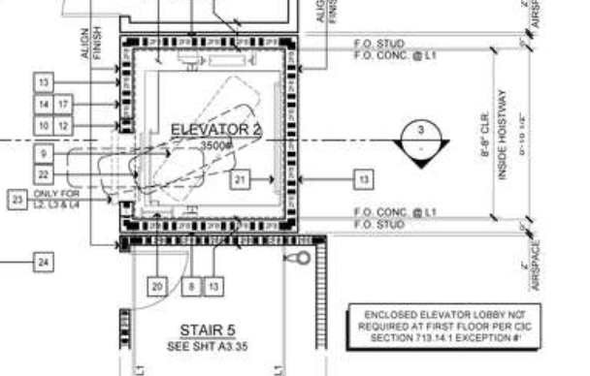
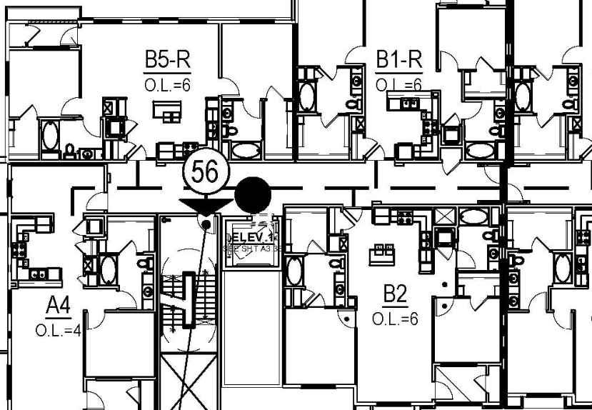
Magnetic Gasketing
Notes:
S: In this plan the architect has called out proprietarily on Line item number 23 smoke guard model 200 and it even references the code where additional protection in front of the elevator shaft is acceptable.
Warm Springs Multi Family Apartment - Fremont, CA

Slide 32
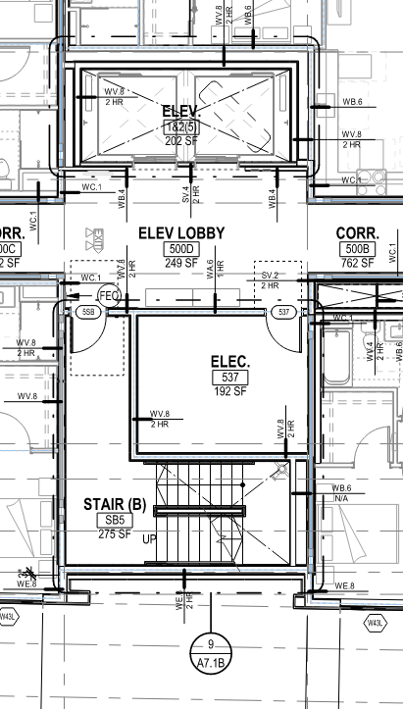
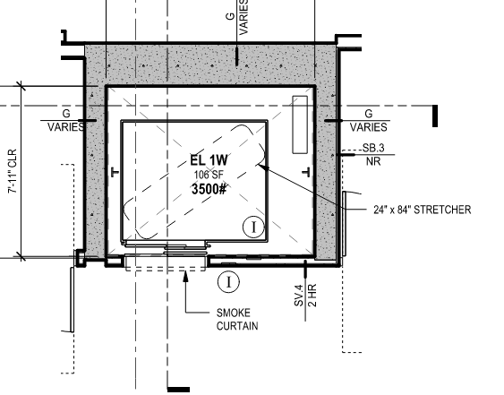
Magnetic Gasketing
Notes:
SH: For less obvious drawing Clues, the dotted lines in front of the elevator openings on both of these sample plans, indicates that there is some type of curtain or rolling magnetic gasketing system, above the door. As Candace mentioned, because these systems are typically enclosed in the soffit above the opening, you won’t find them on the interior elevations, but you can also look at the reflected ceiling plans for an indication of the system.

Slide 33
Notes:
C: Your last option would be an accordion door. Typically we see this is large atrium-like openings.

Slide 34
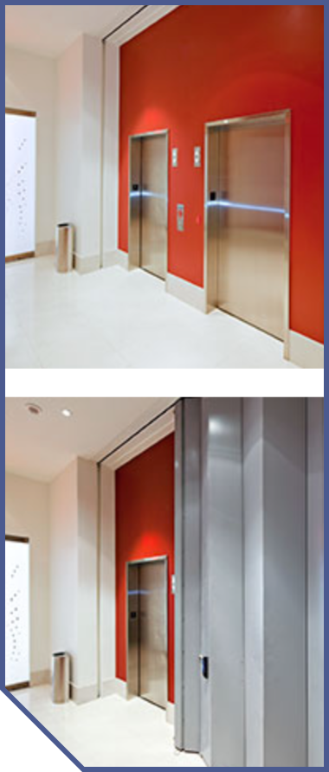
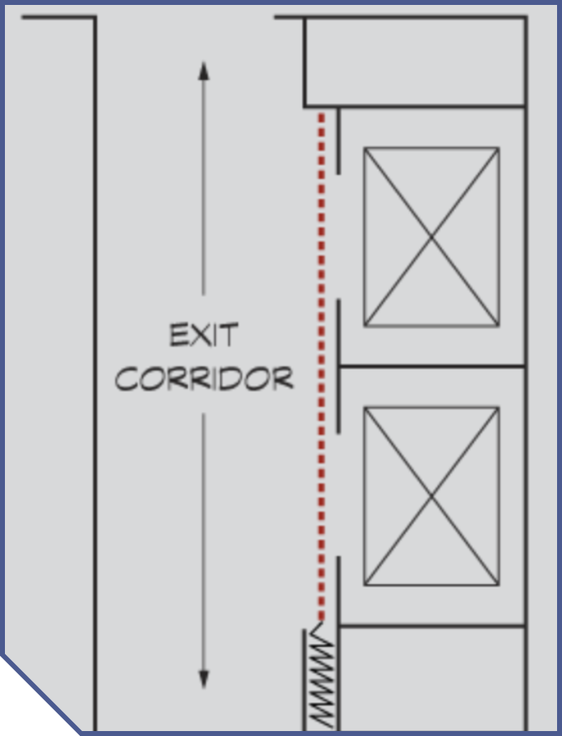
Accordion Doors
Notes:
C: An accordion door will hide either horizontally or vertically and deploy using a track and gasketing to form the smoke resistant seal. This door has the right idea but there are a couple of concerns. There is no egress, so an additional door inside the accordion door would provide that. Also, there is no lite kit per ASME A17.1. Lastly, there is a slight concern for entrapment between the elevator doors and the accordion door.

Slide 35
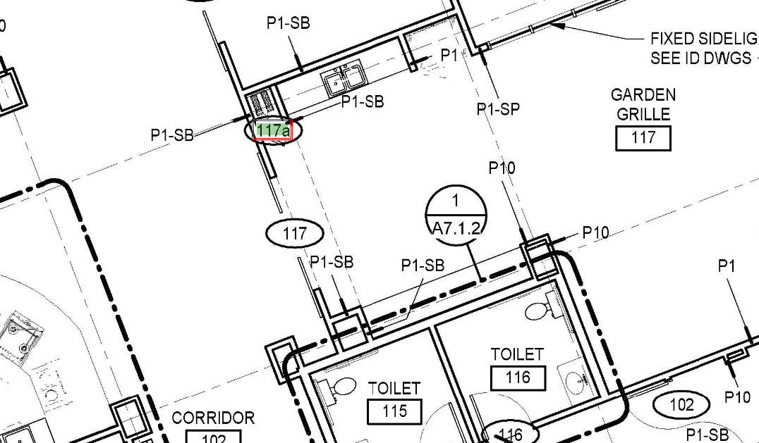
Accordion Door
Notes:
S: An accordion door might be a better fit for an atrium-like opening. This accordion door is shown in the wall right above 117A and just called out in the door schedule.
Kensington of Bethesda

Slide 36
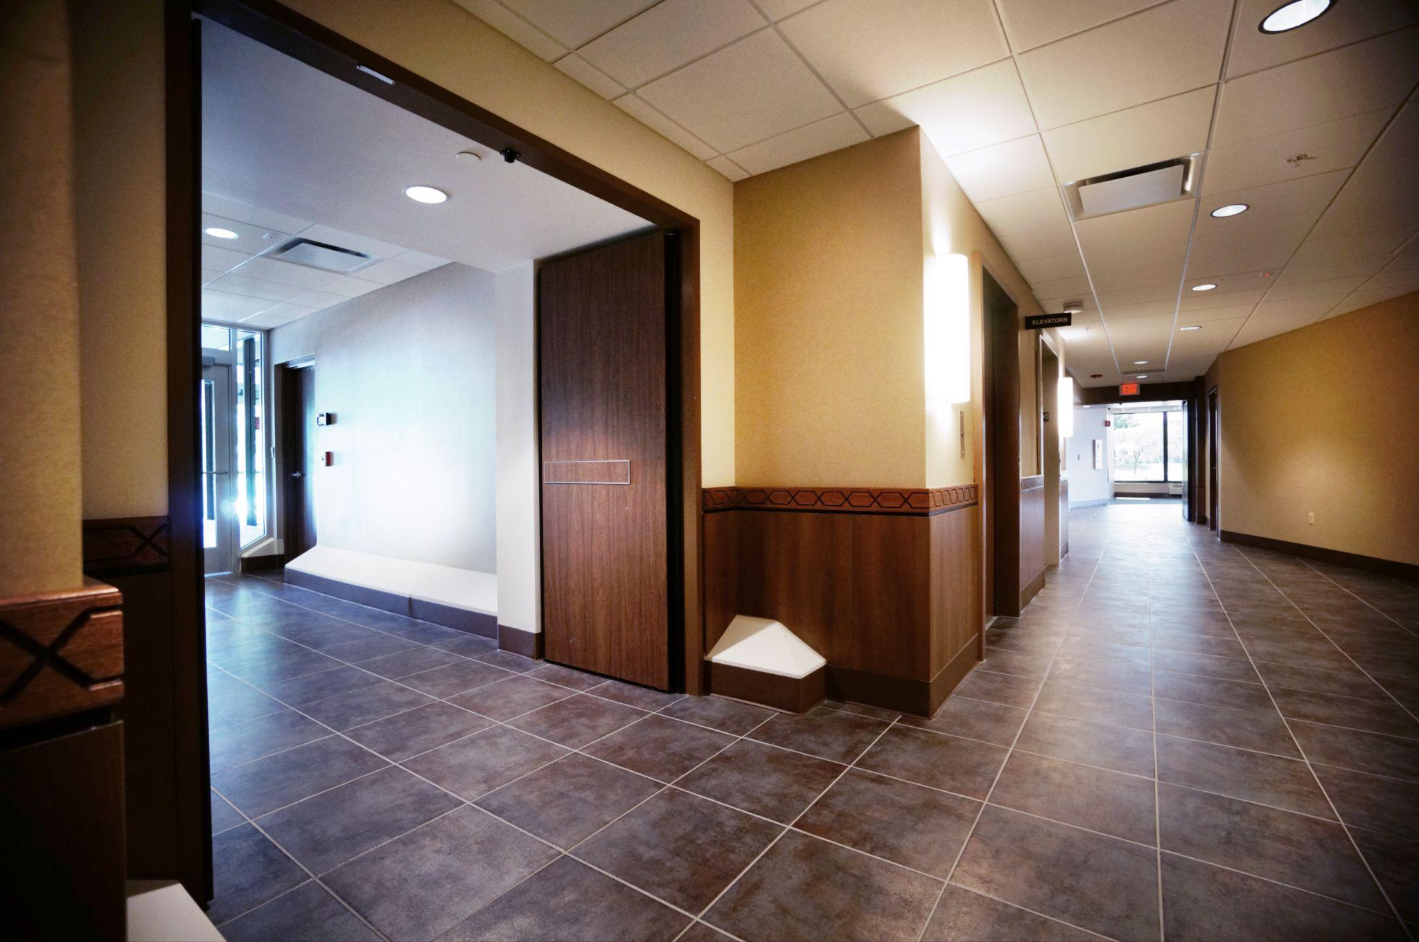
When Do I Need Protection?
Notes:
S: Let’s move on to more life examples. When do we need protection?

Slide 37
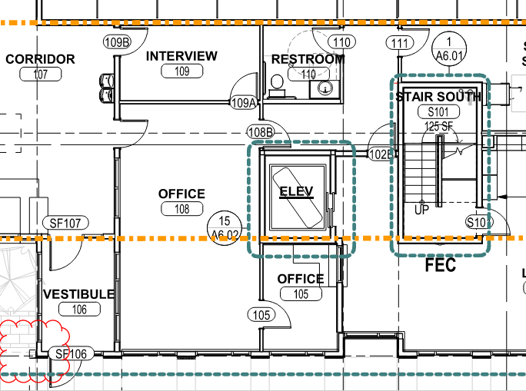
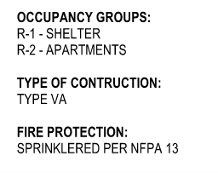
1st floor
3006.2
Exception 2
Notes:
S: As you have heard, figuring out what is needed requires code footwork. Let’s look at a few more examples. Here is an apartment building. The elevator opens into the Lobby – what are my questions to determine what treatment is needed for the elevator?
C: The first question we want to ask ourselves is: Is this a rated corridor? This question supersedes all other questions!
S: this is the first floor and It is not rated. BUT according to the Code Sheet, it is a sprinklered building.
C: 3006.2.1, exception number 2. Elevator protection is not required at the level(s) of exit discharge, provided that the level(s) of exit discharge is equipped with an automatic sprinkler system.
You do not need protection on this level - it is sprinklered and not rated!

Slide 38
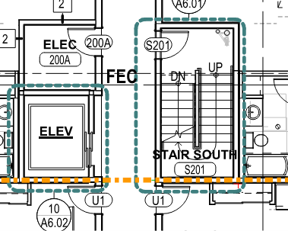
2nd floor
3006.2.1
Rated Corridors
Notes:
S: That is the case for level 1, so let us look at the 2nd floor of that same building? The elevator opens onto a rated corridor. Do I need to treat this opening?
C: According to 3006.2.1 for Rated Corridors: From the point of entry to the point of exit, the entire corridor must be rated including elevator shafts and stairwells. We are creating a safe egress passageway.
This is rated, so it does need protection.

Slide 39
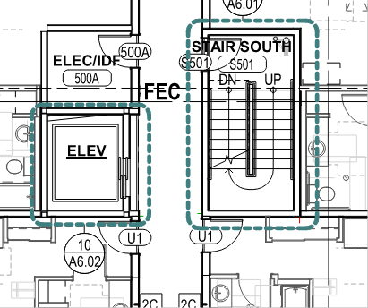
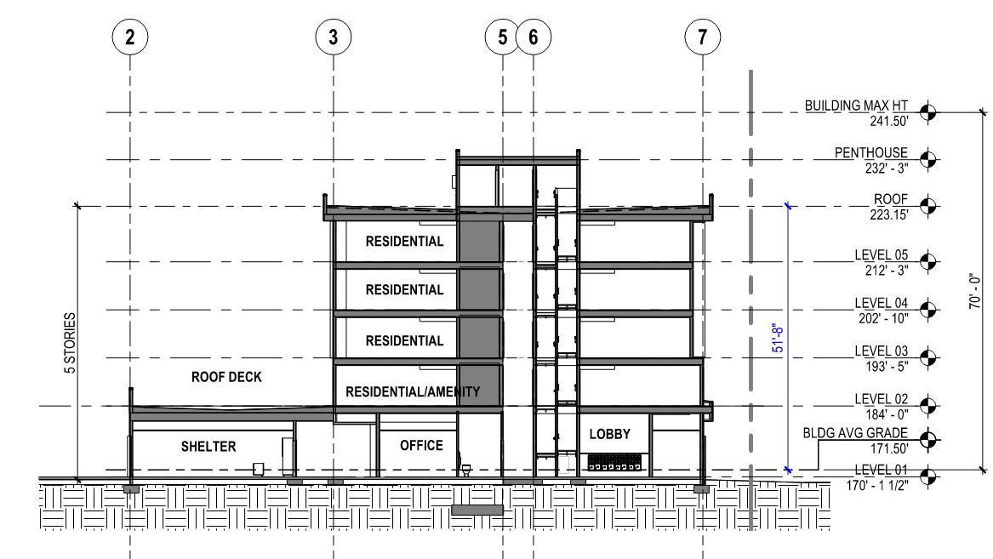
5th floor
3006.2
Notes:
S: Okay, that makes sense because it is a rated corridor. So, what happens on the 5th floor? This is above 75 feet.
C: 3006.2 says elevator hoistway door openings shall be protected where an elevator connects more than 3 stories and one or more of the following applies:
The building is not protected with an automatic sprinkler system - well, the building is, so this would not apply.
The building contains a Group I-1, Condition 2 occupancy, an I-2, or I-3 occupancy - it does not, so these would not apply.
The building is a high rise and the elevator hoistway is more than 75 feet in height. The height of the hoistway shall be measured from the LOWEST floor to the highest floor of floors served by the elevator.
This is true! So this elevator would need protection!
S: Every floor needs to be considered on its own. What is required on one floor may not be required on all. I need protection at the 5th floor and above. The designer has chosen to not include an elevator lobby. What can I specify on that opening as protection?
C: Yes that is true! You could use additional doors in front of the elevator shaft, pressurization, rolling magnetic gasketing systems, or accordion doors. Still, there are stipulations to all those solutions!

Slide 40
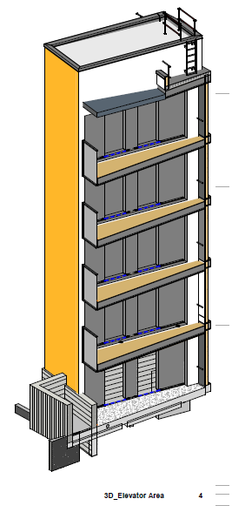
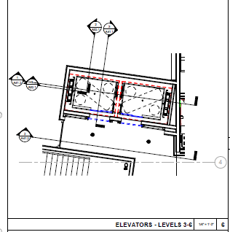
Opens to Exterior
3006.2 Exception #3
Notes:
S: This elevator opens to the exterior of the building. What about this?
C: 3006.2 Exception #3
Elevator lobbies are not required on levels where the elevator opens to the exterior. This elevator would not need protection.

Slide 41
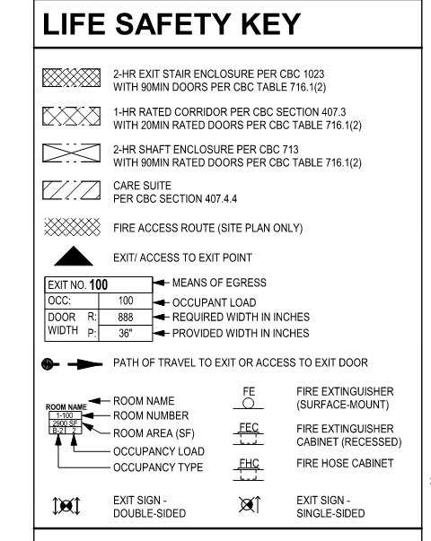
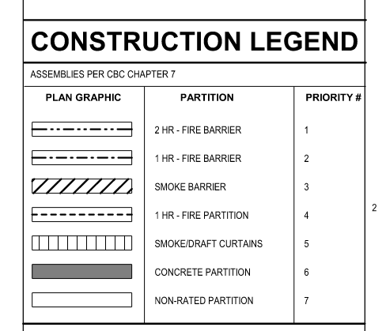
Keys
Notes:
SH: Okay, that’s been a lot on elevators. We are going to move into shaft enclosures. Going back to the clues that your drawings give - you will find legends such as these on those G Sheets we talked about earlier, or may see the Construction Legend on each floor plan showing the hatching indicated on the Floor Plans that indicate the wall construction and where the walls are 1 or 2 hour rated, smoke barrier, or a 1 hour partition.
Shaft enclosures also require rated construction and are shown in the plan.

Slide 42
Keys
Notes:
C: Here are a couple of things to note:
Stairwells are calling out a 2 hour exit with 90 min doors, that follows our previous table from SDI.
The net pattern is a good example showing what a rated wall looks like.
Occupant Load will help determine the direction that the doors need to open. You will also want to look at the path of egress.

Slide 43
Shaft Enclosures
713.4 Shaft enclosures
1023.2 Construction of interior exit stairways
Notes:
S: In this example the legend indicates 2 hour fire barrier walls on 3 sides of the elevator and there is an an exterior wall. Seems to me I need to include an additional door in front of these elevators. Is that correct Candace?
C:
The presence of a fire barrier does not automatically indicate the need for a lobby or additional protection. Keep in mind that elevator cab doors themselves are fire rated and often times, lobbies and additional doors are used for the protection from smoke. We would want to refer to 3006.2 for when protection is needed like we went through earlier.
713.4 covers shaft enclosures, stairwells included, and says that stairways shall have a fire resistance rating of not less than 2 hours where connecting four stories or more and not less than 1 hour when connecting less than four stories. This includes basements. The stairwell has a one hour fire partition rating, so I can conclude from that the building is less than 4 stories just by knowing the code!
S: Wait – Candace I just saw this – there is a fire partition and a fire barrier. Can you help me through the differences there?
C: A fire barrier is a complete barrier usually dividing buildings or sections of a building or even an exit passageway. A fire partition is localized within a building and can be used in a corridor or a lobby.
S: What is needed for the stairwell door which is in a 2 hour barrier?
C: The stairwell is a fire barrier made of fire-rated construction. It is typical that this indicates the stairwell is a safe egress route and therefore we would want a smoke and draft control door tested to UL 1784. This means that it measures how much smoke travels through the opening. 1023.2 for construction of interior exit stairways, they need to be constructed as fire barriers. When it is a path of egress travel, it is likely that it will need smoke and draft control doors.

Slide 44
Shaft Enclosures
713.4 Shaft enclosures
1023.2 Construction of interior exit stairways
Door Schedule
Notes:
SH: In this example. Instead of a legend, we followed the wall type designation to the detail sheet and see that the detail shows that the walls surrounding the stair and trash are 2 hour rated. The door to the stair is 90 minute rated.
C: You will likely need to continue that rating and protect that stairwell with a rated smoke and draft control door system, which is why it is calling out a 90 min door.

Slide 45
Shaft Enclosures
713.4 Shaft enclosures
1023.2 Construction of interior exit stairways
Notes:
C: Here are a couple of Total Doors protecting stairwells. These are in the Longworth Senate building. They have varying degrees of swing and the closers are able to overcome 15lbs of stack pressure, so if the stairwells are pressurized, which most are, the doors will be able to close given that the stairwells are properly pressurized.

Slide 46
Shaft Enclosures
713.4 Shaft enclosures
1023.2 Construction of interior exit stairways
Notes:
C: Here is the Honda building stairwell in California. These are protecting a bank of stairs and held open. What works well here is there is a tendency for egress to turn into a funnel. With three separate doors, this keeps separation and flow is better for egress.

Slide 47
Shaft Enclosures
716.2.2.3 Doors in Interior Exit Stairways and Ramps and Exit Passageways
Notes:
C: 716.2.2.3 fire door assemblies in interior exit stairways and ramps and exit passageways shall have a maximum transmitted temperature rise of not more than 450°F above ambient at the end of 30 minutes of standard fire test exposure.
The exception is that it is not required in buildings equipped with an automatic sprinkler system.
S: What is the significance?
C: If there was a fire and no sprinkler system to control the fire, you would completely burn on the non-fire side of the door without a temperature rise core, that is how hot it can get.
Most buildings are sprinklered, however, so the need for this has diminished.
S: So what do I ask myself when specifying a door for that situation?
C: 1. is the door in an interior exit stairway used for egress? Yes! Ok… then we ask: 2. is the building sprinklered? If yes, dont worry about it, just need smoke protection as mentioned earlier. If no, you may need a different core.
S: Thank you for that clarification. I often get questions from architects about needing a mineral fiber core in the fire rated doors, because it is included like that in many master guide specifications. This helps me see that mineral core doors for a temperature rise situation is not as common as we may be led to think.

Slide 48
Cross Corridor
Notes:
S: This sure looks like a Cross Corridor Door! But It does not appear that there are any rated walls surrounding this - is this suggesting a fire rated situation?
This is the first floor of an outpatient clinic separating the loading dock area from other back of house operations.
C: It sounds like these doors are separating different occupancies in the building.
Since the doors are separating occupancies, they likely need a smoke and draft control doors tested to UL 1784, but not without an artificial bottom seal.

Slide 49
Cross Corridor
Notes:
S: Okay, so this residential project has very long apartment corridors.
C: When the fire alarm goes off the doors automatically swing closed. This will decrease the length of the corridor. The code requires maximum of 75' to the nearest exit in case of fire. This door configuration allows for a longer corridor, but guides the occupant to the closest exit, and blocks the smoke and compartmentalizes the area.
S: Notice too that the hatching in this wall changes, indicating to the contractor that something is “different”. Which on the Code Summary Drawings told me it was an area of separation.

Slide 50
Cross Corridor
Notes:
C: Here are a couple of Total Door cross corridor doors in buildings. They are compartmentalizing different areas of the building. They are designed to be held open and out of the way. One is showing off our standard panic while the other is showing our flush panic device.

Slide 51
Area of Refuge
1009.6.2 - every area of refuge must have direct access to a stairway or elevator
1009.6.4 - areas of refuge must be designed to limit smoke
716.2.1.4 Smoke and Draft Control - UL 1784
Notes:
SH: Areas of Refuge are hard for me to spot. If it weren’t for this note on the drawings I would certainly have overlooked it for this project.
C: All new construction buildings must have an area of refuge on each floor unless both are true:
the building has a sprinkler system
there is a wheelchair friendly escape route out and away from the building
This needs to be a smoke and draft control door.
Stairwells and lobbies can actually be designed as an area of refuge.
1009.6.2 requires that areas of refuge have direct access to a stairway or elevator.
S: A note regarding this would often be found in the building code summary.

Slide 52
Area of Refuge
1009.3.3 Area of Refuge
Exception 2
Notes:
SH: Such as this note I found in the Egress Notes and in another project, this diagram on the Building Summary Drawings in the G Sheets.
C: This is a great note to find: an area of refuge is not needed in stairwells if the building is equipped throughout with an automatic sprinkler system. This building does not need it.

Slide 53
Fire Service Access Elevator Lobby
3007.6.1
3007.6.3
Notes:
S: We talked about elevator lobbies but you also mentioned Fire Service Access Elevator Lobbies. When are those required?
C: Buildings 120’ or taller require this.
S: What are the requirements for the fire service access elevator lobby?
C: This is all on 3007: The enclosed fire service access elevator shall have direct access from the enclosed elevator lobby to an enclosure for an interior exit stairway or ramp - usually we see them directly connected to a stairwell. The fire door assembly protecting the lobby shall comply with UL 1784 without an artificial bottom seal. This plan shows that well with direct connection to the stairwell and the lobby and stairwell doors being being properly tested.

Slide 54
Fire Service Access Elevator Lobby
3007.6.1
3007.6.3
Notes:
C: This is another good example of a fire service access elevator lobby. You have your regular lobby and then your fire service access elevator lobby. The access lobby has direct connection to the stairwell and the doors are all tested to UL 1784 without an artificial bottom seal.

Slide 55
Occupant Evacuation Elevator Lobby
3008.6.1
3008.6.3
3009.6.3.1
Notes:
S: When is an occupant evacuation elevator lobby required? And what are its requirements?
C: When is a building is over 420’ an occupant evacuation elevator lobby is required.
C: The requirements are in 3008 and very similar to the fireman access lobby. You must have have direct access from the enclosed elevator lobby to an enclosure for an interior exit stairway or ramp. The doors must all be tested to UL 1784 without an artificial bottom seal. All the same thing. The difference is that each door protecting the lobby must have alite kit.
The elevator traction section and life safety plan is where we found information on this elevator lobby.

Slide 56
Notes:
C: Here is a flow chart we have created to determine when you may need an elevator lobby. If you prefer, we have also put this into a checklist!

Slide 57
Notes:
S: The q&a Candace and I have been going through are typical to figuring out what is needed to correctly select and specify fire controls for vertical applications.
C: Hopefully this checklist and the flow chart will help offer different options for your learning style for determining if you need protection. It is not a coverall, but it can be good as a basic guide. Of course, always check with your local authority and feel free to drop me an email or call me any time.

Slide 58
Code Resources
Notes:
S: Candace knows these codes but as architects, specifiers, and contractors, we often need to be reminded just what it is the codes are saying. I do not purchase a copy of the code every new code cycle since codes became available on the internet. There are a few code resources I use. This one is called upcodes. It gives you free access to all of the building codes current and past so you can look up code references.

Slide 59
Code Resources
Notes:
S: Here I took a screenshot of Section 3006.1 of the Los Angeles county Building Code. Without a subscription this is about as much information I can get. I have access to read the entire code, but I cannot copy and paste it for instance, but this helps me follow along and dig a little deeper into the requirements and its related design ramifications.

Slide 60
Code Resources
Notes:
S: And here is a screen shot of the international code council digital codes tool, which gives you a very similar menu and options. It lists the States on the left and you can access the code you are looking for, whether you need the building code, the energy code, mechanical, whatever you are looking for.
ICC Digital Codes - Home (iccsafe.org)

Slide 61
Code Resources
Notes:
And again you see a similar layout to view the Section 3006 Elevator Lobbies and Hoistway Opening Protection.

Slide 62
Details & Submittals
Notes:
S: I have also found a host of information on the manufacturer Total Door website to design, detail, and specify doors for projects. Candace What should I expect to see in the submittal package from the contractor?
C: Great question!
You will want to review the specifications to see what is required for the opening. For Integrated Door Systems, you will see that you need to include: shop drawings which you will receive with your quote. It will indicate the basics on them. Do you have kick plates, lite kits, unequal pairs, mechanism height, leaf size, and more. Then look at recommended frame profiles and detail drawings are on our website and will guide a smooth pocket build, backing placement, electrical placement, and installation.

Slide 63
Submittals
Notes:
S: What decisions should I make prior to bidding?
C: You will want to send in samples on the finish that has been picked out by the architect. The earlier the better! There is no punishment for sending samples in early.
S: What environmental information is available for my LEED or other sustainable rating system project?
C: You will want to include the UL EPD, UL HPD, red list items and LEED, if necessary.
S: Are there performance standards should I be sure to include in my spec?
C: BHMA A156.32 - this is the standard for Integrated Door Systems. In order to be considered a true integrated door system, the manufacturer MUST test to this standard. This takes months to pass and you test the entire system to 1 million cycles under a single testing label.
Certificate of Compliance - this is by a third party testing agency and covers every components in your door system. It lists all the standards and testing that we are certified to.

Slide 64
Submittals - Finishes
Notes:
S: Let’s review quickly the finish options. What types of finishes are available?
C: Virtually any finish is available. From paint, veneer, metal, architectural film, wall coverings. You name it, it is likely possible. If you can think of something I did not name, just ask! You never know!
S: What finishes can be field applied?
C: The only finish that may be field applied on a rated door… and this applies to ANY RATE DOOR… is paint. Otherwise, according to our certificate of compliance, we must apply the specialty finishes at the factory of fabrication.
S: What samples might be request for submittals?
C: In the specifications, for submittals, we call for samples and reference section 01. In all reality, what we need is for the architect to select a finish and then to send us a sample about 6” x 6” directly to the factory. We perform testing on it to make sure it meets our standards. Adhesion, routing, bending, or whatever is needed. Having a sample will ensure that we get our hands on it and there are no issues down the road.
S: Excellent. Thank you!

Slide 65
Candace Kitchen
candace@totaldoor.com
248-623-6899 ext. 116
Sherry Harbaugh, FCSI, CCS, RA, SCIP
sherry@trc-consultants.com
THANK YOU!
Notes:
C: Thank you greatly for your time today! We hope you enjoyed the presentation and found it helpful.
What questions do you have?

